Slide 1
The Proposal as a Plan for Action
INLS 781, Fall 2014

Slide 2
The 4 P’s view of a proposal
Phase: it’s one of the several phases of a research project
Process: in this course, we’ll go through the process of developing the proposal
Product: at the end of the course, you will have a completed proposal
Plan: the proposal will be your plan for the work you’ll do in INLS 992

Slide 3
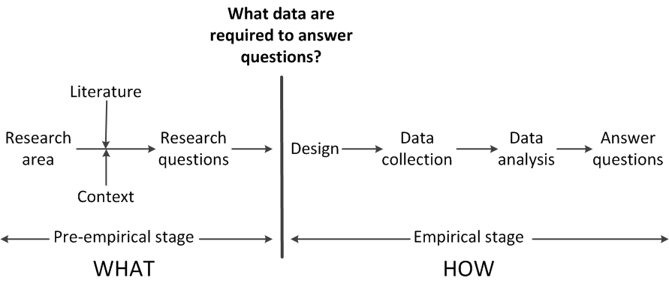
Simplified model of research
Adapted from Punch, 2006, Fig. 2.1

Slide 4
“Keyhole” or “Hourglass” Structure

