Slide 1
INLS 623– Three Tiered Architectures
Instructor: Jason Carter

Slide 2
Review: Internet
Server
Client
HTTP
Request
Response
GET
POST
Redirect
HTML
JavaScript
Java
PHP
SQL
ASP.NET
CSS
AJAX
Python
Cookies

Slide 3
Review: Sample PHP
<h1>Hello from Dr. Chuck's HTML Page</h1>
<p>
<?php
echo "Hi there.\n";
$answer = 6 * 7;
echo "The answer is $answer, what ";
echo "was the question again?\n";
?>
</p>
<p>Yes another paragraph.</p>

Slide 4
Review: Interpreted Languages
Interpreter reads code and performs operations one line at a time.
PHP
Interpeter
Machine Language

Slide 5
Review: Connecting to MySQL
<?php
$servername = "localhost";
$username = "root";
$password = "root";
$dbname = "classicmodels";
// Create connection
$conn = new mysqli($servername, $username, $password, $dbname);
// Check connection
if ($conn->connect_error) {
die("Connection failed: " .
$conn->connect_error);
}
?>

Slide 6
Review: Selecting from a table
<?php
$servername = "localhost";
$username = "root";
$password = "root";
$dbname = ”classicmodels";
// Create connection
$conn = new mysqli($servername, $username, $password, $dbname);
// Check connection
if ($conn->connect_error) {
die("Connection failed: " .
$conn->connect_error);
$sql = "select * from customers";
$result = $conn->query($sql);
}
?>

Slide 7
<?php
$servername = "localhost";
$username = "root";
$password = "root";
$dbname = ”classicmodels";
// Create connection
$conn = new mysqli($servername, $username,$password, $dbname);
// Check connection
if ($conn->connect_error) {
die("Connection failed: " .
$conn->connect_error);
$sql = "select * from customers";
$result = $conn->query($sql);
//if the number of rows are greater than 0
if ($result->num_rows > 0) {
//while there are rows
while($row = $result->fetch_assoc()) {
echo $row['customerNumber']." ".$row['customerName']." ".$row['contactFirstName']." ".$row['contactLastName'];
echo "<br />";
echo "<br />”;
}
}
}
//close the connection
mysqli_close($conn);
?>

Slide 8
List Tables
<?php
$servername = "localhost";
$username = "root";
$password = "root";
$dbname = "classicmodels";
// Create connection
$conn = new mysqli($servername, $username, $password, $dbname);
// Check connection
if ($conn->connect_error) {
die("Connection failed: " .
$conn->connect_error);
}
?>

Slide 9
Selecting Data
<?php
$servername = "localhost";
$username = "root";
$password = "root";
$dbname = ”classicmodels";
// Create connection
$conn = new mysqli($servername, $username, $password, $dbname);
// Check connection
if ($conn->connect_error) {
die("Connection failed: " .
$conn->connect_error);
$sql = ”show tables from $dbname";
$result = $conn->query($sql);
}
?>

Slide 10
<?php
$servername = "localhost";
$username = "root";
$password = "root";
$dbname = ”classicmodels";
// Create connection
$conn = new mysqli($servername, $username,$password, $dbname);
// Check connection
if ($conn->connect_error) {
die("Connection failed: " .
$conn->connect_error);
$sql = "select * from customers";
$result = $conn->query($sql);
//if the number of rows are greater than 0
if ($result->num_rows > 0) {
//while there are rows
while($row = $result->fetch_row()) {
echo $row[0];
echo "<br />”;
}
}
}
//close the connection
mysqli_close($conn);
?>

Slide 11
Inserting Data
<?php
//variables that will be inserted into the database
$number = mt_rand(9000,1000000);
$customerNumber = $number;
$customerName = "The Little Shop that Could";
$contactFirstName = "Alex";
$contactLastName = "Becky";
$phone = "555555555";
$addressLine1 = "City that never sleeps";
$addressLine2 = "";
$city = "Chapel Hill";
$state = "NC";
$postalCode = "27514";
$country = "US";
$salesRepEmployeeNumber = 1056;
$creditLimit = 2000.00;
?>

Slide 12
<?php
$sql = "insert into customers values ('$customerNumber','$customerName', '$contactFirstName',
'$contactLastName', '$phone', '$addressLine1', '$addressLine2', '$city', '$state', '$postalCode', '$country',
'$salesRepEmployeeNumber', '$creditLimit')";
//execute the query
result = $conn->query($sql);
?>

Slide 13
<?php
if($result)
{
echo "New record created successfully";
}
else
{
echo "Error: " . $sql . "<br>" . mysqli_error($conn);
}
mysqli_close($conn);
?>

Slide 14
Inserting Dynamic Data
Use HTML forms to collect data
<form>
</form>
Form tags contain html elements
There are many html elements
Input
Text
Radio
submit

Slide 15
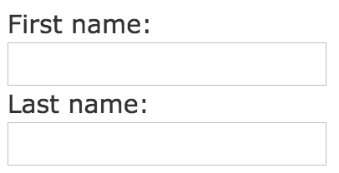
Input Text Tags
<form>
First name:<br>
<input type="text" name="firstname">
<br>
Last name:<br>
<input type="text" name="lastname">
</form>

Slide 16
Input Submit Tag
<form action="action_page.php">
First name:<br>
<input type="text" name="firstname" value="Mickey">
<br>
Last name:<br>
<input type="text" name="lastname" value="Mouse">
<br><br>
<input type="submit" value="Submit">
</form>

Slide 17
Submit
Sends the values of the input tag (not the submit button) to the server
The action tag determines which file processes the values from the input tag
<form action="action_page.php">
How?

Slide 18
Pass values to Server/PHP
GET (default)
form submission is passive (like a search engine query), and without sensitive information
GET is best suited to short amounts of data. Size limitations are set in your browser
action_page.php?firstname=Mickey&lastname=Mouse
<form action="action_page.php” method=“GET”>

Slide 19
Pass Values to Server/PHP
POST
form is updating data, or includes sensitive information (password)
POST offers better security because the submitted data is not visible in the page address
<form action="action_page.php" method="POST">

Slide 20
How does PHP Get The Values?
Superglobals
Built in variables that are available at all scopes
$GLOBALS
$_SERVER
$_REQUEST
$_POST
$_GET
$_FILES
$_ENV
$_COOKIE
$_SESSION

Slide 21
PHP $_POST
Collects form data after submitting the HTML from using post
<form action="action_page.php”
method = “POST”>
First name:<br>
<input type="text" name="firstname" value="Mickey">
<br>
Last name:<br>
<input type="text" name="lastname" value="Mouse">
<br><br>
<input type="submit"
value="Submit">
</form>
echo $_POST[‘firstname’];
echo $_POST[‘’lastname’];

Slide 22
PHP $_GET
Collects form data after submitting the HTML from using post
<form action="action_page.php”
method = “GET”>
First name:<br>
<input type="text" name="firstname" value="Mickey">
<br>
Last name:<br>
<input type="text" name="lastname" value="Mouse">
<br><br>
<input type="submit"
value="Submit">
</form>
echo $GET[‘firstname’];
echo $GET[‘’lastname’];

Slide 23
Display Orders
Look at file displayOrders.php

Slide 24
Practice
Create an html form that allows a user to search for a customer by state

Slide 25
Practice
Create an html form that allows a user to enter information into the employee table

Slide 26
Practice
Create an html form that allows a user to enter a quantity in stock and see all products that are below that quantity
Create an html form that allows a user to enter a quantity in stock and see all products that are above that quantity

Slide 27
Three Tiered Architectures
Presentation tier
Client Program (Web Browser)
Application Server
Middle tier
Database System
Data management tier

Slide 28
The Three Layers
Presentation tier
Primary interface to the user
Needs to adapt different displays (PC, cell, tablet, etc)
Middle tier
Implements business logic (implements complex actions, maintains state between different steps of workflow)
Access different data management systems
Data management tier
One or more standard database management system

Slide 29
Technologies
HTML
Javascript
Client Program (Web Browser)
Application Server
(Apache)
PHP
Cookies
Database System
(MySQL)
XML
Stored Procedures
Functions

Slide 30
Advantages of the Three-tier Architecture
Heterogeneous
Tiers can be independently maintained, modified, and replaced
Scalability
Data Management Tier can be scaled by database clustering without involving other tiers
Middle Tier can be scaled by using load balancing
Fault Tolerance
Data Management Tier can be replicated without involving other tiers
Software development
Code is centralized
Interaction between tiers through well-defined APIs: Can reuse standard components at each tier

Slide 31
Disadvantages of 3-Tier Architecture
It is more complex
It is more difficult to build a 3-tier application
The physical separation of the tiers may affect the performance of all three
If hardware and network bandwidth are not good enough because more networks, computers, and processes are involved

Slide 32
Example
editTable.php
The presentation tier (html) and middle tier (php) are together

Slide 33
Example
while($row = $result->fetch_assoc()) {
echo "<tr>";
echo "<td>";
echo $row['customerNumber'];
//echo $row['orderdetails.orderNumber'];
echo "</td>";
echo "<td>";
echo $row['checkNumber'];
echo "</td>";
echo "<td>";
echo $row['paymentDate'];
echo "</td>";
echo "<td>";
echo "$".$row['amount'];
echo "</td>";

Slide 34
HTML Templates
Provides place holders in html that are filled with values from PHP
Done using some kind if template engine

Slide 35
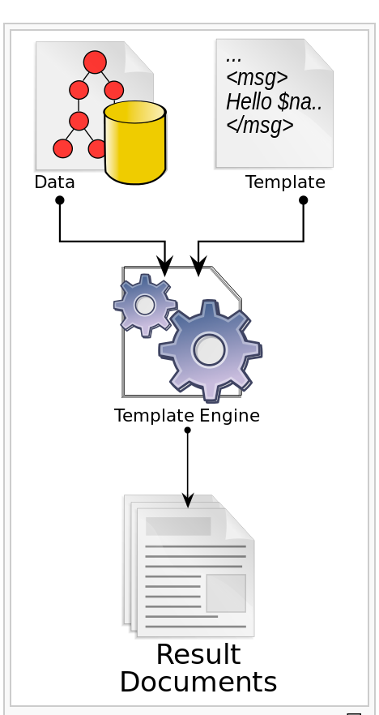
HTML Templates

Slide 36
PHP Templates
HTML
MySQL
PHP
HTML

Slide 37
XML And XLST
HTML
MySQL
PHP
XML
XLST
HTML

Slide 38
XML and XLST
XML = eXtensible Markup Language
XML is much like HTML
Designed to describe data, not to display it
XML tags are not predefined. Must define your own tags.

Slide 39
Difference Between XML and HTML
XML is not a replacement for HTML.
XML and HTML were designed with different goals:
XML was designed to describe data, with focus on what data is
HTML was designed to display data, with focus on how data looks
HTML is about displaying information, while XML is about carrying information
Notes:
XML is not a replacement for HTML.
XML and HTML were designed with different goals:
XML was designed to describe data, with focus on what data is
HTML was designed to display data, with focus on how data looks
HTML is about displaying information, while XML is about carrying information

Slide 40
XML Elements
An XML document contains XML Elements
XML Element
everything from (including) the element's start tag to (including) the element's end tag
<allPayments>
<payment>
<customerNumber>103</customerNumber>
<checkNumber>155</checkNumber>
<paymentDate>10-23-2014</paymentDate>
<amount>$55.53</amount>
<payment>
</allPayments>

Slide 41
XML Naming Rules
XML elements must follow these naming rules:
Names can contain letters, numbers, and other characters
Names cannot start with a number or punctuation character
Names cannot start with the letters xml (or XML, or Xml, etc)
Names cannot contain spaces
Any name can be used, no words are reserved.
Please be descriptive.

Slide 42
XML Syntax
All XML elements must have a closing tag
<message>hi how are you</message> (correct)
<message>hi how are you (incorrect)
XML Tags are case sensitive
Opening and closing tags must be written in the same case
<message>hi how are you</message> (correct)
<Message>hi how are you</message> (incorrect)
XML tags must have a root
<root>
<child>
<subchild>.....</subchild>
</child>
</root>

Slide 43
Practice
Create XML for the productLines table
<allProductLines>
<productLines>
<productLine></productLine>
<textDescription></textDescription>
<htmlDescription></htmlDescription>
<image></image>
</productLines>
</allProductLines>

Slide 44
XLST
XSLT = EXtensible Stylesheet Language Transformations
Transforms xml document into html

Slide 45
Transforming XML Using XLST
Start with an XML Document
<?xml version="1.0" encoding="UTF-8"?>
<catalog>
<cd>
<title>Empire Burlesque</title>
<artist>Bob Dylan</artist>
<country>USA</country>
<company>Columbia</company>
<price>10.90</price>
<year>1985</year>
</cd>
</catalog>

Slide 46
Transforming XML Using XLST
Create an xlst stylesheet

Slide 47
<?xml version="1.0" encoding="UTF-8"?>
<xsl:stylesheet version="1.0"
xmlns:xsl="http://www.w3.org/1999/XSL/Transform">
<xsl:template match="/">
<html>
<body>
<h2>My CD Collection</h2>
<table border="1">
<tr bgcolor="#9acd32">
<th>Title</th>
<th>Artist</th>
</tr>
<xsl:for-each select="catalog/cd">
<tr>
<td><xsl:value-of select="title"/></td>
<td><xsl:value-of select="artist"/></td>
</tr>
</xsl:for-each>
</table>
</body>
</html>
</xsl:template>
</xsl:stylesheet>

Slide 48
Transforming XML Using XLST
Link the XSL Style Sheet to the XML Document
<?xml version="1.0" encoding="UTF-8"?>
<?xml-stylesheet type="text/xsl" href="cdcatalog.xsl"?>
<catalog>
<cd>
<title>Empire Burlesque</title>
<artist>Bob Dylan</artist>
<country>USA</country>
<company>Columbia</company>
<price>10.90</price>
<year>1985</year>
</cd>
</catalog>

Slide 49
How does This work in PHP
editTable.xml.php

Slide 50
Smarty Templates
A template engine for PHP, facilitating the separation of presentation (HTML/CSS) from application logic.

Slide 51
PHP Frameworks
Streamline the the development of web applications written in PHP by providing a basic structure for which to build the web applications
Saves time
Helps build more stable applications
Reduces amount of repetitive coding
Force you to follow a pattern

Slide 52
PHP Frameworks
The Zend Framework
CakePHP
Symfony
CodeIgniter

Slide 53
Homework
Explain the advantages and disadvantages of a three tiered architecture.
Use XML and XLST to design a three tiered architecture for the classicmodels database.
Create an html form that allows a user to search for customers by state. The user should be able to enter a state in a textbox and a list of customers in a table are shown.
Create an html form that allows a user to enter a quantity in stock and see all products that are below that quantity. The user should enter the quantity in a textbox and a list of products in a table are shown.
Create an html form that allows a user to enter a quantity in stock and see all products that are above that quantity.
The user should enter the quantity in a textbox and a list of products in a table are shown.

Slide 54
Homework
Research Question
Compare and contrast two PHP frameworks. You can use the ones mentioned in the lecture or search for others.

