Slide 1
INLS 623– Sql
Instructor: Jason Carter
Notes:
Functions

Slide 2
SQL SELECT DISTINCT
SELECT DISTINCT column_name,column_name FROM table_name;

Slide 3
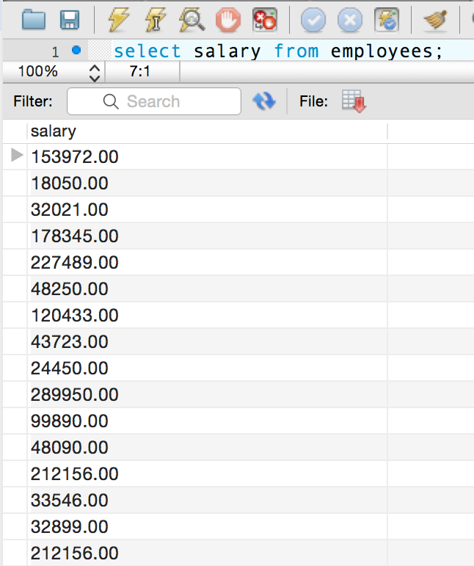
A column may contain many duplicate values; and sometimes you only want to list the distinct values
Duplicate rows

Slide 4
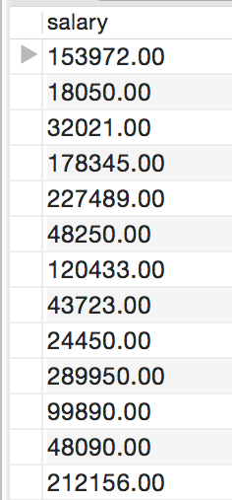
Removing Duplicate Salaries
select distinct salary from employees

Slide 5
Sorting Results
SELECT column_name,column_name FROM table_name ORDER BY column_name,column_name ASC;
SELECT column_name,column_name FROM table_name ORDER BY column_name,column_name DESC;
ASC means ascending order
1,2,3,4,5,6
DESC means descending order
6,5,4,3,2,1
ASC is default

Slide 6
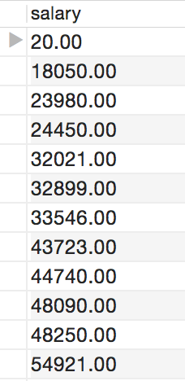
Sorting Results in Ascending Order
select distinct salary from employees order by salary

Slide 7
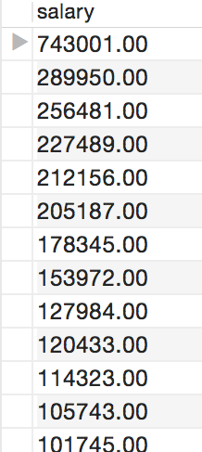
Sorting Results in Descending Order
select distinct salary from employees order by salary

Slide 8
Return a Certain number of Results
SELECT column_name,column_name FROM table_name ORDER BY column_name,column_name LIMIT value;
Value is an actual number
SELECT column_name,column_name FROM table_name ORDER BY column_name,column_name LIMIT 10;

Slide 9
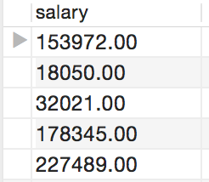
Limit Example
select distinct salary from employees limit 5

Slide 10
Filtering Records
Use the where clause
SELECT column_name,column_name FROM table_name WHERE column_name operator value;
operator

Slide 11
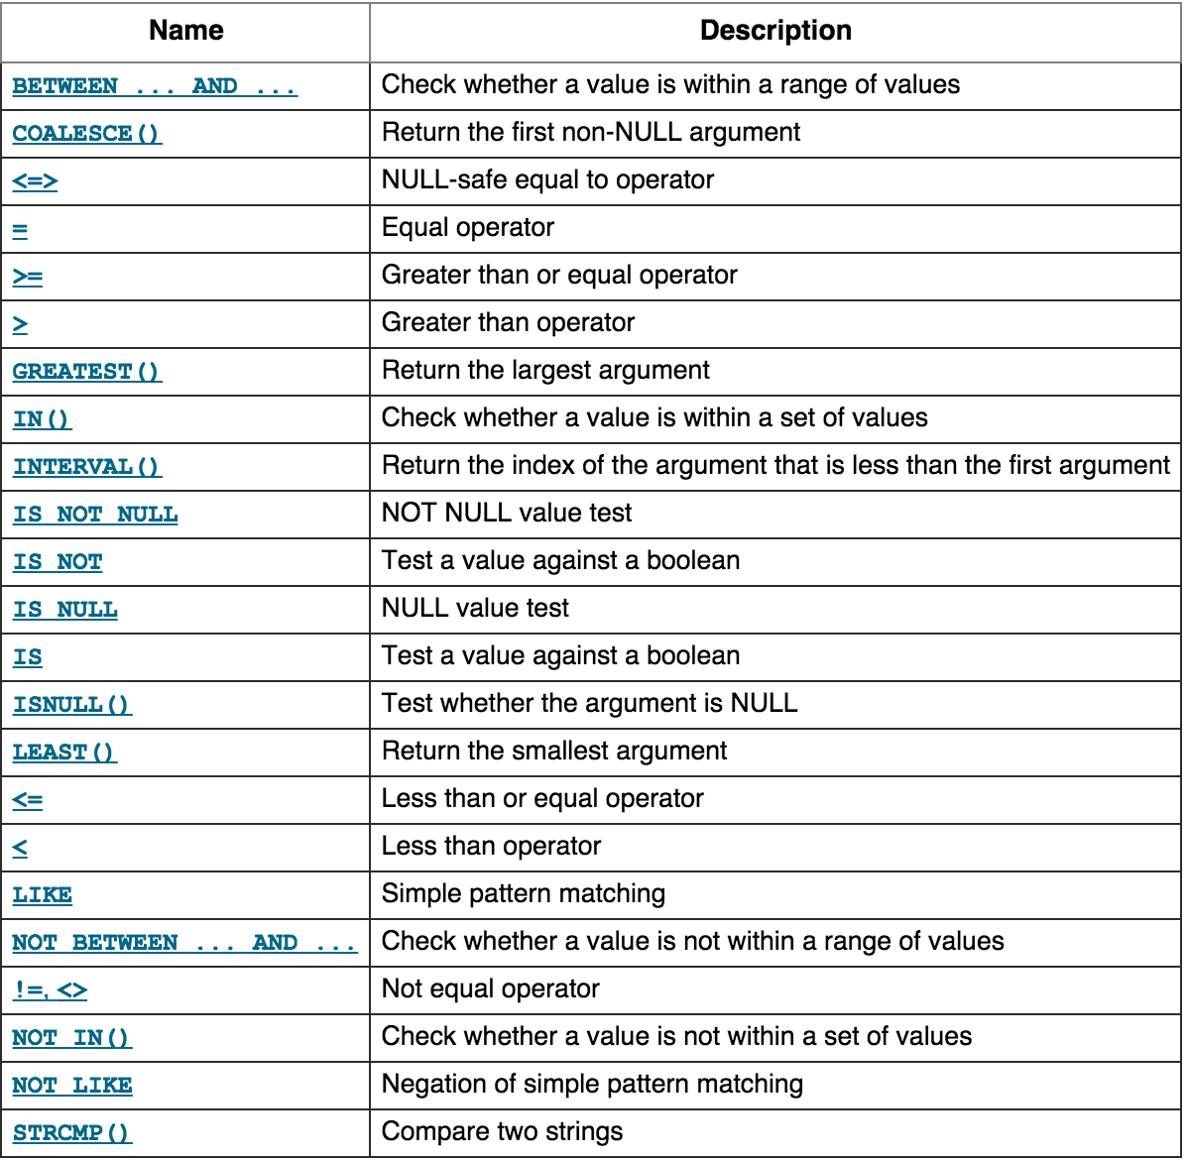
Operators

Slide 12
Where Clause Example
select distinct salary from employees where salary = 18050.00

Slide 13
Where Operators
>
<
>=
<=
<> or !=
These operators are straightforward

Slide 14
LIKE Operator
The LIKE operator is used in a WHERE clause to search for a specified pattern in a column
SELECT column_name(s) FROM table_name WHERE column_name LIKE pattern;
How do we specify a pattern?

Slide 15
Wildcards

Slide 16
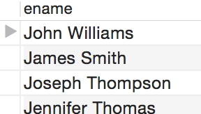
Like and Wildcards Example
% wildcard
select ename from
employees where ename LIKE 'J%'

Slide 17
Like and Wildcards Example
select ename from employees where ename LIKE 'John William_'

Slide 18
In Operator
The IN operator allows you to specify multiple values in a WHERE clause
It is like an or
SELECT column_name(s) FROM table_name WHERE column_name IN (value1,value2,...);

Slide 19
In Operator Example
SELECT * FROM flights WHERE origin IN ('Los Angeles','Madison');

Slide 20
Between Operator
The BETWEEN operator is used to select values within a range.
SELECT column_name(s) FROM table_name WHERE column_name BETWEEN value1 AND value2;
The values can be numbers, text, or dates.

Slide 21
Between Example
SELECT * FROM flights WHERE distance between 100 and 500 order by distance

Slide 22
Not Between
The BETWEEN operator is used to select values outside of a range.
SELECT column_name(s) FROM table_name WHERE column_name NOT BETWEEN value1 AND value2;

Slide 23
Not Between Example
SELECT * FROM flights WHERE distance not between 100 and 500 order by distance

Slide 24
Temporarily Rename Table or Column
SQL aliases are used to give a database table, or a column in a table, a temporary name.
Columns
SELECT column_name AS alias_name FROM table_name;
Tables
SELECT column_name(s) FROM table_name AS alias_name;

Slide 25
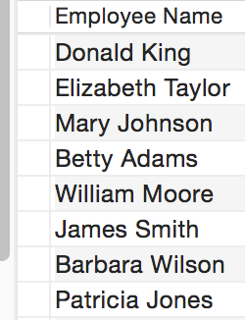
Alias Example
Select ename as "Employee Name" from employees

Slide 26
Joins
Used to combine rows from two or more tables, based on a common field between them.
The most common type of join is the inner join
You can type inner join or join

Slide 27
Inner Join
Returns all rows when there is at least one match in BOTH tables
Two tables
Faculty and class
Want to know the class name and who is teaching the course (faculty name)
How would you write this without using joins?
select faculty.fname, class.class_name from faculty, class where faculty.fid = class.fid
Notes:
select faculty.fname, class.class_name from faculty, class where faculty.fid = class.fid

Slide 28
Inner Join
Faculty
Class
A set of records which match in both the faculty and class table, i.e. all faculty who teach a course.

Slide 29
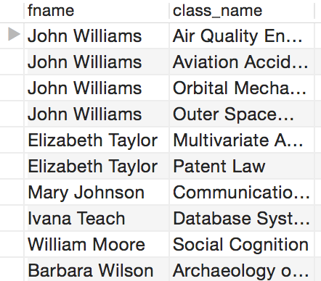
INNER JOIN EXAMPLE
select faculty.fname, class.class_name from faculty inner join class on faculty.fid = class.fid;

Slide 30
Left Join
The LEFT JOIN keyword returns all rows from the left table (table1), with the matching rows in the right table (table2). The result is NULL in the right side when there is no match.
Faculty
Class
A set of records which match all of the rows in the faculty table with matching rows in the class table, i.e. all faculty and their courses regardless of whether they teach a course

Slide 31
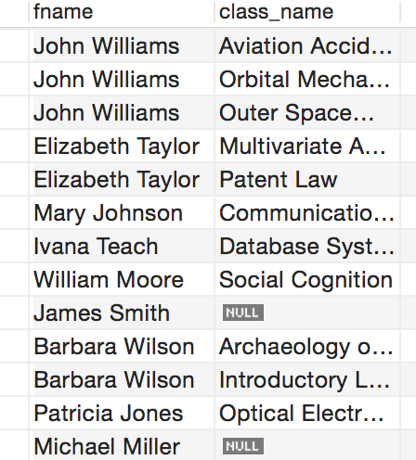
Left Join Example
select faculty.fname, class.class_name from faculty left join class on faculty.fid = class.fid;
Faculty who don’t teach a course

Slide 32
Right Join
The RIGHT JOIN keyword returns all rows from the right table (table2), with the matching rows in the left table (table1). The result is NULL in the left side when there is no match.
Faculty
Class
A set of records which match all of the rows in the class table with matching rows in the faculty table, i.e. all classes and faculty regardless of whether there is a faculty member teaching the course

Slide 33
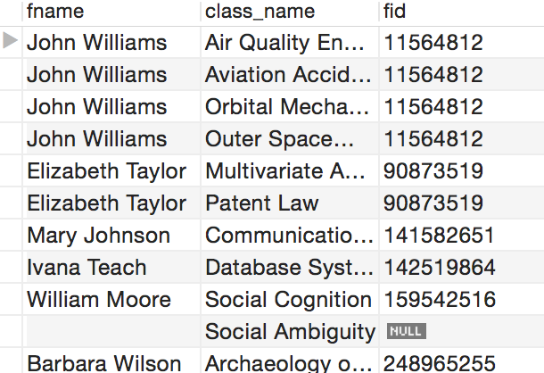
Right Join Example
select faculty.fname, class.class_name, faculty.fid from faculty right join class on faculty.fid = class.fid;
Class with no faculty

Slide 34
SQL Aggregate Functions
SQL aggregate functions return a single value, calculated from values in a column
avg()
count()
max()
min()
sum()

Slide 35
AVG or Average
The AVG() function returns the average value of a numeric column
SELECT AVG(column_name) FROM table_name

Slide 36
AVG Example
Get the average cruising range of aircraft
select avg(cruisingrange) as "Average Cruising Range" from aircraft

Slide 37
Count
The COUNT() function returns the number of rows that matches a specified criteria
Column name
SELECT COUNT(column_name) FROM table_name;
Count the number of records in the table
SELECT COUNT(*) FROM table_name;
Count number of distinct columns
SELECT COUNT(DISTINCT column_name) FROM table_name;

Slide 38
Max
The MAX() function returns the largest value of the selected column.
SELECT MAX(column_name) FROM table_name;

Slide 39
Max Example
select max(salary) as "highest salary" from employees;

Slide 40
Min
The MIN() function returns the smallest value of the selected column
SELECT MIN(column_name) FROM table_name;

Slide 41
Min Example
select min(salary) as "lowest salary" from employees;

Slide 42
Group By
Used in conjunction with the aggregate functions to group the result-set by one or more columns.
Used to group rows into subgroups by the one or more values of columns.
SELECT column_name, aggregate_function(column_name) FROM table_name WHERE column_name operator value GROUP BY column_name;

Slide 43
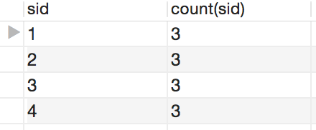
Group By Example
How many items each supplier sells?
select sid, count(sid) from catalog group by sid
What if we want to know the supplier’s name?

Slide 44
Group By Example
How many items each supplier (the name of the supplier) sells?
We need the suppliers and catalog table
select suppliers.sname, count(catalog.sid) as "number of items" from catalog join suppliers on catalog.sid = suppliers.sid group by catalog.sid
Notes:
select suppliers.sname, count(catalog.sid) as "number of items" from catalog
join suppliers
on catalog.sid = suppliers.sid group by catalog.sid

Slide 45
Having
Used to to specify a filter condition for groups of rows or aggregates.
Often used with GROUP BY
SELECT column_name, aggregate_function(column_name) FROM table_name WHERE column_name operator value GROUP BY column_name HAVING aggregate_function(column_name) operator value;

Slide 46
Having Example
The suppliers (name) that sell 3 or more items.
select suppliers.sname, count(catalog.sid) as "number of items" from catalog join suppliers
on catalog.sid = suppliers.sid group by catalog.sid
having count(catalog.sid) >= 3

Slide 47
SubQuery
A query that is nested inside another query
SELECT * FROM table_name WHERE column_name = (SELECT column_name FROM table_name)

Slide 48
SubQuery Example
select max(salary) as "highest salary" from employees;
We also want to know the employee’s name with the highest salary.
select ename, max(salary) as "highest salary" from employees where salary = (select max(salary) from employees);

Slide 49
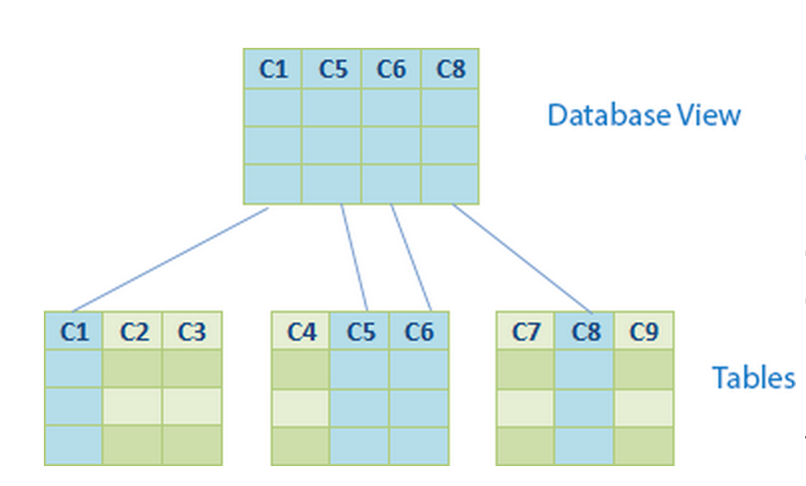
Views
A database view is a virtual table or logical table

Slide 50
Views
You can query against a view
When the data of the tables changes, the view reflects that changes as well
A database view allows you to simplify complex queries
A database view helps limit data access to specific users
A database view provides extra security layer. (read only)

Slide 51
Views
CREATE
VIEW [view_name]
AS
[SELECT statement]
The view name cannot be the same name as tables

Slide 52
View Examples
CREATE VIEW customerProductSales AS SELECT orderDetails .orderNumber, customerName, SUM(quantityOrdered * priceEach) as total
FROM orderDetails INNER JOIN orders ON orders.orderNumber = orderdetails.orderNumber
INNER JOIN customers ON orders.customerNumber = customers.customerNumber
GROUP BY orderDetails .orderNumber
AS

Slide 53
Install the new Database
Customers: stores customer’s data.
Products: stores a list of scale model cars.
ProductLines: stores a list of product line categories.
Orders: stores sales orders placed by customers.
OrderDetails: stores sales order line items for each sales order.
Payments: stores payments made by customers based on their accounts.
Employees: stores all employee information as well as the organization structure such as who reports to whom.
Offices: stores sales office data.

Slide 54
Practice
Get the last name of all employees

Slide 55
Practice
Get the last name of all employees (NO DUPLICATES)

Slide 56
Practice
Get the last name of all employees sorted in alphabetical order (no duplicates).
Get the last name of all employees sorted in reverse alphabetical order (no duplicates).

Slide 57
Practice
Select the first 10 customers.

Slide 58
Practice
Find all offices in the US and France.

Slide 59
Practice
Find all offices that are not in the US and France.

Slide 60
Practice
Find product whose buy price within the range of $90 and $100.

Slide 61
Practice
Find the product whose buy price is out of the range of $20 and $100

Slide 62
Practice
Find employees where their first name starts with character ‘a’.
Find employees where their last name ends with ‘on’.
Find employee whose first name starts with T, ends with m and contains any single character between.

Slide 63
Practice
Show all line items for each order
Show all line items for each order only show each orderNumber once

Slide 64
Practice
Find all orders that belong to each customer (even if that customer does not have an order)
Notes:
f you want to know how many orders in each status,

Slide 65
Practice
Want to know the number of orders for each status.
Notes:
ind which order has total sales greater than $1000

Slide 66
Practice
Find which order has total sales greater than $1000.
Clue…there is a SUM() function that adds up the numeric value of each column
Find all orders that has shipped and has total sales greater than $1500

