Slide 1
MON april 6
INLS 151

Slide 2
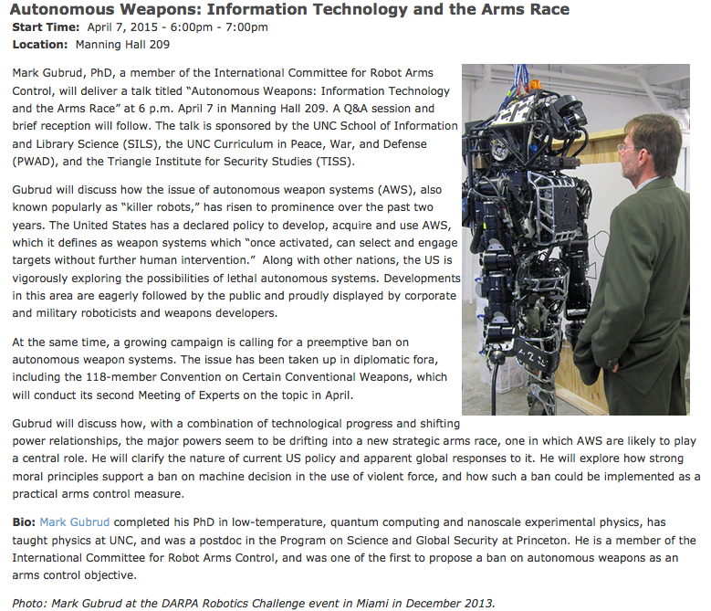

Slide 3
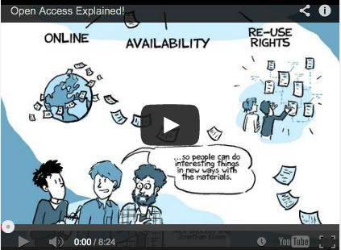
http://www.sparc.arl.org/resources/resource-type/webcasts-videos-podcasts
Jonathan Eisen & Nick Shockey
PLOS Public Library of Science http://www.plos.org/

Slide 4
INFORMATION IS NOT “FREE” – IT IS A COMMODITY!
INFORMATION WANTS TO BE FREE!

Slide 5
[Why haven’t…] Universities not embraced the idea of Open Access science. They pay millions of dollars a year for subscriptions, even for articles that were done at their own universities, thus it would make sense to me that they would support this system. The only thing I can think is that there must be some other factors at play here…
-Emily
The biggest concern I saw out of this article was that colleges and universities, the biggest group that purchase these subscriptions for their students, aren't dong anything to try to fix this problem. What do you think that universities can do to alleviate the problem?
-Terry
How long will it take for information to be accessible to everyone? What type of advancements are needed for open access to be considered as a viable option?
-Javairia

Slide 6
I find it surprising that in a time when we complain about others making decisions for us that we are content with having a review board decide what research we should read and care about…
I agree with the author vision of having an open platform whereby anybody can submit his or her research for others to view, as this would allow individuals to assess an article’s importance based on their own benchmarks.
-Alex

Slide 7
Researchers
Publishers
Libraries
Government Funders
Joe/Jane Public Citizen
Journals / Conferences
Vested-interest Corporations
Universities

Slide 8
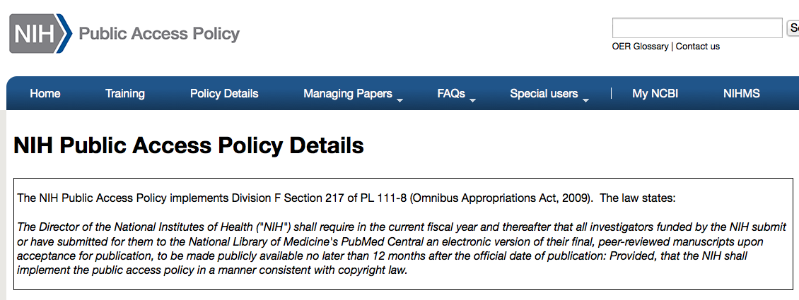
http://publicaccess.nih.gov/policy.htm
The National Institutes of Health (NIH), a part of the U.S. Department of Health and Human Services , is the nation’s medical research agency
NIH is the largest source of funding for medical research in the world

Slide 9
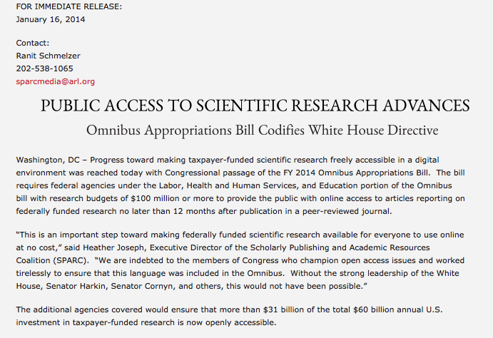
http://www.sparc.arl.org/news/omnibus-appropriations-bill-codifies-white-house-directive

Slide 10
Teams | Presentation Date
James, Caitlin, Bill & Matt
Emily, Josh & Porsha | Wed April 15
Grace, Henry, Javairia & Benny
Terry
Cherish
Greg
Sophia, Ryan, Rickell & Mark
Alex, Ben, Charlie, Maddie
Lucy, May & Emma | Mon April 20
Kaley
Erin & Sam

