Slide 1
INLS 151
wednesday, january 14

Slide 2
learning outcomes for today…
Better understand the role of information behavior in decision theory
Distinguish between two models of decision theory (optimizing & satisficing)
Identify and describe examples of bias surrounding information behavior and decision-making

Slide 3
Seeker(s) and situation | Main motivation | Sources of information | Time pressure | Degree of thoroughness
Julie: car purchase | Optimize functionality and value | Friends, web pages, salespeople | Low (months) | low
Leslie: library research | Class assignment; earn credit/grade | Online catalogs, books, journals, professional advice (on how to search | Moderate (weeks) | moderate
Hospital ICU team members: caring for an accident victim | Work assignment; desire to help others | Observation of patient, paper and electronic records, monitoring devices, medical manuals, hospital employees | Very high (hours or days, based on patient improvement | High
Joe: horse race wager | Desire for thrill; to win money | Special journals, observation, intuition | Very high (minutes) | high
George: legal research | Work assignment; help relatives | Special databases and publications, professional advice | High (days) | high
Maria: information on cancers | Curiosity; preemptive information search | Web pages, books, brochures, friends, experts | None (lifetime) | moderate

Slide 4
Seeker(s) and situation | Main motivation | Sources of information | Time pressure | Degree of thoroughness
Julie: car purchase | Optimize functionality and value | Friends, web pages, salespeople | Low (months) | low
Leslie: library research | Class assignment; earn credit/grade | Online catalogs, books, journals, professional advice (on how to search | Moderate (weeks) | moderate
Hospital ICU team members: caring for an accident victim | Work assignment; desire to help others | Observation of patient, paper and electronic records, monitoring devices, medical manuals, hospital employees | Very high (hours or days, based on patient improvement | High
Joe: horse race wager | Desire for thrill; to win money | Special journals, observation, intuition | Very high (minutes) | high
George: legal research | Work assignment; help relatives | Special databases and publications, professional advice | High (days) | high
Maria: information on cancers | Curiosity; preemptive information search | Web pages, books, brochures, friends, experts | None (lifetime) | moderate
What factors might determine an individual's point of satisficing? Or in other words if two people have the same information goal, time pressure, etc., what might make one person feel satisfied sooner/later than the other person?

Slide 5
A bat and a ball cost $1.10 in total. The bat costs $1 more than the ball. How much does the ball cost?

Slide 6
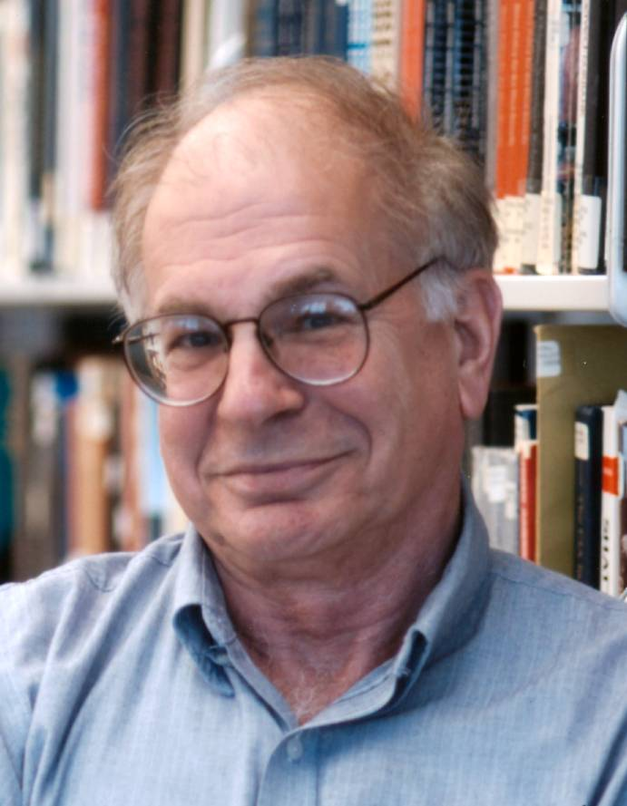
“People are not accustomed to thinking hard and are often content to trust a plausible judgment that comes quickly to mind.”
Daniel Kahneman. (2003). American Economic Review 93 (5), p. 1450

Slide 7
Two-systems of thought [exist in parallel]
System 1
Intuitive, implicit more “perceptual”
Affective
Heuristic-based
Relies on mental shortcuts
Unconscious
Automatic
Evolved early
Independent of general intelligence
Relatively invulnerable to aging
Generally faster
General feeling of certitude
System 2
Explicit and rule-based
More “analytical”
Conscious
Slow
Effortful
Controllable
Logical / abstract
Constrained by working memory, sequential
Permits hypothetical thinking
Correlated with general intelligence
Develops with age and is more vulnerable to aging

Slide 8
Decision Theory
Focuses on how we use our freedom
Assumption
There are options to choose between
Assumption
We choose in a non-random way
Our choices are goal-directed activities
Assumption
Assumption

Slide 9
Goal-directed behavior in the presence of options
Decision theory is concerned with…

Slide 10
The Classical Model: Rational Choice Theory or Optimizing
To make the best decision:
define the problems
establish goals and objectives
generate all possible alternatives
consider the consequences of all alternatives
evaluate all alternatives
select the best alternative
implement and evaluate the decision

Slide 11
The Classical Model: Rational Choice Theory or Optimizing
Assumptions…
human beings have well-ordered preferences
people go through life with all their options arrayed before them, as if on a buffet table
we have complete information about the costs and benefits associated with each option
we compare the options with one another on a single scale of preference, or value, or utility
and after making the comparisons, we choose so as to maximize our preferences, or values, or utilities.
von Neumann, J., & Morgenstern, O. (1944). Theory of games and economic behavior.
Princeton, NJ: Princeton University Press.

Slide 12
Mathematical Decision Process Models:
Expected Value Theory
The rational procedure is to:
identify all possible outcomes
determine their values (positive or negative)
determine the probabilities that will result from each course of action
multiply the two to give an expected value
Expected value theory says you should always choose the option with the HIGHEST EXPECTED VALUE

Slide 13
 | Probability of outcome | Outcome | Expected Value
Option 1 | 50% | $100
Option 2 | 80% | $59

Slide 14
 | Probability of outcome | Outcome | Expected Value
Option 1 | 50% | $100 | .5 x 100 = 50
Option 2 | 80% | $59 | .8 x 59 = 47.2
Expected value theory indicates option 1 is best

Slide 15
 | Probability of outcome | Outcome | Expected Value
Option 1 | 100% | $1,000,000
Option 2 | 50% | $3,000,000

Slide 16
 | Probability of outcome | Outcome | Expected Value
Option 1 | 100% | $1,000,000 | 1,000,000
Option 2 | 50% | $3,000,000 | 1,500,000
EV says you should prefer option 2 to option 1.
Many people prefer 1 to 2. Why?
Option 1 is a sure thing … option 2 is a gamble…

Slide 17
 | Probability of outcome | Outcome | Expected Value
Option 1 | 95% | $1,000,000
Option 2 | 50% | $3,000,000

Slide 18
 | Probability of outcome | Outcome | Expected Value
Option 1 | 95% | $1,000,000 | 950,000
Option 2 | 50% | $3,000,000 | 1,500,000
$3 million is not really three times as desirable a consequence as $1 million…I would probably be MORE satisfied with an almost sure million than to risk gaining nothing…

Slide 19
Mathematical Decision Process Models:
Multiattribute Utility Theory (MAUT)
We can construct a scale, called a utility scale in which we try to quantify the amount of satisfaction (UTILITY) we would derive from each option

Slide 20
Multiattribute Utility Theory MAUT
 | Attribute A | Degree of importance (utility) of A | Attribute B | Degree of importance (utility) of B
Option 1 | Low cost | .5 | Low quality | .3
Option 2 | High cost | .5 | High quality | .8
Assigning weights

Slide 21
behavioral economics
assumption of complete information that characterizes rational choice theory is implausible
choice theorists treat information itself as a “commodity,” something that has a price (in time or money), and is thus a candidate for consumption along with more traditional goods
Payne, J. W., Bettman, J. R., & Johnson, E. J. (1993). The adaptive
decision maker. New York: Cambridge University Press.

Slide 22
Satisficing model of decision making
Simon argued that the presumed goal of maximization (or optimization) is virtually always unrealizable in real life, owing both to the complexity of the human environment and the limitations of human information processing.
Simon, H. A. (1957). Models of man, social and rational: Mathematical
essays on rational human behavior. New York: Wiley.

Slide 23
Satisficing model of decision making
In choice situations, people actually have the goal of “satisficing” rather than maximizing.
To satisfice, people need only to be able to place goods on some scale in terms of the degree of satisfaction they will afford, and to have a threshold of acceptability.

Slide 24
To satisfice is to pursue not the best option, but a good enough option.
Simon, H. A. (1957). Models of man, social and rational: Mathematical
essays on rational human behavior. New York: Wiley.

Slide 25
To satisfice is to pursue not the best option, but a good enough option.
Simon, H. A. (1957). Models of man, social and rational: Mathematical
essays on rational human behavior. New York: Wiley.
satisficing: when you don’t have the time or
just don’t care enough to do the very best

Slide 26
info behavior & decision making
Are we biased?
Asking another way – do we use simplifications and shortcuts to make decisions?
Like what?

Slide 27
Traps (biases) in decision making to avoid
Anchoring | Giving disproportional weight to early, first received information
Comfort | A bias toward alternative that support the status quo
Recognition | Tendency to place a higher value on that which is familiar
Confirmation bias | Using only the facts that support our decision
Sunk-cost | Tendency to make decisions that justify previous decisions that are not working
Framing | Framing of the problem impacts the eventual solution
Prudence | Tendency to be overcautious when faced with high-stakes decisions
Memory | Tendency to base predictions on memory of past events, which are often over influenced by both recent and dramatic events

Slide 28
Traps (biases) in decision making to avoid
Self-serving bias | Tendency for individuals to attribute their own successes to internal factors while putting the blame for failures on external factors
Halo Effect | Drawing a general impression (good or bad) about an individual on the basis of a single characteristic
Projection | Attributing one’s own characteristics or beliefs to other people
Stereotyping | Judging someone on the basis of one’s perception of the group to which that person belongs
Overconfidence | Believing too much in our own ability to make good decisions

Slide 29
