Slide 1
INLS 623– Database Systems II– File Structures, Indexing, and Hashing
Instructor: Jason Carter
Notes:
Functions

Slide 2
Review
Databases
Logically Coherent Collection of related data
Database has tables and there are relationships between the tables
Where are those tables physically stored?

Slide 3
Memory
Primary Memory
Random Access Memory (RAM)
Secondary Memory
Disk (Hard Disk)
Tape
Solid State Devices (SSD)
DVD/Blue Ray
How are those table stored in memory?

Slide 4
File Storage
Which type of memory do we typically store files in and why?
Secondary Storage
Secondary Storage is persistent and cheaper (than primary storage)
Primary memory is faster
We chose persistence and money over speed

Slide 5
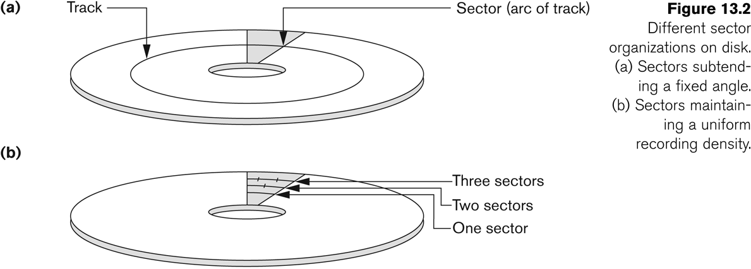
Disk Storage Devices (contd.)

Slide 6
Disk Storage Devices (contd.)
A track is divided into smaller blocks or sectors
because it usually contains a large amount of information
The division of a track into sectors is hard-coded on the disk surface and cannot be changed.
One type of sector organization calls a portion of a track that subtends a fixed angle at the center as a sector.
A track is divided into blocks.
The block size B is fixed for each system.
Typical block sizes range from B=512 bytes to B=4096 bytes.
Whole blocks are transferred between disk and main memory for processing.

Slide 7
Records
Records = Rows in a table
Fixed and variable length records
Records contain fields (attributes) which have values of a particular type
E.g., amount, date, time, age
Fields themselves may be fixed length or variable length
Variable length fields can be mixed into one record:
Separator characters or length fields are needed so that the record can be “parsed.”

Slide 8
Blocking
Blocking:
Refers to storing a number of records in one block on the disk.
Blocking factor (bfr) refers to the number of records per block.
remember block size is a constant for a device
Spanned Records:
Refers to records that exceed the size of one or more blocks and hence span a number of blocks.

Slide 9
Files of Records
A file is a sequence of records, where each record is a collection of data values (or data items).
Think of a file as a table though one can have multiple tables in a file
A file descriptor (or file header) includes information that describes the file, such as the field names and their data types, and the addresses of the file blocks on disk.
Records are stored on disk blocks.
The blocking factor bfr for a file is the (average) number of file records stored in a disk block.
A file can have fixed-length records or variable-length records.

Slide 10
Files of Records (contd.)
File records can be unspanned or spanned
Unspanned: no record can span two blocks
Spanned: a record can be stored in more than one block
The physical disk blocks that are allocated to hold the records of a file can be contiguous, linked, or indexed.
In a file of fixed-length records, all records have the same format. Usually, unspanned blocking is used with such files.
Files of variable-length records require additional information to be stored in each record, such as separator characters and field types.
Usually spanned blocking is used with such files.

Slide 11
Unordered Files
Also called a heap or a pile file.
New records are inserted at the end of the file.
Deletion can be to mark a record as invalid
Later compaction can be done to recover space.
A linear search through the file records is necessary to search for a record since the files are unordered
This requires reading and searching half the file blocks on the average, and is hence quite expensive.
Record insertion is quite efficient.
Reading the records in order of a particular field requires sorting the file records after reading.

Slide 12
Ordered Files
Also called a sequential file.
File records are kept sorted by the values of an ordering field (eg. SSN)
Insertion is expensive: records must be inserted in the correct order.
It is common to keep a separate unordered overflow (or transaction) file for new records to improve insertion efficiency; this is periodically merged with the main ordered file.
A binary search can be used to search for a record on its ordering field value.
This requires reading and searching log₂ of the file blocks on the average, an improvement over linear search.
Reading the records in order of the ordering field is quite efficient.

Slide 13
How does A Database Manipulate Data on Disk?

Slide 14
Items Table
Field | Data Type
item_id | int
title | varchar
long_text | text
item_date | datetime
deleted | Enum(‘Y’,’N’)
category | int

Slide 15
Finding Data
SELECT * FROM items WHERE category=4;
How does MYSQL know where to find and return the data for this query?
Start at the beginning of the file
Read in enough to know where the category data field starts
Read in the category value
Determine if it satisfies the where condition
If it does add that record to the return set
If it doesn’t figure out where the next record set is and repeat

Slide 16
Finding Data (Continued)
Database will read the entire data file off disk
It does not matter how many rows satisfy the where clause
This is very inefficient!
Using a SQL command, how can we make this process more efficient?

Slide 17
Making Data Finding more Efficient
Use the LIMIT Keyword
SELECT * FROM items WHERE category=4 LIMIT 1;
When does this query stop reading from disk?
After the correct row is found.
If row is at end of table, we still waste time reading the disk.
Can we make reading data more efficient?

Slide 18
Index: Making Data Finding more Efficient
An index is a data structure that makes finding data faster
Adds additional storage space and writes to disk to maintain the index data structure
Holds a field value, and pointer to the record it relates to
Indexes are sorted
What is a data structure?
A way of organizing data in a computer so that it can be used efficiently
Notes:
A database index is a data structure that improves the speed of data retrieval operations on a database table at the cost of additional writes and storage space to maintain the index data structure. Indexes are used to quickly locate data without having to search every row in a database table every time a database table is accessed. Indexes can be created using one or more columns of a database table, providing the basis for both rapid random lookups and efficient access of ordered records.

Slide 19
Data Structures
Array
Hashtable/DictionaryAssociative Array
Tuple
Graphs
Trees
Object

Slide 20
Array: Data Structures
A collection of elements (values or variables), each identified by at least one array index or key

Slide 21
Indexing
Have we ever used indexes before?
When we set primary keys

Slide 22
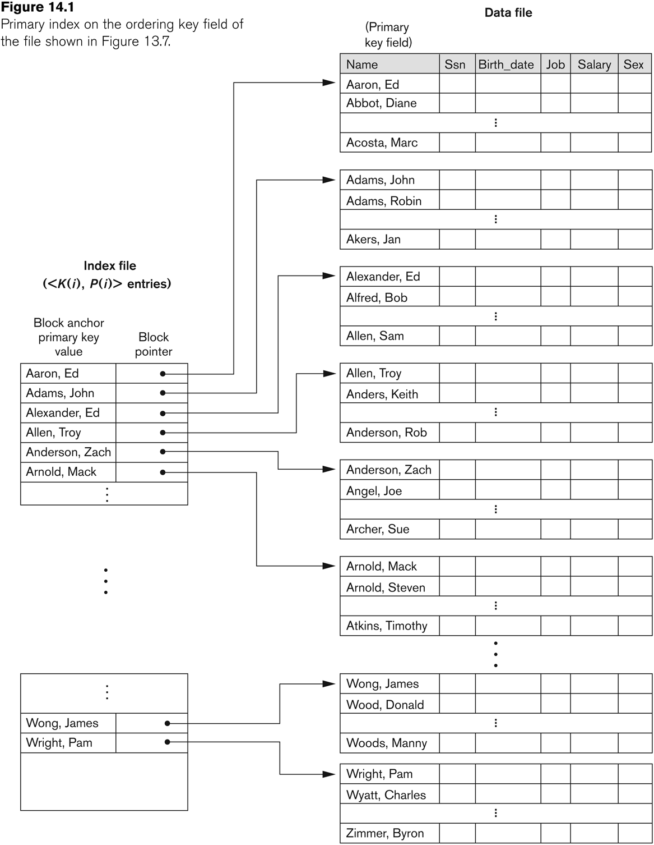

Slide 23
Arrays for Indexing
Holds a field value, and pointer to the record it relates to
Indexes are sorted
Can an array be used for indexing?

Slide 24
B Trees For indexing
A tree data structure that keeps data sorted and allows searches, sequential access, insertions, and deletions in logarithmic time
O(log N) basically means time goes up linearly while the n goes up exponentially. So if it takes 1 second to compute 10 elements, it will take 2 seconds to compute 100 elements, 3 seconds to compute 1000 elements, and so on.

Slide 25
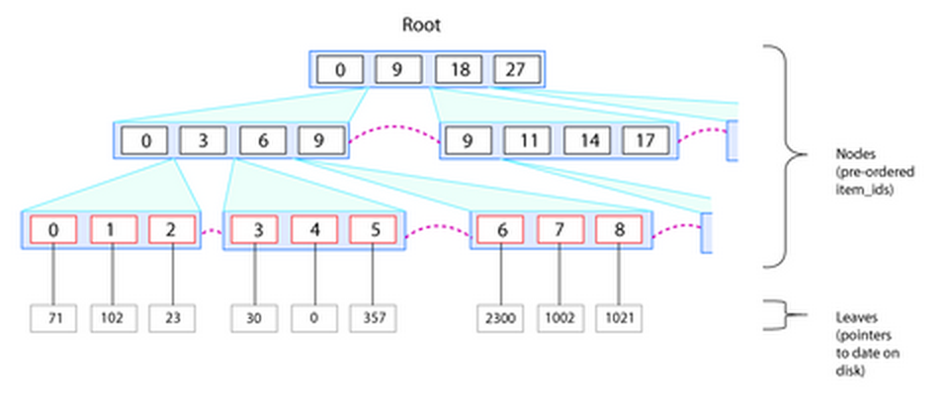
B Tree and Indexing Example
Index for item_id
4 sorted values representing
the range of item_ids
The child nodes have the same range values
last level nodes containing the final item_id value and pointer to the byte in the disk file the record lies
Notes:
top level node here contains 4 sorted values representing the range of item_ids to be found below this node. The child nodes have the same range values showing the values taken by its own children. At the last level we have nodes containing the final item_id value, and a pointer to the byte in the disk file the final record lies.

Slide 26
B Tree and Indexing Example
Looking for item_id 4
Is this really more efficient?
Notes:
top level node here contains 4 sorted values representing the range of item_ids to be found below this node. The child nodes have the same range values showing the values taken by its own children. At the last level we have nodes containing the final item_id value, and a pointer to the byte in the disk file the final record lies.

Slide 27
B Tree and Indexing Example
We needed to do 3 hops to get to item id 4.
We had to look at the entire index for item_id
Looking for item_id 20

Slide 28
B Tree and Indexing Example
We needed to do 3 hops to get to item id 20.
# of hops required increases in a sort-of logarithmic manner with respect to database size
Opposite to exponential growth
Logarithmic shoots up in the beginning, but slows
Exponential grows slowly at the beginning, but shoots up rapidly

Slide 29
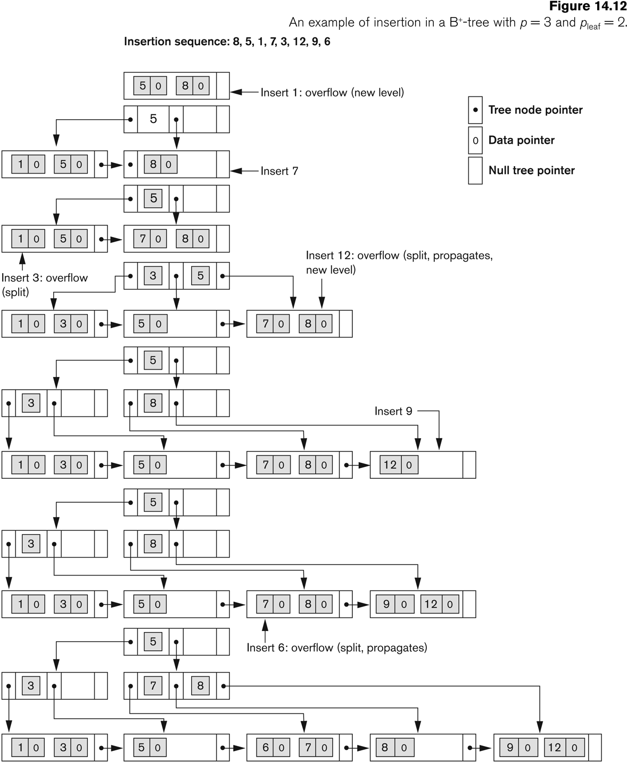
An Example of an Insertion in a B-tree

Slide 30
Indexing: General Rules of Thumb
Index fields in the WHERE CLAUSE of a SELECT Query
User Table
ID (INT) PK
Email_address
During login, MySQL must locate the correct ID by searching for an email
Without an index, every record in sequence is checked until the email address is found
Notes:
As a general rule of thumb, indexes should be applied to any column named in the WHERE clause of a SELECT query.
For example, assume we have a usertable with a numeric ID (the primary key) and an email address. During log on, MySQL must locate the correct ID by searching for an email. With an index, MySQL can use a fast search algorithm to locate the email almost instantly. Without an index, MySQL must check every record in sequence until the address is found.
It’s tempting to add indexes to every column, however, they are regenerated during every table INSERT or UPDATE. That can hit performance; only add indexes when necessary.

Slide 31
Indexing: General Rules of Thumb
Should we add an index to every field?
No, because indexes are regenerated during every table INSERT OR UPDATE
Hurts performance
Notes:
It’s tempting to add indexes to every column, however, they are regenerated during every table INSERT or UPDATE. That can hit performance; only add indexes when necessary.

Slide 32
Indexing: General Rules of Thumb
Only add indexes when necessary
Indexes should not be used on small tables.
Tables that have frequent, large batch update or insert operations.
Indexes should not be used on columns that contain a high number of NULL values.
Columns that are frequently manipulated should not be indexed.

Slide 33
Other Topics
Full Text Search and Indexes
CHAR VS VARCHAR
Char if you know your data will be of equal length
Example: States
VARCHAR if you are not sure
How Graph databases are stored
Notes:
select * from articles WHERE MATCH(title,body) AGAINST ('MySQL');

Slide 34
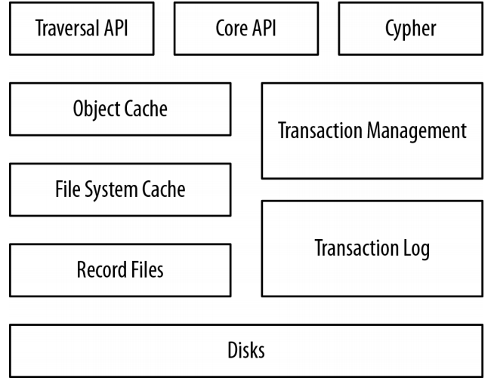
Neo4j Architecture

Slide 35
Store files
Neo4j stores graph data in a number of different store files.
Each store file contains the data for a specific part of the graph (e.g., nodes, relationships, properties)
neostore.nodestore.db
neostore.relationshipstore.db
neostore.propertystore.db
neostore.propertystore.db.index
neostore.propertystore.db.strings
neostore.propertystore.db.arrays
Notes:
String compression:
http://docs.neo4j.org/chunked/stable/short-strings.html

Slide 36
Node store
neostore.nodestore.db
Size: 9 bytes
1st byte: in-use flag
Next 4 bytes: ID of first relationship
Last 4 bytes: ID of first property of node
Fixed size records enable fast lookups

Slide 37
Relationship store
neostore.relationshipstore.db
Size: 33 bytes
1st byte: In use flag
Next 8 bytes: IDs of the nodes at the start and end of the relationship
4 bytes: Pointer to the relationship type
16 bytes: pointers for the next and previous relationship records for each of the start and end nodes. ( property chain)
4 bytes: next property id

Slide 38
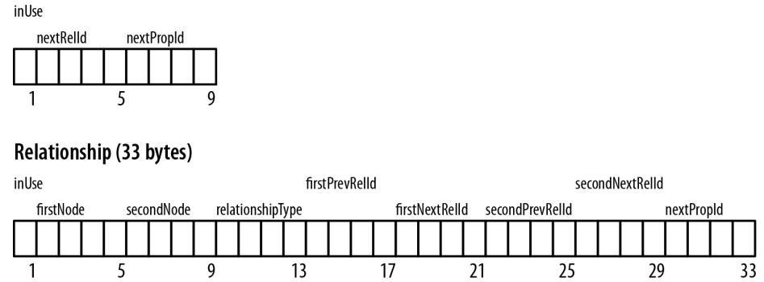
Node/property record structure

Slide 39
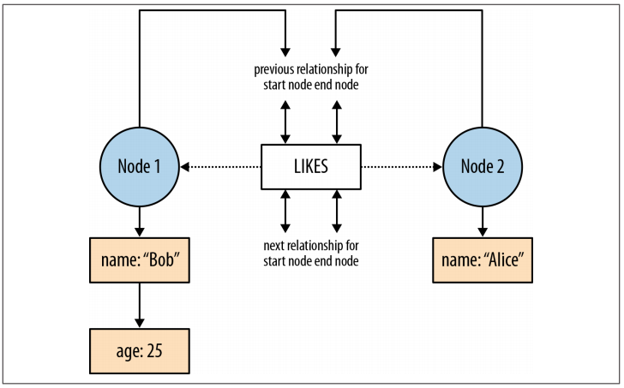
How a graph is physically stored

Slide 40
Neo4j: Data Size
nodes | 2³⁵ (∼ 34 billion)
relationships | 2³⁵ (∼ 34 billion)
properties | 2³⁶ to 2³⁸ depending on property types (maximum ∼ 274 billion, always at least ∼ 68 billion)
relationship types | 2¹⁵ (∼ 32 000)
Notes:
References: http://docs.neo4j.org/chunked/stable/capabilities-capacity.html
Data size is mainly limited by the address space of the primary keys of the nodes, relationships, property, relationship types.

