Slide 1
INLS 560 – Strings
Instructor: Jason Carter
Notes:
Functions

Slide 2
Types
int
list
string

Slide 3
Basic String Operations
Many types of programs perform operations on strings
So far we’ve only really seen strings as input/output
In Python, many tools for examining and manipulating strings
Strings are sequences, so many of the tools that work with sequences work with strings

Slide 4
Accessing the Individual Character in a String
To access an individual character in a string:
Use a for loop
Format: for character in string:
Useful when need to iterate over the whole string, such as to count the occurrences of a specific character
Use indexing
Each character has an index specifying its position in the string, starting at 0
Format: character = my_string[i]

Slide 5
Accessing Characters
IndexError exception will occur if:
You try to use an index that is out of range for the string
Likely to happen when loop iterates beyond the end of the string
len(string) function can be used to obtain the length of a string
Useful to prevent loops from iterating beyond the end of a string
myString = “Hello World”
n = len(myString)
print(myString[n+1]) #This will cause an IndexError
print(myString[n]) #This will also cause an IndexError

Slide 6
Accessing Chararacters
0 | 1 | 2 | 3 | 4 | 5 | 6 | 7
“C” | “o” | “m” | “p” | “u” | “t” | “e” | “r”
my_string = “Computer”
print my_string[0]

Slide 7
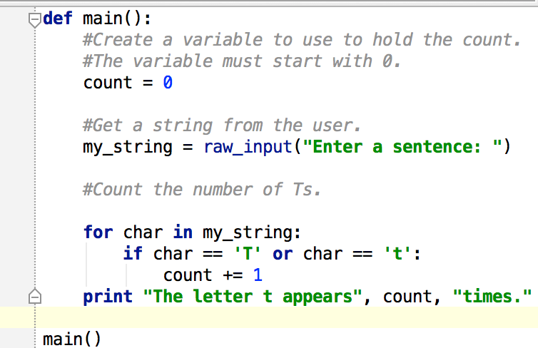
Using a For Loop to Access Characters

Slide 8
String Concatenation
• Concatenation: appending one string to the end of another string
Use the + operator to produce a string that is a
combination of its operands
The augmented assignment operator += can also be used to concatenate strings
The operand on the left side of the += operator must
be an existing variable; otherwise, an exception is
raised

Slide 9
String Concatenation
Unlike print, string concatenation does not put spaces between your strings.
s1 = “INLS560”
s2 = “rocks!”
bigstring = s1 + “ “ + s2
print(bigstring) #prints INLS560 rocks!

Slide 10
Strings Are Immutable
Strings are immutable (unchangeable)
Once they are created, they cannot be changed
Concatenation doesn’t actually change the existing
string, but rather creates a new string and assigns the
new string to the previously used variable
Cannot use an expression of the form
string[index] = new_character
Statement of this type will raise an exception

Slide 11
String Functions
• Strings in Python have many types of methods, divided into different types of operations
General format:
mystring.function(arguments)
• Some functions test a string for specific characteristics
Generally Boolean methods, that return True if a condition exists, and False otherwise

Slide 12
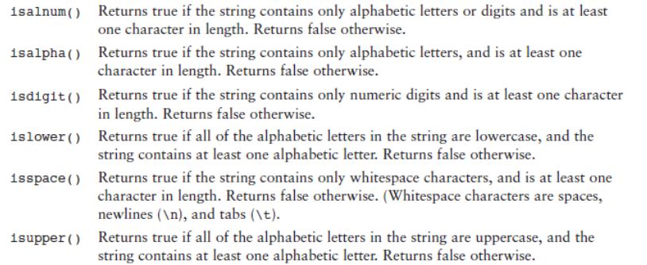
String Testing Functions

Slide 13
Practice
Write a program that asks the user to input a sentence and counts the number of spaces that are in the inputted string.
Example: Please enter a sentence: Fall break was so fun!
The number of spaces in your sentence is: 4

Slide 14
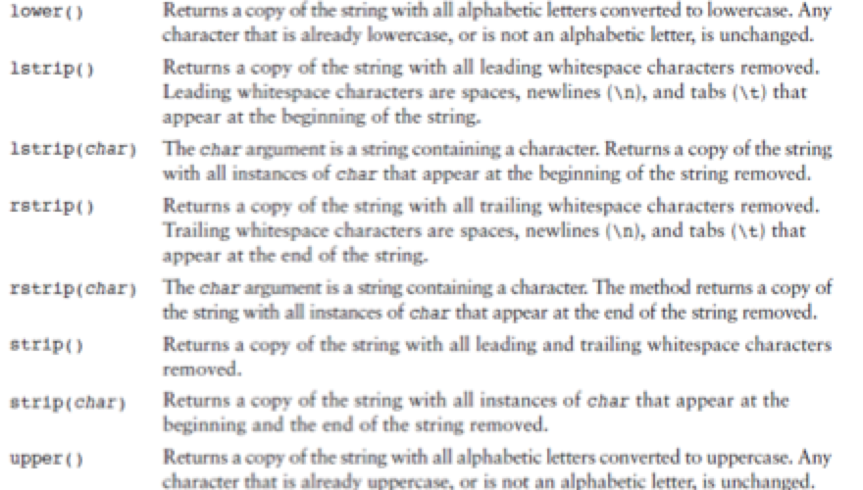
String Modification Methods

Slide 15
More String Methods
Programs commonly need to search for substrings
Several methods to accomplish this:
endswith(substring): checks if the string ends with substring
Returns True or False
startswith(substring): checks if the string starts with substring
Returns True or False

Slide 16
More String Methods
Several methods to accomplish this cont’d):
find(substring): searches for substring within the string
Returns lowest index of the substring, or if the substring is not contained in the string, returns -1
replace(substring, new_string):
Returns a copy of the string where every occurrence of substring is replaced with new_string

Slide 17
Testing, Searching, and Manipulating Strings
You can use the in operator to determine whether one string is contained in another string
General format: string1 in string2
string1 and string2 can be string literals or variables referencing strings
Similarly you can use the not in operator to determine whether one string is not contained in another string

Slide 18
Splitting a String
split function: returns a list containing the words in the string
By default, uses space as separator
Can specify a different separator by passing it as an argument to the split method

Slide 19
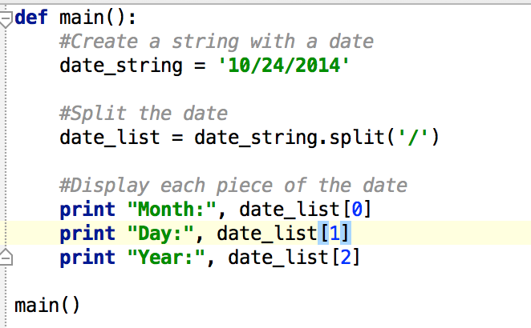
Splitting a String

Slide 20
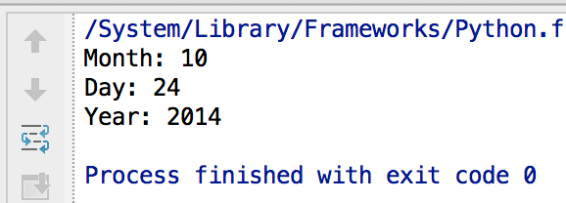
Splitting a String - Output

