Slide 1
INLS 560 – File Input and Output
Instructor: Jason Carter
Notes:
Functions

Slide 2
Input and Output
Input from the keyboard:
Output to the console:
File I/O

Slide 3
File Input and Ouput
For a program to retain data between the times it is run, you must save the data
Data is saved to a file, typically on computer disk
Saved data can be retrieved and used at a later time
“Writing data to”: saving data in a file
Output file: a file that data is written to

Slide 4
File Input: Reading Data From a File
open function: used to open a file
Creates a file object and associates it with a file on the disk
General format:
file_object = open(file_path, mode)
file_object allows one to:
get information about a file
perform different computations on a file
file_path is the location of the file
The programmer provides the file_path as a string
mode
The way the file will be used

Slide 5
File_Object

Slide 6
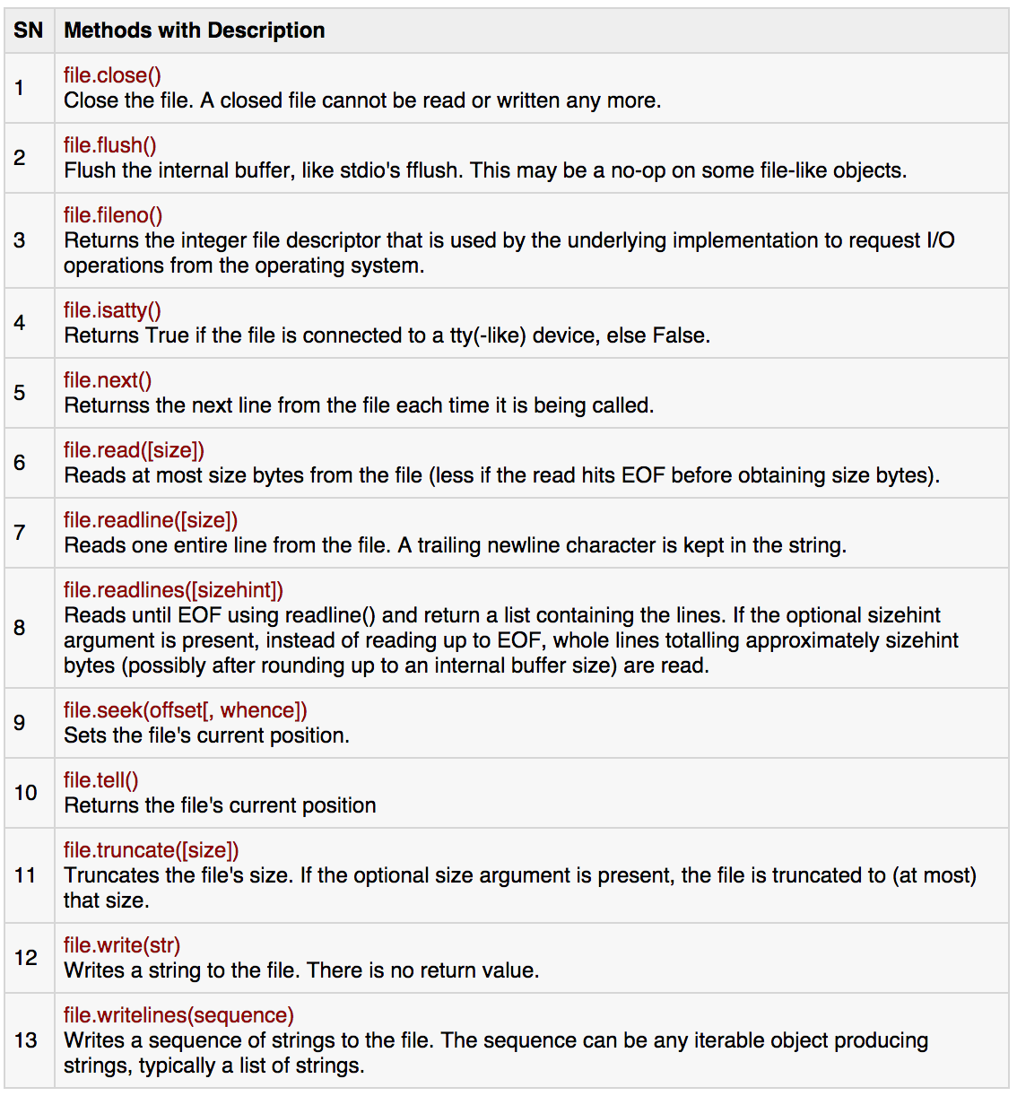
File_Object

Slide 7
File_Path
Specifying the location of a file
If open function receives a filename that does not contain a path, assumes that file is in same directory as program
If program is running and file is created, it is created in the same directory as the program
Can specify alternative path and file name in the open function argument, file_path

Slide 8
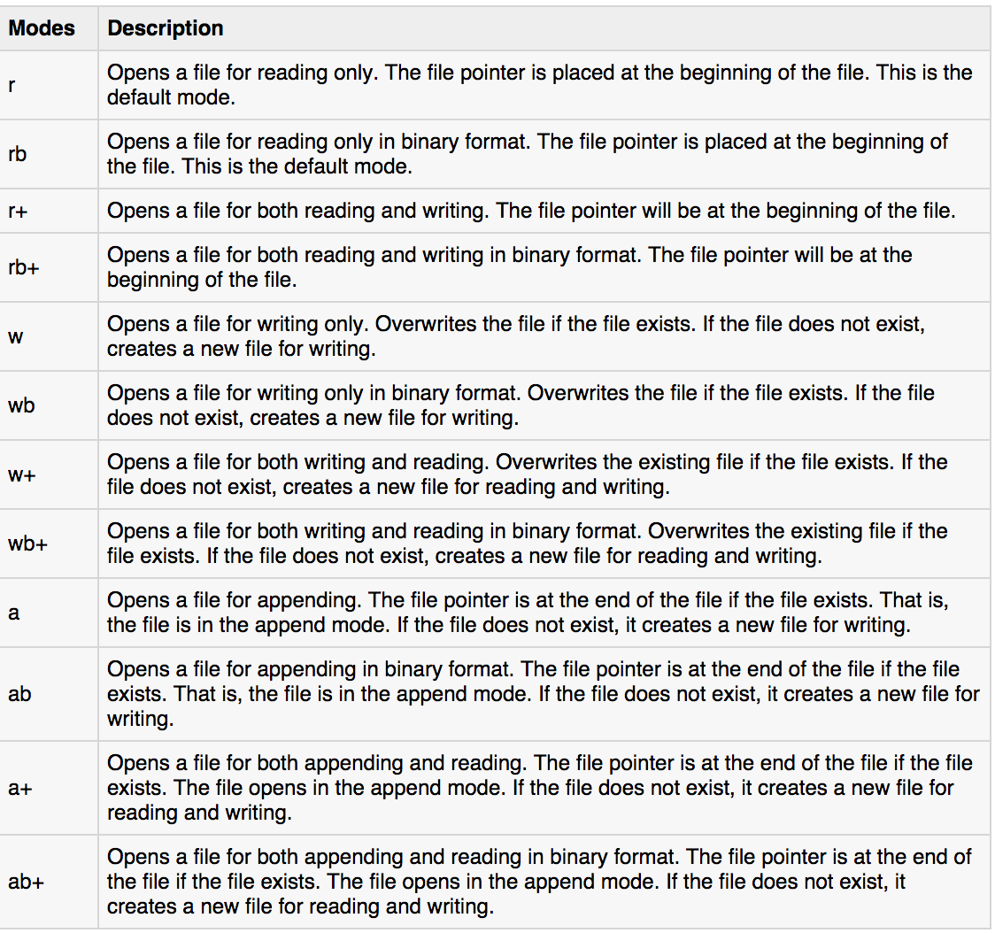
File Modes

Slide 9
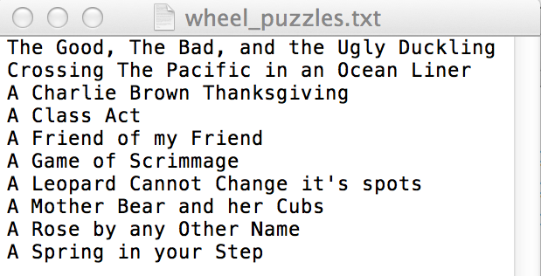
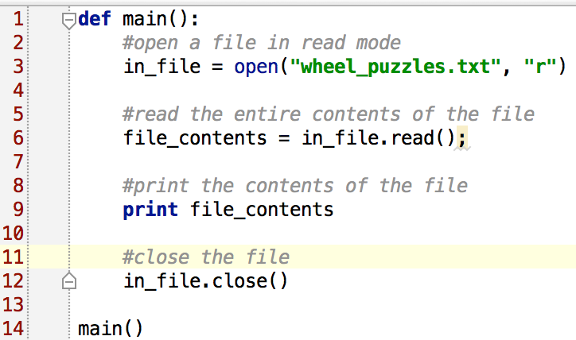
Opening and Reading a File

Slide 10
Opening and Reading a File - Output

Slide 11
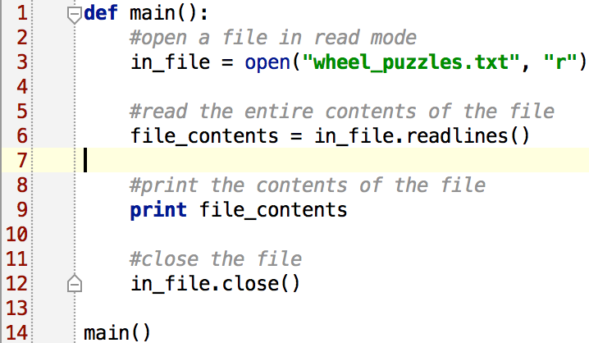
Reading a File Line by Line
readlines() function: reads the entire file line by line until End of File (EOF) is reached and returns a list containing the lines

Slide 12
Reading a File Line by Line - Output
Each line has an end of line character (EOL): \n
In many cases, you need to strip the EOL character
rstrip() function: string method that strips specific characters from end of the string

Slide 13
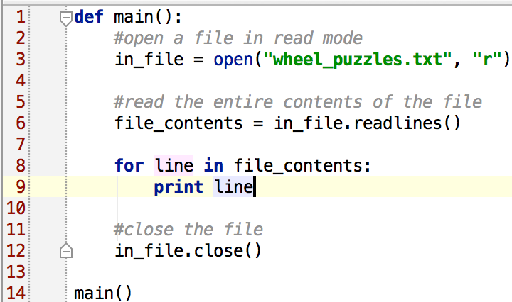
Reading a File - List

Slide 14
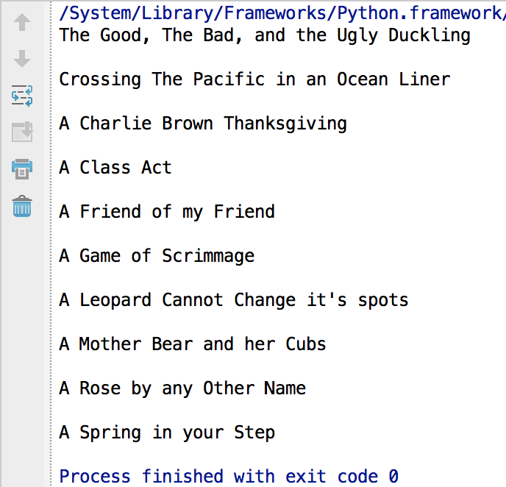
Reading a File – List output

Slide 15
Reading a File – List Strip

Slide 16
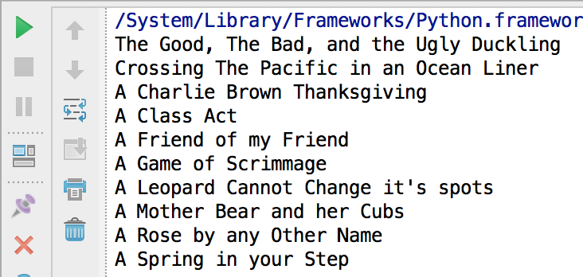
Reading a File – List Strip output

Slide 17
Writing Data To a File
file_object = open(file_path, “w”)
write function
Used to write data to a file
file_object.write(string)
File should be closed using file object close function
Format: file_variable.close()
When open file with ‘w’ mode, if the file already exists it is overwritten

Slide 18
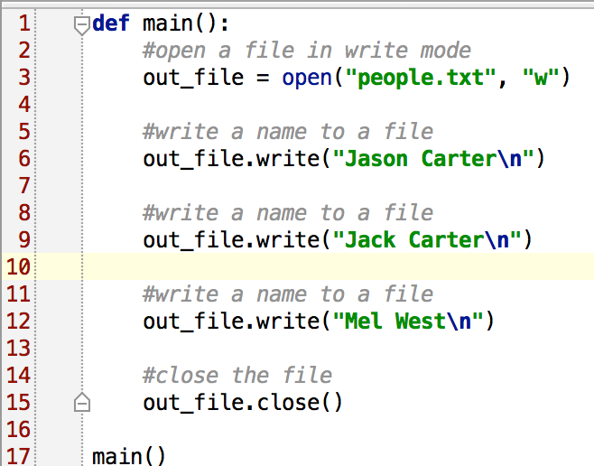
Writing Data To a File

Slide 19
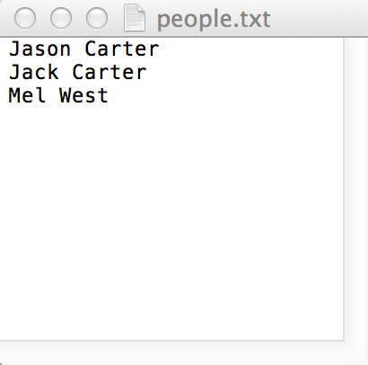
Writing Data To a File - Output

Slide 20
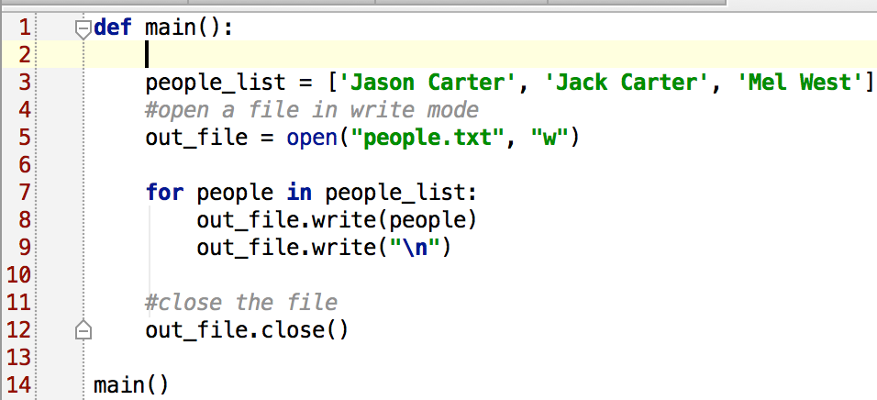
Writing Data To a File - List

Slide 21
Writing Data To a File - Output

Slide 22
Appending Data To an Existing File
To append data to a file use the ‘a’ mode
If file exists, it is not erased, and if it does not exist it is created
Data is written to the file at the end of the current contents

Slide 24
Practice
Write a function that creates 1000 random numbers and writes them to a file named random_numbers.txt
Write a function that reads in each number and outputs the sum and average of the numbers in your file.
Hints:
To write an int to file use:
number = 123
out_file.write(str(number))
To convert a string to an int that you read from a file use :
number = int(infile.readline())

