Slide 1
INLS 560 – While Loops
Instructor: Jason Carter
Notes:
Functions

Slide 2
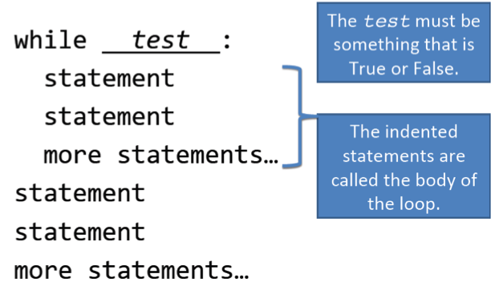
While Loops

Slide 3
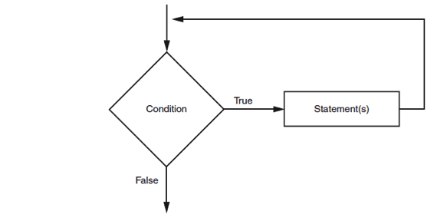
The While Loop

Slide 4
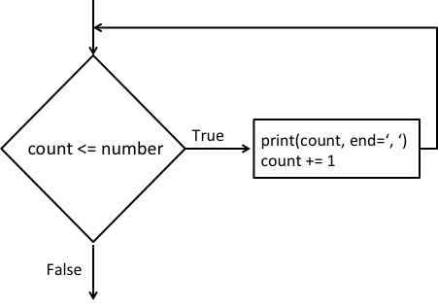
The While Loop

Slide 5
The While Loop
In order for a loop to stop executing, something has to happen inside the loop to make the condition false
Iteration: one execution of the body of a loop
while loop is known as a pretest loop
Tests condition before performing an iteration
Will never execute if condition is false to start with
Requires performing some steps prior to the loop

Slide 6
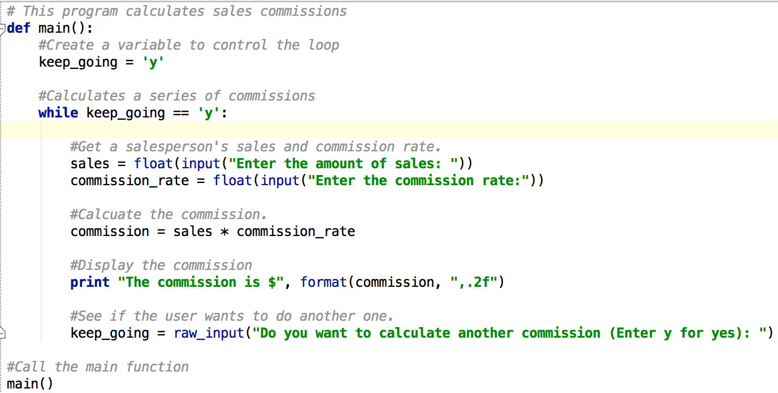

Slide 7
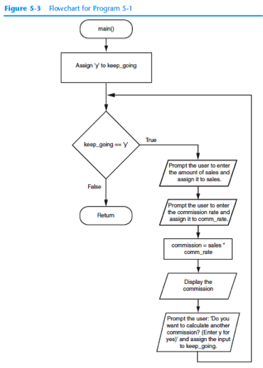

Slide 9
Infinite Loops
Loops must contain within themselves a way to terminate
Something inside a while loop must eventually make the condition false
Infinite loop: loop that does not have a way of stopping
Repeats until program is interrupted
Occurs when programmer forgets to include stopping code in the loop

Slide 10
Calling Functions in a Loop
Functions can be called from statements in the body of a loop
Often improves the design
Example:
Write a function to calculate then display the commission for a sales amount
Call the function inside a loop

Slide 11
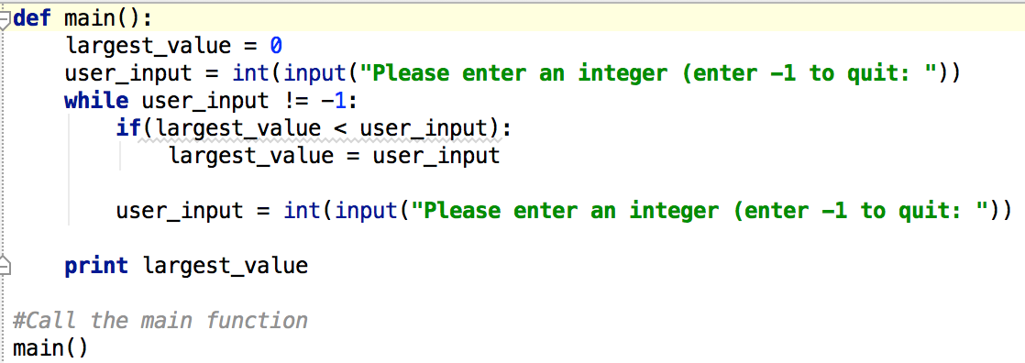
Loop Practice – Largest Input
Write the function largestInput(): this takes no parameters, repeatedly reads integers from the user (stopping when the user enters -1), and returns the largest value input.

Slide 12
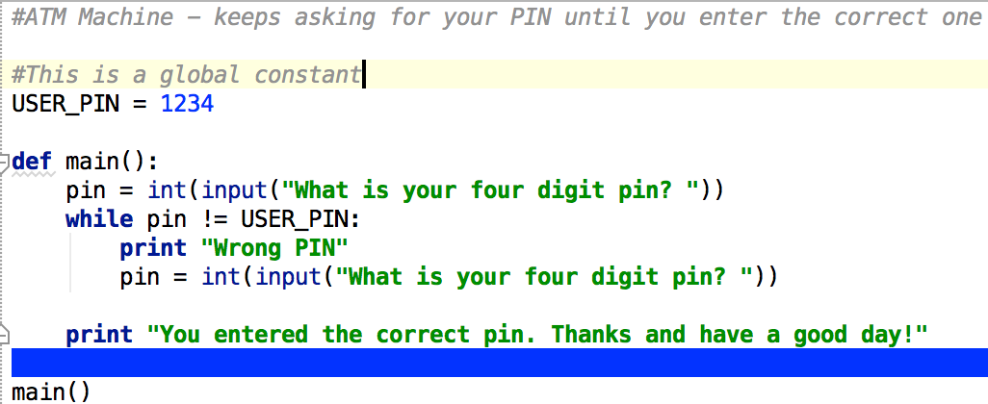
While Loop General Algorithm
while ( some condition is true ) : # Do this code
#Something here should modify the condition above

Slide 13
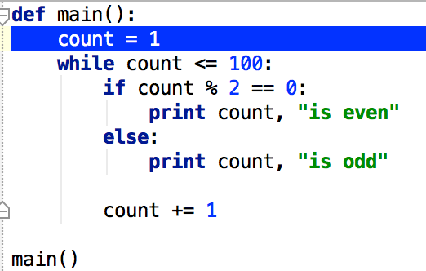
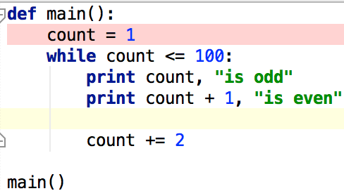
Loops that Count
These loops are equivalent.

Slide 14
Practice
Write a loop that counts from1 to 100 and only prints odd numbers.

Slide 15
Standard Library Functions and the import Statement
Just like we have built-in functions like print and input, we also have libraries of other pre-written functions.
Modules: files that stores functions of the standard library
Help organize library functions not built into the interpreter
Copied to computer when you install Python
To call a function stored in a module, need to write an import statement
Written at the top of the program
Format: import module_name

Slide 16
Generating Random Numbers
Random number are useful in a lot of programming tasks
random module: includes library functions for working with random numbers
Dot notation: notation for calling a function belonging to a module
Format: module_name.function_name()

Slide 17
Generating Random Numbers
randint function: generates a random number in the range provided by the arguments
Arguments
Function call

Slide 18
Generating Random Numbers
randint function: generates a random number in the range provided by the arguments
Returns a number between 1 and 100
The number variable is set equal to the return value of random.randint(1,100)

Slide 19
Printing a Random Number

Slide 20
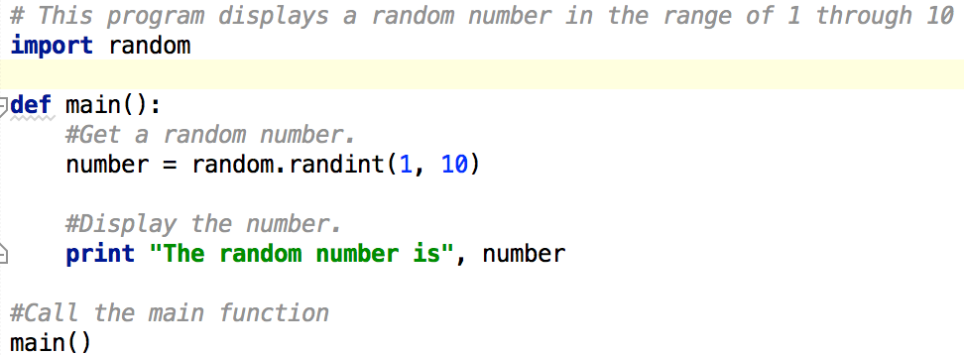
Random Numbers Example

Slide 21
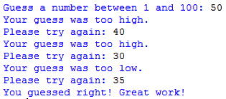
Random Numbers Practice
Guess the Number!
Write a program that:
Randomly generates an integer between 0 and 100.
Continue to prompt your user to enter numbers until they enter the randomly generated number. (Think while loop)
To make the game a little easier, tell the user if their guess was too low or too high, and of course be sure to tell them when they guess correctly!
Sample Output

