Slide 1
INLS 560 – Conditionals
Instructor: Jason Carter
Notes:
Functions

Slide 2
Conditionals
What happens if secondNumber = 0?
Traceback (most recent call last):
File "/Users/jasocarter/PycharmProjects/Test/Test.py", line 9, in <module>
quotient = firstNumber/secondNumber
ZeroDivisionError: integer division or modulo by zero

Slide 3
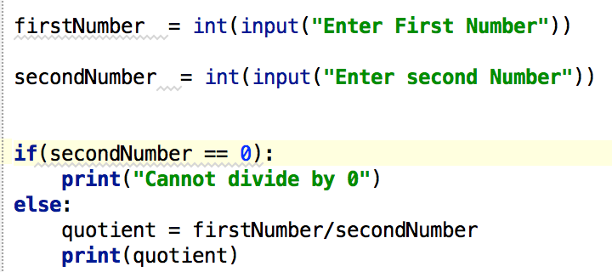
Conditionals

Slide 4
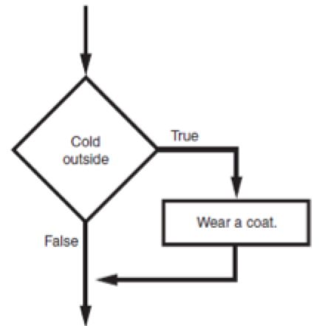
The “if” Statement

Slide 5
The “if” Statement
Python syntax
if condition:
Statement
Statement
First line is known as the if clause
Includes the keyword if followed by condition
The condition can be true or false
When the if statement executes, the condition is tested, and if it is true the block statements are executed. Otherwise, block statements are skipped

Slide 6
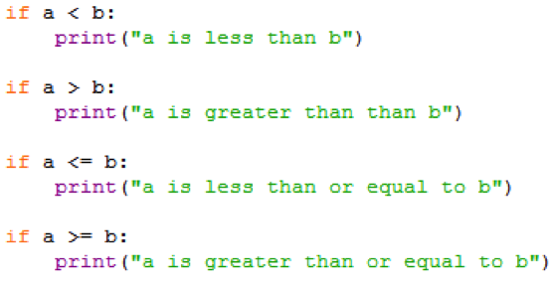
if Statement Examples

Slide 7
Boolean Expressions and Relational Operators
Boolean expression: expression tested by if statement to determine if it is true or false
Example: a > b
true if a is greater than b; false otherwise
Relational operator: determines whether a specific relationship exists between two values
Example: greater than (>)

Slide 8
Boolean Expressions and Relational Operators
Expression | Meaning
x > y | Is x greater than y?
x < y | Is x less than y?
x >= y | Is x greater than or equal to y?
x <= y | Is x less than or equal to y?
x == y | Is x equal to y?
x != y | Is x not equal to y?
== operator determines whether the two operands are equal to one another
Do not confuse with assignment operator (=)

Slide 9
Boolean Expressions and Relational Operators
Any relational operator can be used in a decision block
Example: if balance == 0
Example: if payment != balance
You can use if statements inside of functions
Statements in inner block must be indented with respect to the outer block

Slide 10
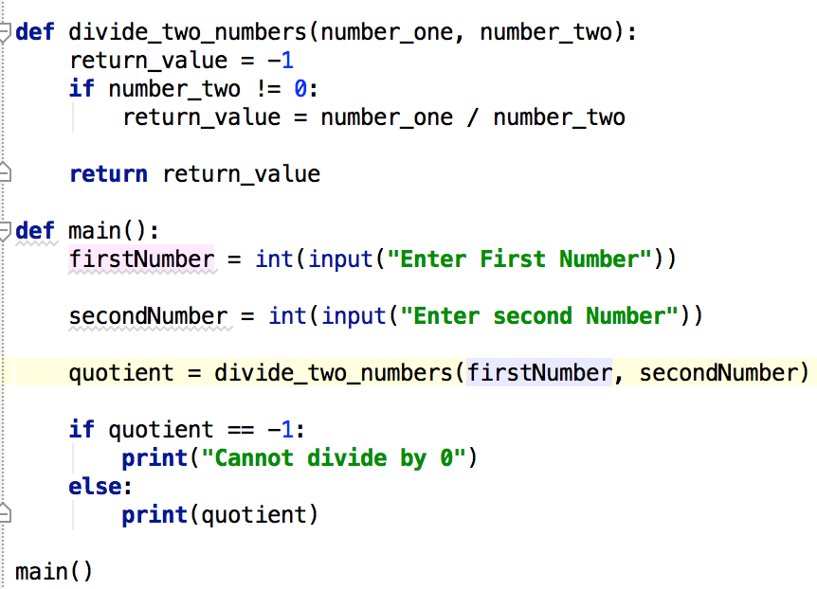
if-Statement Inside a Function

Slide 11
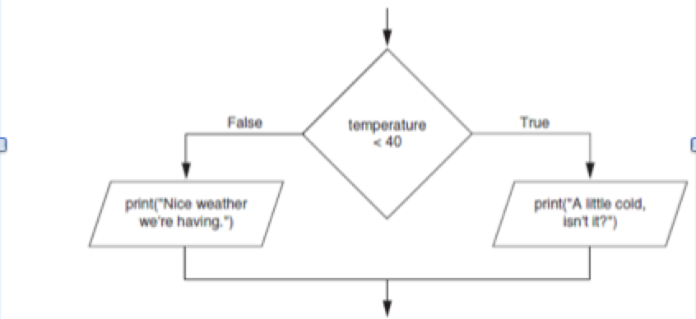
The if-else Statement

Slide 12
The if-else Statement

Slide 13
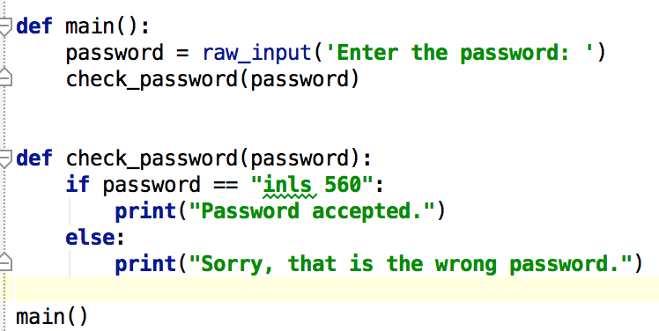
If-Else Example

Slide 14
Comparing Strings
Strings can be compared using the == and != operators
String comparisons are case sensitive
Strings can be compared using >, <, >=, and <=
Compared character by character based on the ASCII values for each character
If shorter word is substring of longer word, longer word is greater than shorter word

Slide 15
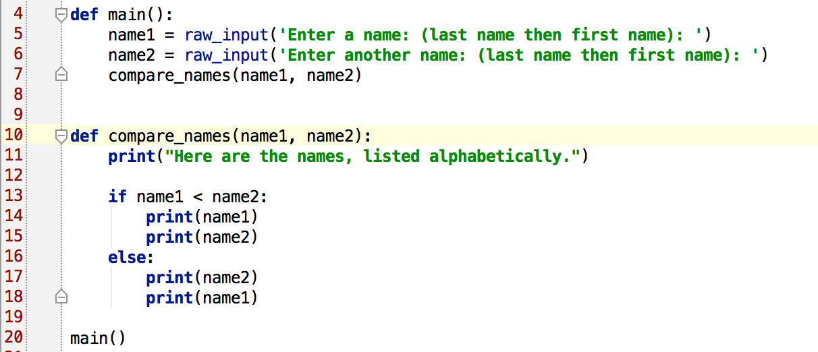
Using String Comparisons

Slide 16
Practice
Write a program that prompts a user for his or her age and prints out whether or not they are (legally) allowed to drink alcohol.
You should write 2 functions:
main – needs to prompt the user for their age
legal – needs to output if the person is of legal drinking age

Slide 17
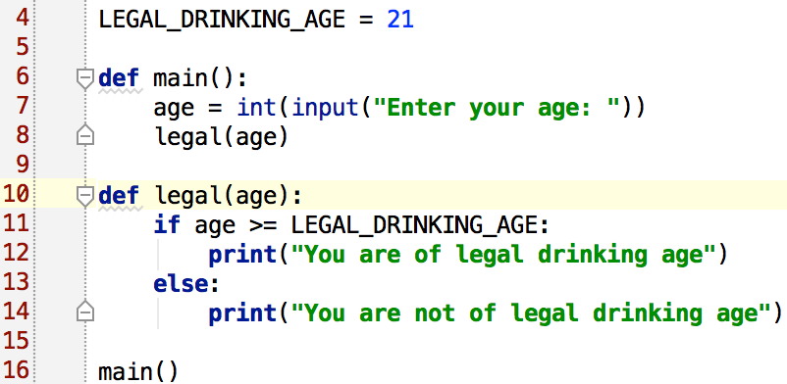
Practice Solution

Slide 18
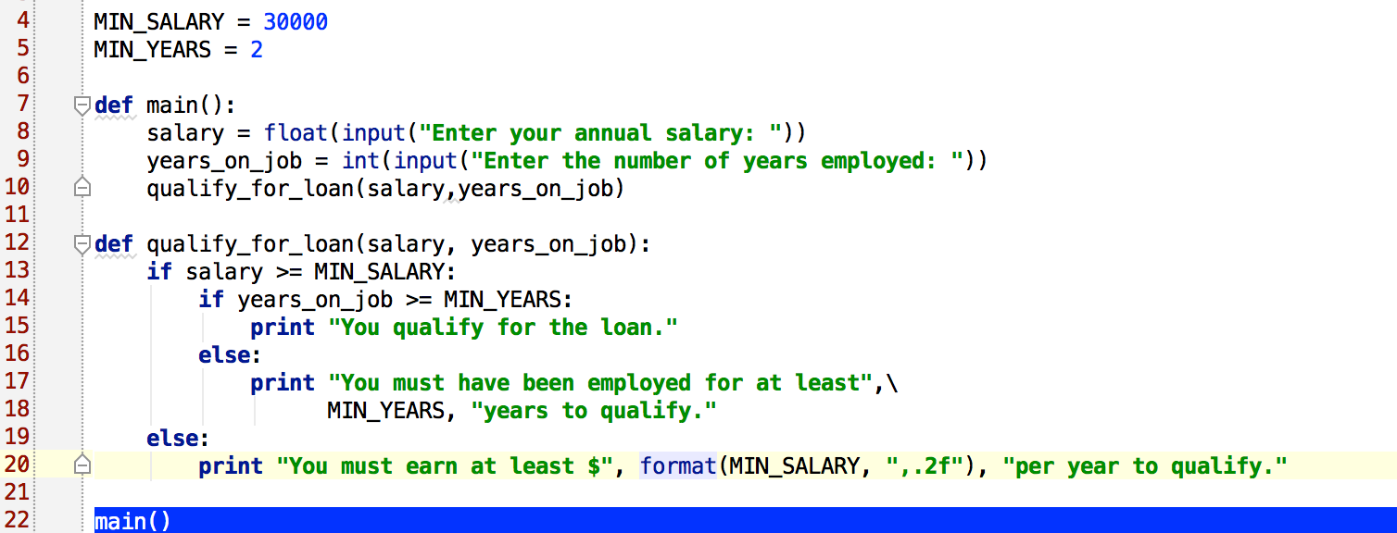
Explain what the code is doing
format(MIN_SALARY, “,.2f”)
NESTED if-else

Slide 19
Comments
Comments: notes of explanation within a program
Ignored by Python interpreter
Intended for a person reading the program’s code
Begin with a # character
End-line comment: appears at the end of a line of code
Typically explains the purpose of that line

Slide 20
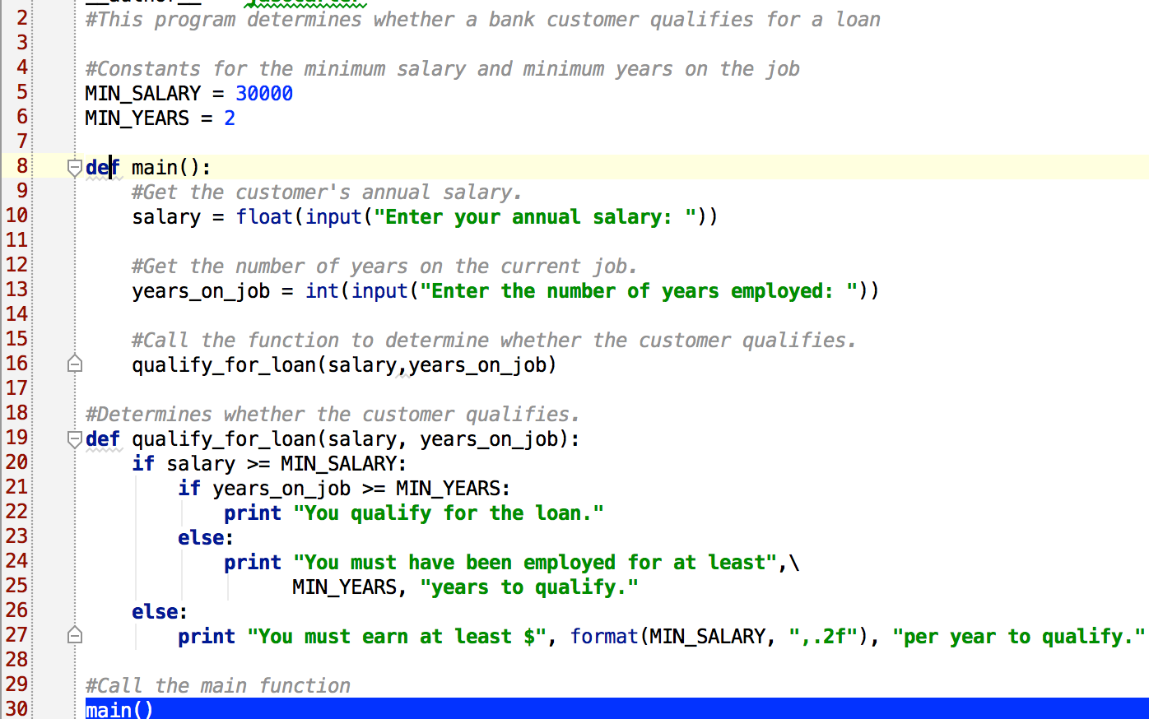
Comments Example

Slide 21
Formatting Output
format() function
Takes two arguments
First argument can be
string
float
Integer
Second argument is a format spec

Slide 22
Formatting Spec
s
string
d
integer
f
float
%.<number of digits>f - Floating point numbers with a fixed amount of digits to the right of the dot.
For each type (string, integer,float), one can specify the number of characters (strings) or digits (integer, float) to display

Slide 23
Formatting Strings

Slide 24
Formatting Integers and Floats
Integer
Float

Slide 25
Nested if-else

Slide 26
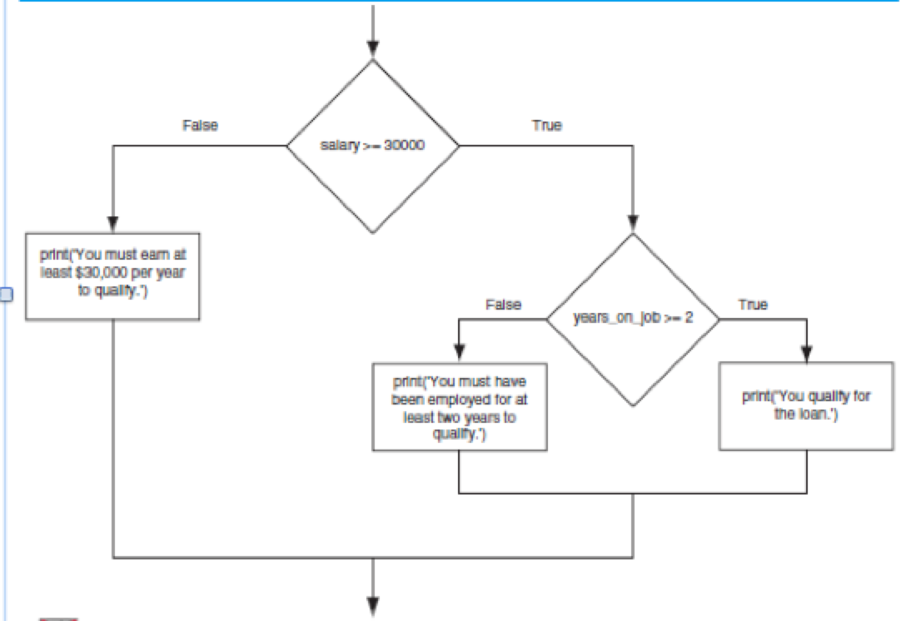
Nested Decision Structure

Slide 27
Nested Decision Structures and the if-elif-else Statement
A decision structure can be nested inside another decision structure
Commonly needed in programs
Example:
Determine if someone qualifies for a loan, they must meet two conditions:
Must earn at least $30,000/year
Must have been employed for at least two years
Check first condition, and if it is true, check second condition

Slide 28
Nested Decision Structures and the if-elif-else Statement
Important to use proper indentation in a nested decision structure
Important for Python interpreter
Makes code more readable for programmer
Rules for writing nested if statements:
else clause should align with matching if clause
Statements in each block must be consistently indented

Slide 29
if-elif-else statement
if-elif-else statement: special version of a decision structure
Makes logic of nested decision structures simpler to write
Can include multiple elif statements
Syntax: if condition1
statements
elif condition2
statements
else
statements

Slide 30
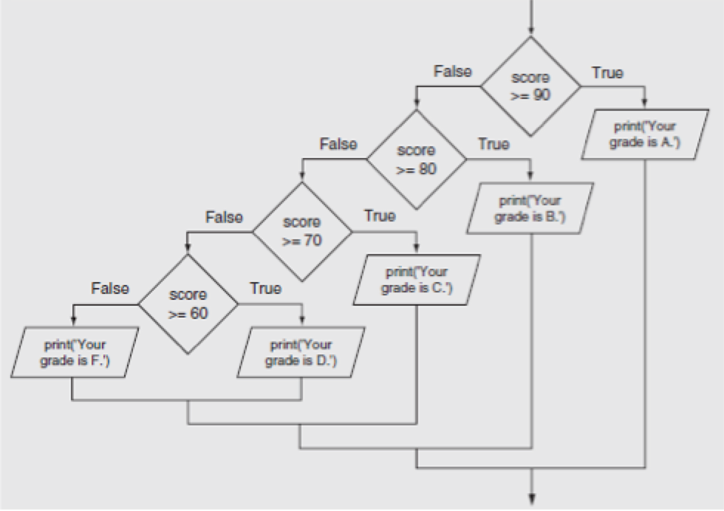
Nested Decision Structure to Determine a Grade

Slide 31
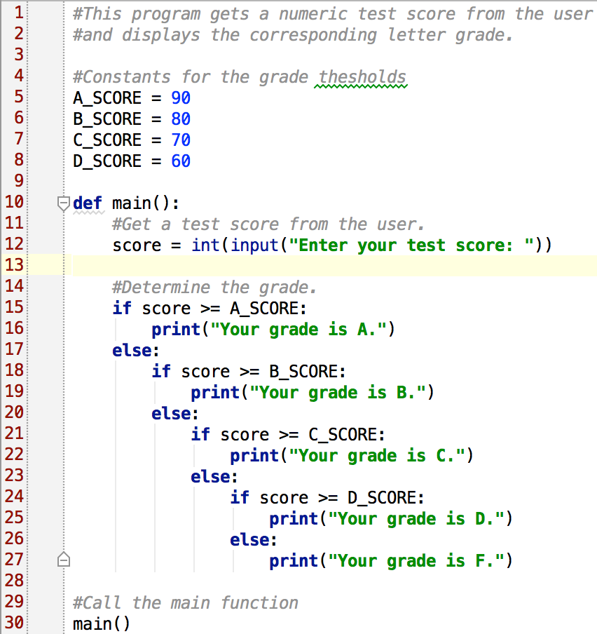

Slide 32
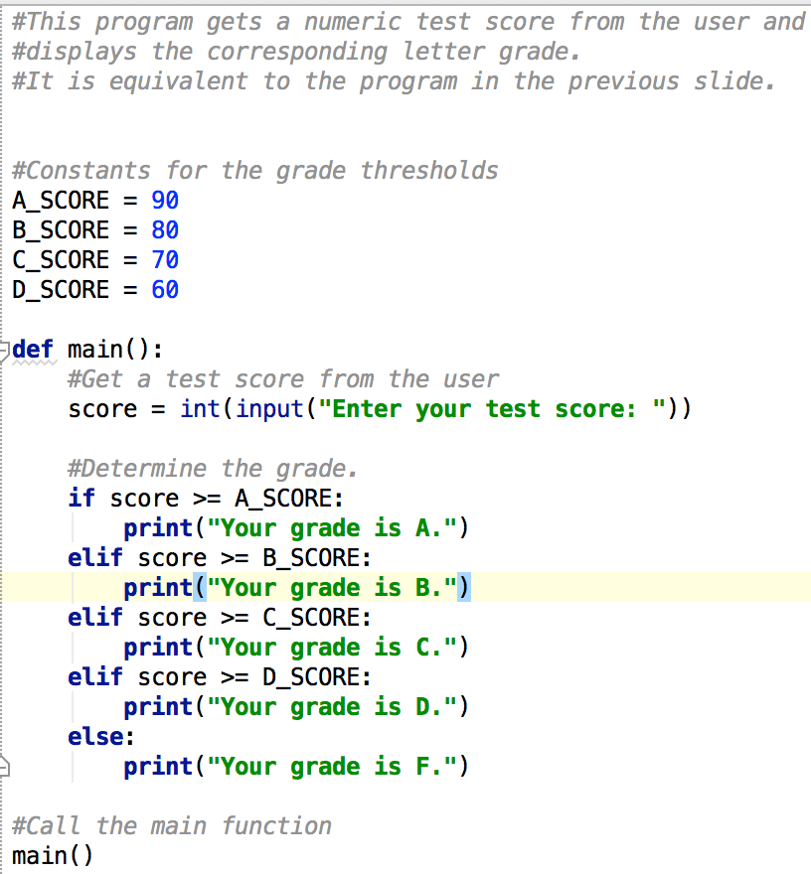

Slide 33
Logical Operators
Logical operators: operators that can be used to create complex Boolean expressions
and operator and or operator: binary operators, connect two Boolean expressions into a compound Boolean expression
not operator: unary operator, reverses the truth of its Boolean operand

Slide 34
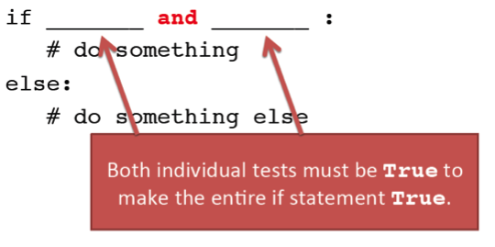
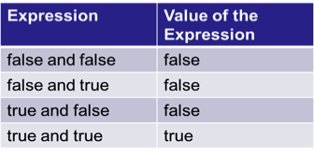
The and Operator
Truth table for the and operator

Slide 35
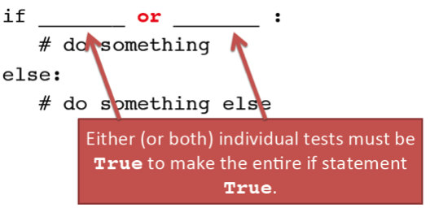
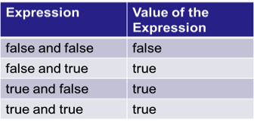
The or Operator
Truth table for the or operator

Slide 36
Short-Circuit Evaluation
Short circuit evaluation: deciding the value of a compound Boolean expression after evaluating only one sub expression
Performed by the or
If left operand is true, compound expression is true. Otherwise, evaluate right operand
Performed by the and
If left operand is false, compound expression is false. Otherwise, evaluate right operand
Notes:
if x >= 5 and x <= 10: # show with inputs 6, 4, 12
if x <= 10 or x >= 65: # show with inputs 10, 45, 66

Slide 37
The not Operator
Takes a Boolean expression as operand and reverses its logical value
Sometimes it may be necessary to place parentheses around an expression to clarify to what you are applying the not operator
Truth table for the not operator

Slide 38
Checking Numeric Ranges with Logical Operators
To determine whether a numeric value is within a specific range of values, use and
Example: x >= 10 and x <= 20
To determine whether a numeric value is outside of a specific range of values, use or
Example: x < 10 or x > 20

Slide 39
Boolean Variable
Boolean variable: references one of two values, True or False
Represented by bool data type
Commonly used as flags
Flag: variable that signals when some condition exists in a program
Flag set to False → condition does not exist
Flag set to True → condition exists

Slide 40
Review Questions
Does an if statement always need to be followed by an else statement?
If you write an if-else statement, under what circumstances do the statements that appear after the else clause execute?
Assume the variables a = 2, b = 4, c = 6. What do the following statements evaluate to (true or false)?
a == 4 or b > 2
6 <= c and a > 3
1 != b and c != 3
a >= -1 or a <= b
not (a > 2)

Slide 41
Practice
Write a program that asks the user when their birthday is (month and day of month as ints). Then print a message telling them if their birthday has already passed this year, is yet to come this year, or is today.
You should write 2 functions:
main: prompts the user for their birth month and day, calls birthdayMessage
birthdayMessage: takes in the birth month and day and outputs a message about their birthday

