Slide 1
INLS 560 – Functions
Instructor: Jason Carter
Notes:
Functions

Slide 2
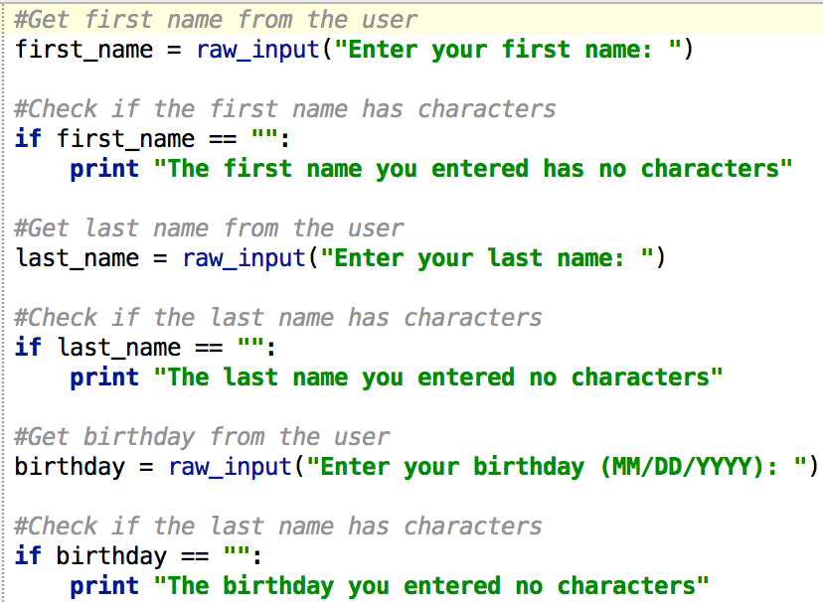

Slide 3
Change the Program
Change the lines that say
“The first name you entered has no characters”
“The last name you entered has no characters”
“The birthday you entered has no characters”
TO
Lines that say
“The first name you entered is empty”
“The last name you entered is empty”
“The birthday you entered is empty”

Slide 4
Make changes 3 places

Slide 5
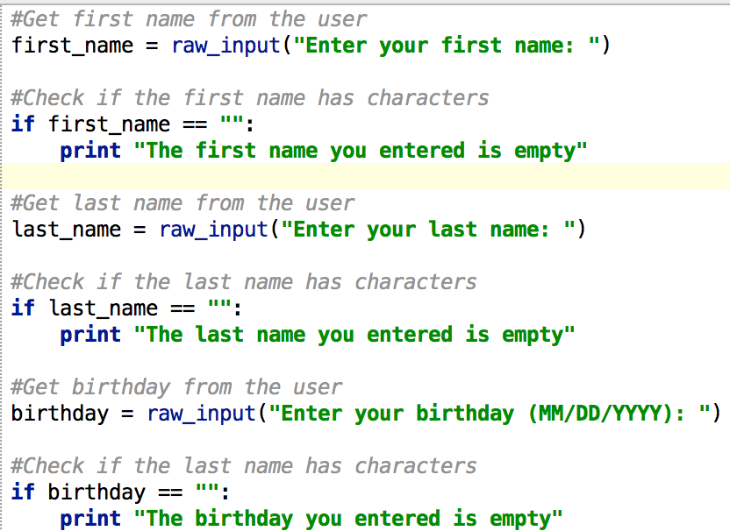

Slide 6
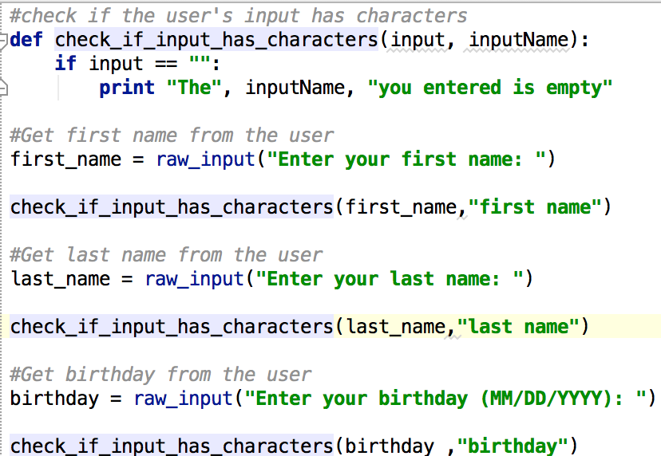

Slide 7
Why Functions?
Makes your program easier to read and debug.
Groups statements
If changes have to be made, only one place to make them in
Reduce repetitive code.
Makes programs smaller.
Reuse
Well-designed functions are often useful for many programs
Debug once

Slide 8
Function
A named sequence of statements that performs a computation
Pick a name for a function that describes what it does just like variable names
Usually one task of a large program
Functions can be executed in order to perform overall program task
Known as divide and conquer approach
Modularized program: program wherein each task within the program is in its own function
Function
Input
Output

Slide 9
Divide and Conquer
Program to make dinner
make_appetizier()
make_salad()
make_entrée()
make_dessert()

Slide 10
Two Types of Functions
Built-in
User defined

Slide 11
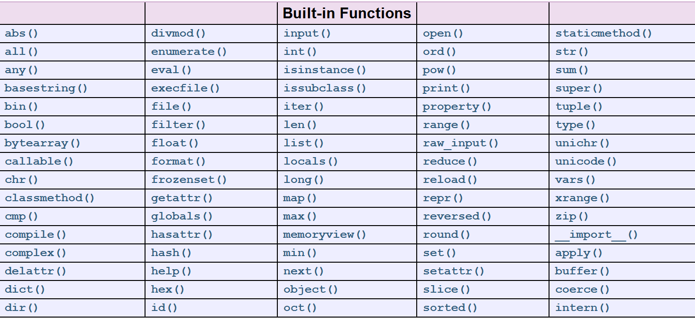
Built-in Functions
https://docs.python.org/2/library/functions.html#

Slide 12
Built-in Functions
To use functions we call them
print “Hello World”
print (“Hello World”)
print
Input
Output
What is the input to the print function?
“Hello World”
What is the output of the print function?
Printing the words Hello World to the console

Slide 13
Built-in Functions
len
Return the length (the number of items) of an object. The argument may be a sequence (such as a string, bytes, tuple, list, or range) or a collection (such as a dictionary, set, or frozen set).
len(“Hello World”)
print
Input
Output
What is the input to the len function?
“Hello World”
What is the output of the len function?
11

Slide 14
Built-in Functions
abs
Return the absolute value of a number. The argument may be a plain or long integer or a floating point number. If the argument is a complex number, its magnitude is returned
abs(-4.5)
abs
Input
Output
What is the input to the abs function?
-4.5
What is the output of the len function?
4.5

Slide 15
Built-in Functions
Print the length of the string “Hello World” to the console
print(len(“Hello World”))
length = len(“Hello World”);
print(length )
Print the absolute value of -4.5 to the console
print(abs(-4.5))
abs_value= abs(-4.5)
print(abs_value)

Slide 16
Two Types of Functions
Built-in
User defined

Slide 17
User Defined Functions
Function Header
def name():
statement
statement
statement
Notice how the statements are indented!!!
This is how python knows where a function begins and ends

Slide 18
Indentation
Each block must be indented
Lines in block must begin with the same number of spaces
Use tabs or spaces to indent lines in a block, but not both as this can confuse the Python interpreter
Pycharm automatically indents the lines in a block
Blank lines that appear in a block are ignored

Slide 19
Calling User Defined Functions
After defining a function, to run the code inside, you call the function.
When a function is called:
Interpreter jumps to the function and executes statements in the block
Interpreter jumps back to part of program that called the function

Slide 20
Flow of Execution
The order in which statements are executed
Execution always begins at the first statement of the program
Statements are executed one at a time, in order from top to bottom.
name():
statement
statement
statement
name()
Execution starts here

Slide 21
Calling User Defined Functions
name():
statement
statement
statement
name()
name()
After defining a function, you can call it any number of times
Each time it is called Python acts as if you had typed in all the lines of the function definition
A function call must come after the function definition!

Slide 22
main() Function
From this point on, always define a main() function in your programs
Always call the main()function as the last line in your program.
main function: called when the program starts
Calls other functions when they are needed
Defines the mainline logic of the program

Slide 23
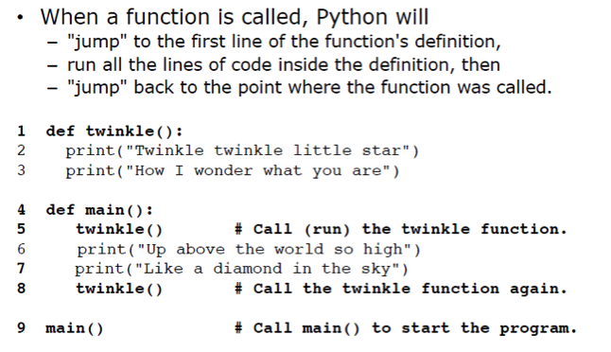
Example User Defined Functions

Slide 24
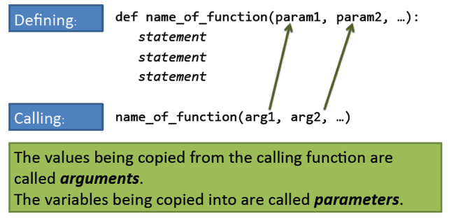
Arguments and Parameters
User Defined functions can take input just like built-in functions

Slide 25
Example Arguments and Parameters

Slide 26
Local Variable
Local variable: variable that is assigned a value inside a function
Belongs to the function in which it was created
Only statements inside that function can access it, error will occur if another function tries to access the variable
Scope: the part of a program in which a variable may be accessed
For local variable: function in which created

Slide 27
Local Variable
A local variable cannot be accessed by statements inside its function which precede its creation
Different functions may have local variables with the same name
Each function does not see the other function’s local variables, so no confusion

Slide 28
Example

Slide 29
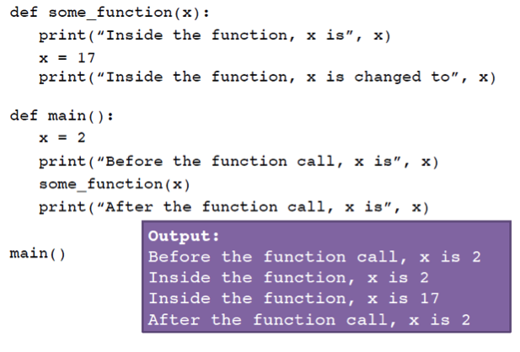
Example
Notes:
Changes made to a parameter value within the function do not affect the argument
Known as pass by value
Provides a way for one-way-only communication between one function and another function
Calling function can communicate with called function

Slide 30
Example

Slide 31
Parameters are Local Variables
“That sounds like local variables.”
Just as local variables are invisible outside of the function that owns them, variables used as parameters inside a function definition are local to that function.
Parameters in a function definition are really local variables that are created and assigned values automatically when the function is called.

Slide 32
Types of Functions
User defined functions has output like built-in functions
Output can be
printed something to the console or screen
Functions that return a value are called “fruitful functions”
Functions that do not return a value are called void functions

Slide 33
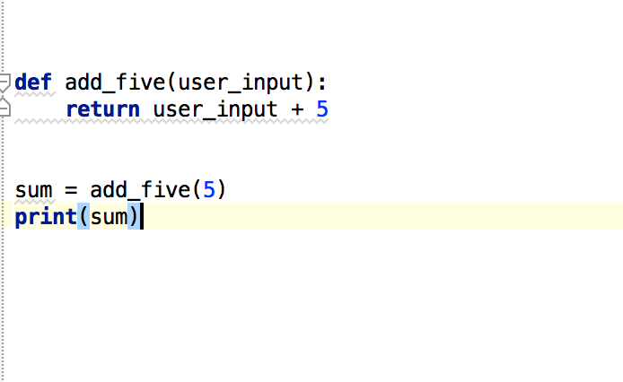
Fruitful Functions
Return keyword

Slide 34
Void Functions

Slide 35
In-Class Example
Using functions, write a program that prompts the user for 3 numbers and outputs the average of those numbers.

Slide 36
Global Variables
Global variable: created by assignment statement written outside all the functions
Can be accessed by any statement in the program file, including from within a function
DO NOT USE GLOBAL VARIABLES!
Global variables making debugging difficult
Many locations in the code could be causing a wrong variable value
Functions that use global variables are usually dependent on those variables
Makes function hard to transfer to another program
Global variables make a program hard to understand!

Slide 37
Global Constants
Global constant: global name that references a value that cannot be changed
OK to use global constants in a program
To simulate global constant in Python, create global variable and do not re-declare it within functions

Slide 38
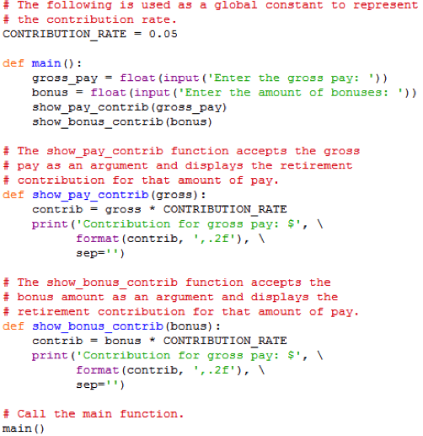
Global Constant Example

Slide 39
In-Class Example
Write a Python program that asks the user to input 2 numbers and outputs the sum of those numbers.
Use 2 functions
main(): - Prompts the user to enter 2 numbers and calls sum()
sum(): - Takes in 2 parameters and outputs the sum of those numbers

