Slide 1
INLS 560 – Relational DATABASES
Instructor: Jason Carter
Notes:
Functions

Slide 2
Input and Output
Input from the keyboard:
Output to the console:

Slide 3
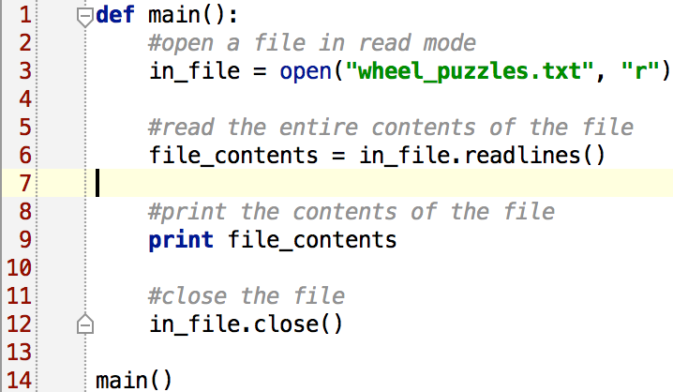
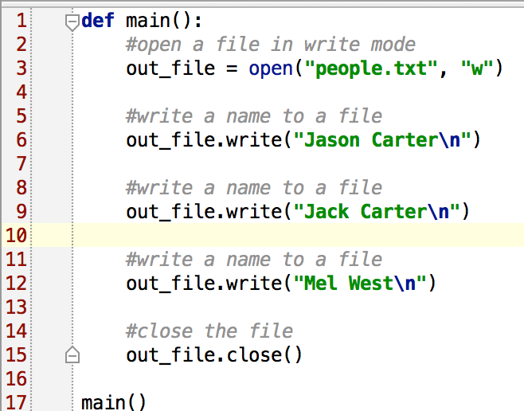
Input and Output
Input from flat files
Output from files

Slide 4
Input and Output
Databases
Relational
Graph
Object-oriented

Slide 5
Relational Databases
Model data by storing rows and columns in tables
Efficiently retrieve data from those tables and in particular where there are multiple tables and the relationships between those tables involved in the query.

Slide 6
Relational Database Systems in Wide Use
Three Major Database Management Systems in wide use
Oracle - Large, commercial, enterprise-scale, very very tweakable
MySql - Simpler but very fast and scalable - commercial open source
SqlServer - Very nice - from Microsoft (also Access)
Postgres – Open source, enterprise scale
SQLite – Very small, mostly used for one user

Slide 7
Terminology
Database - Contains many tables
Table - contains rows and columns
Row - is a set of fields it generally represents an “object” like a person or a music track
Column- One of possibly many elements of data corresponding to the object represented by the row

Slide 8
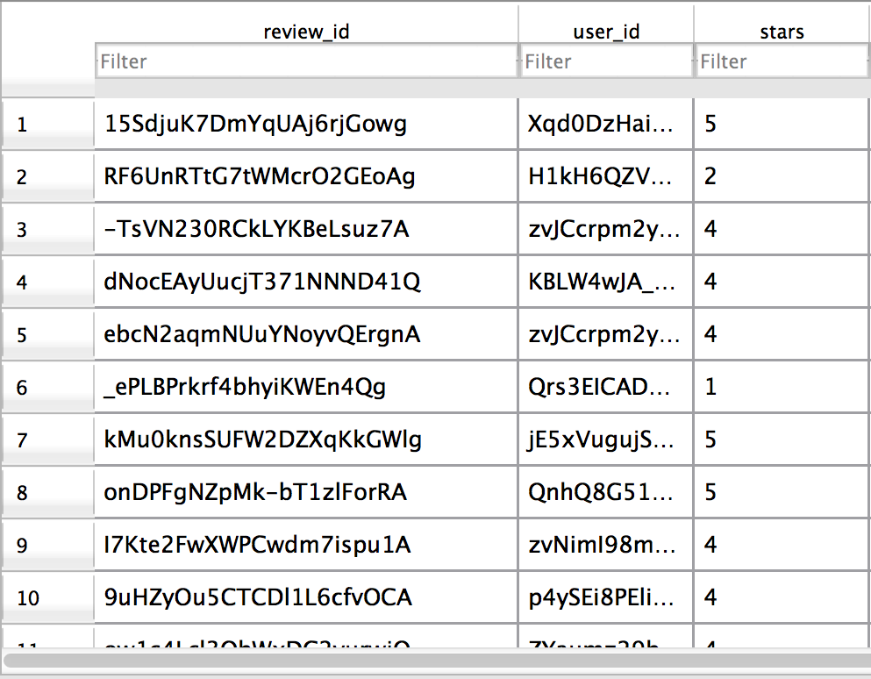
Table
Columns
Rows

Slide 9
SQLite Database Manager
SQLite is a very popular database - it is free and fast and small
There are many programs to manage/manipulate SQL Databases
http://sqlitebrowser.org/
SQLite is embedded in Python and a number of other languages

Slide 10
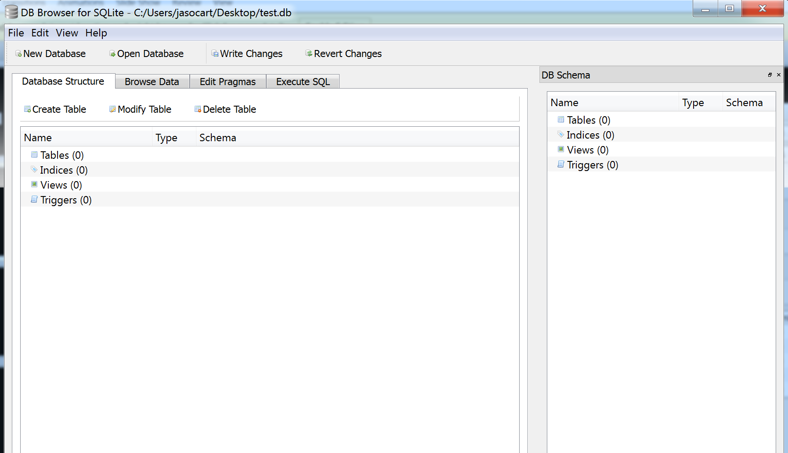
SQLite Database Manager (cont’d)

Slide 11
Start Simple - A Single Table
Lets make a table of People - with a Name and an E-Mail

Slide 12
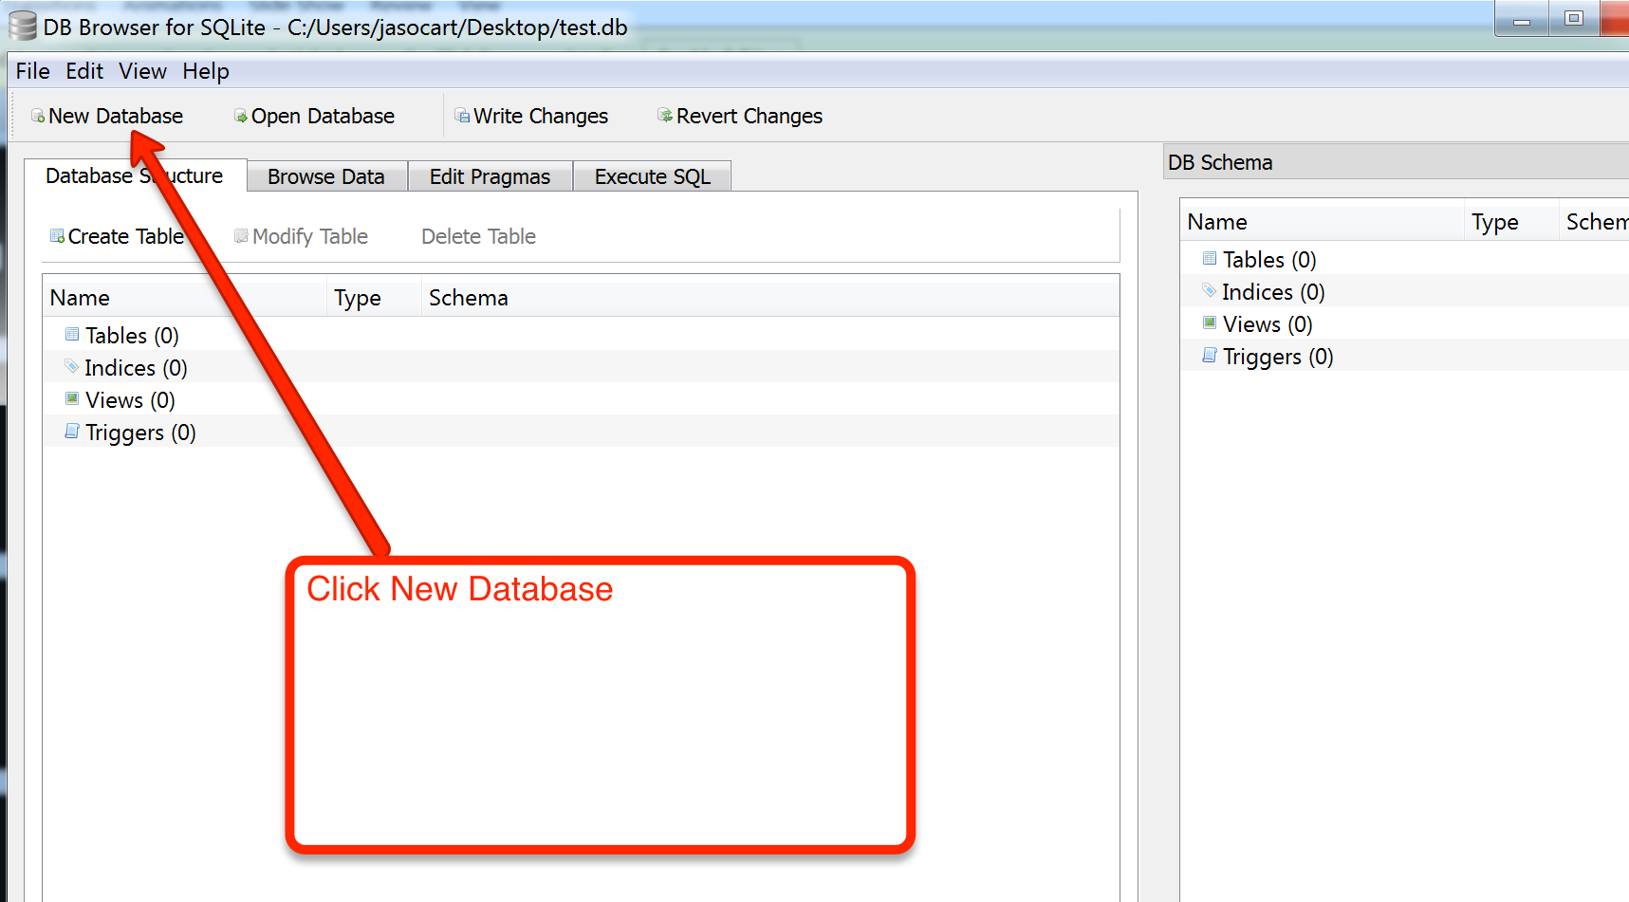
Click New Database

Slide 13
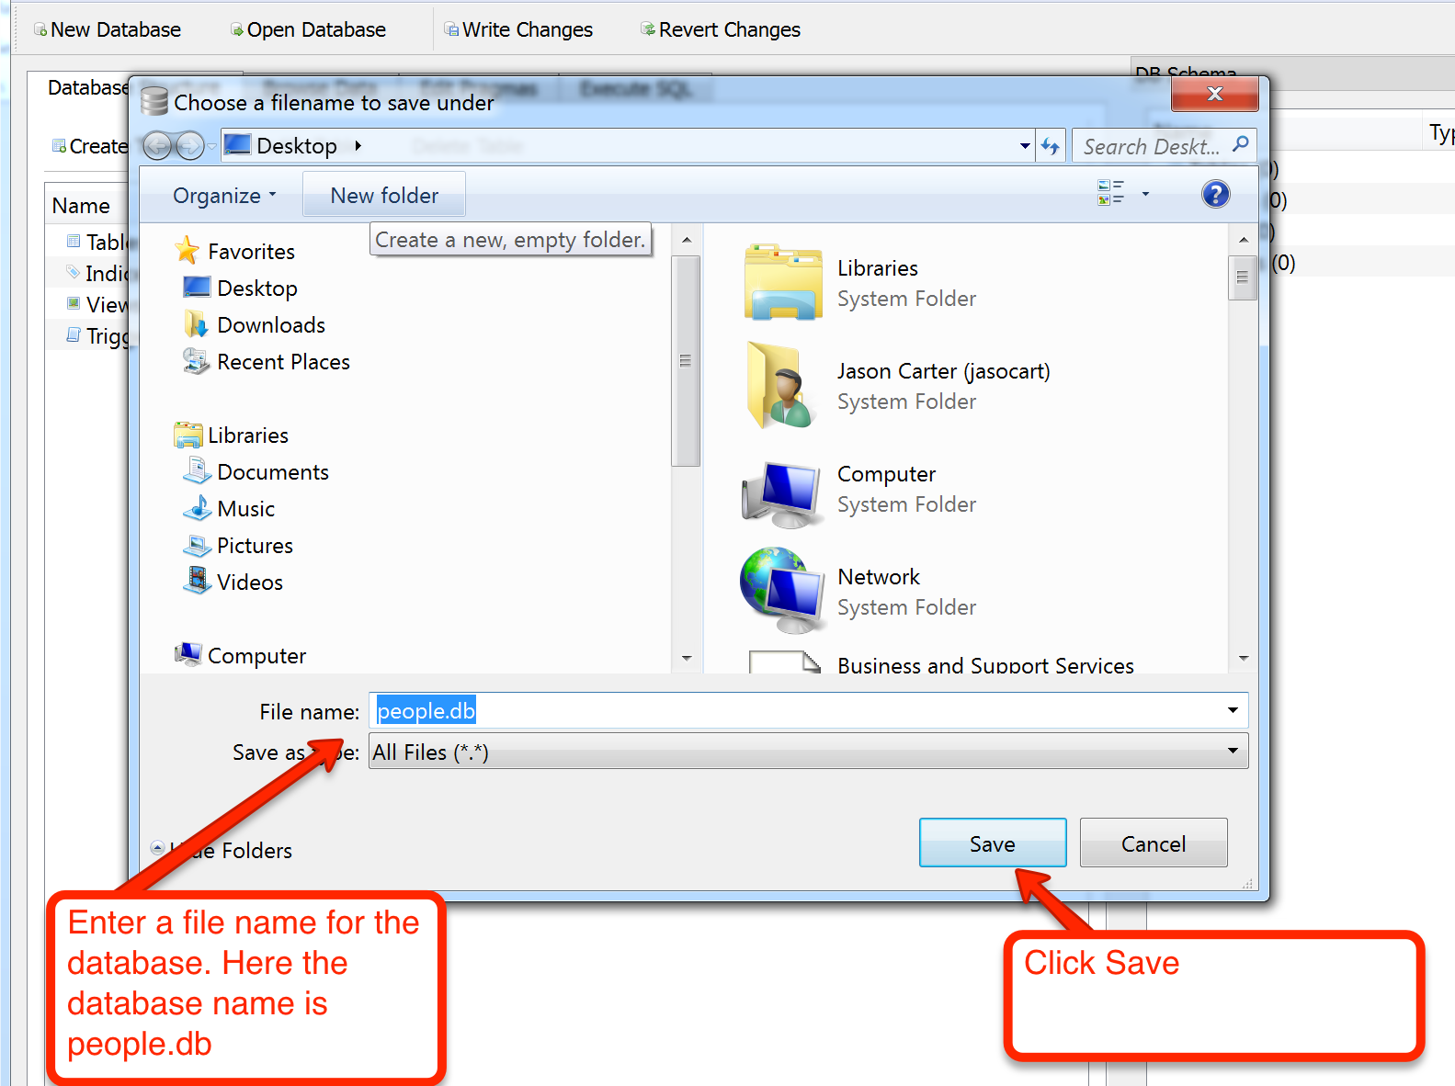
Enter a File Name for the Database

Slide 14
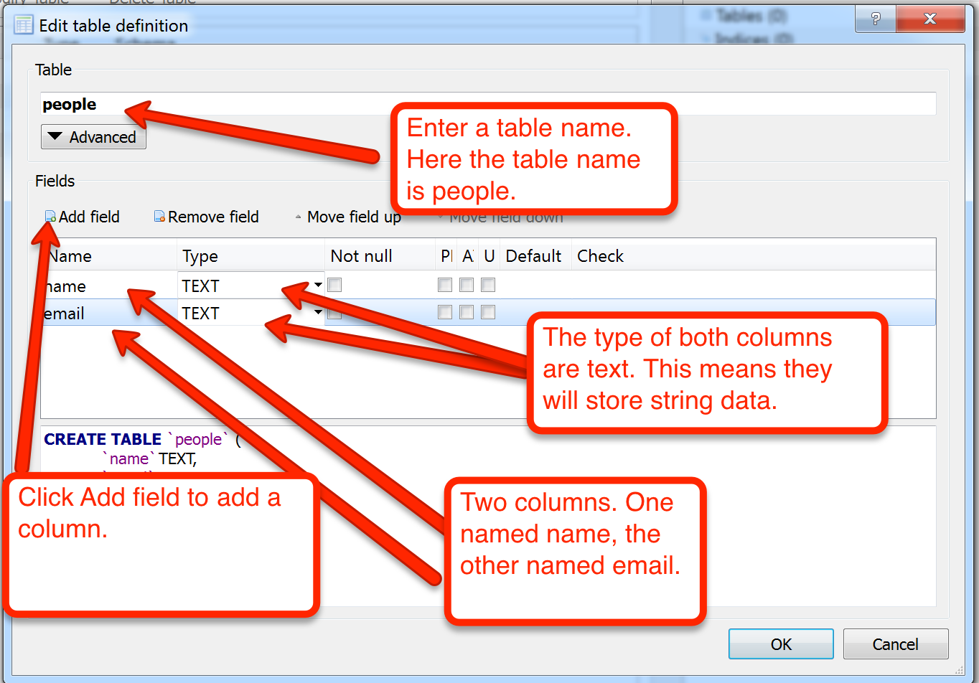
Create a Table
Make sure you click OK.

Slide 15
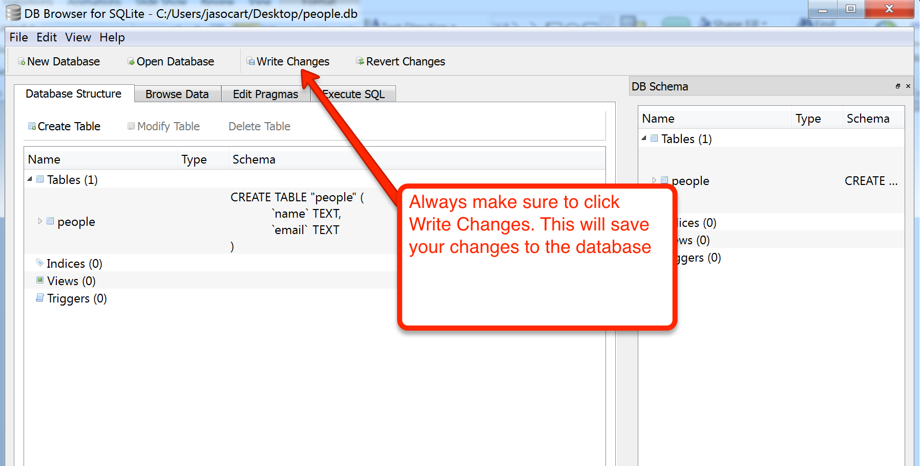
Saving Changes

Slide 16
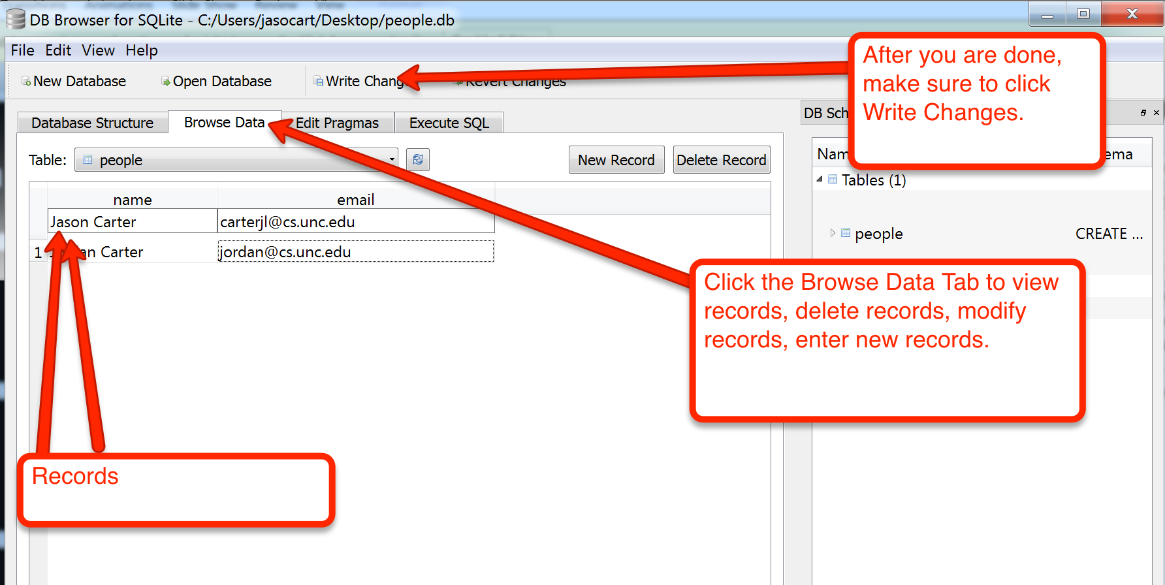
Entering Data

Slide 17
Structured Query Language (SQL)
Structured Query Language: the language we use to issue commands to the database
Create a table
Retrieve some data
Insert data
Delete data
Update data

Slide 18
Retrieving Records: select Statement
The select statement retrieves a group of records - you can either retrieve all the records or a subset of the records with a WHERE clause
select * from table_name
select * from people
select * from table_name where column_name = ‘value’
select * from people where email = ‘carterjl@cs.unc.edu’

Slide 19
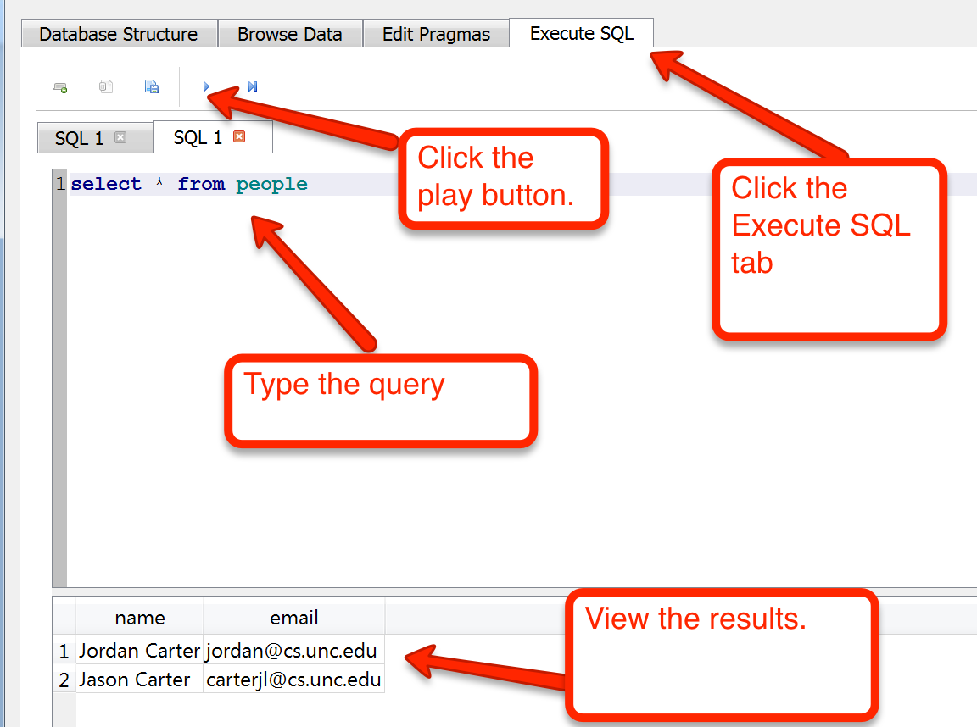
Executing a Select Query

Slide 20
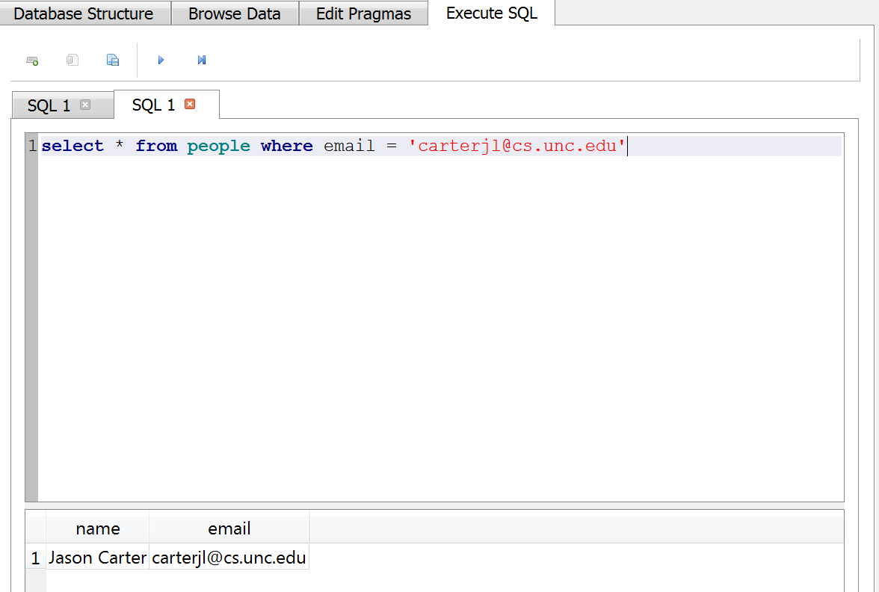
Executing a Select Query

Slide 21
Inserting Records: Insert Statement
The Insert statement inserts a row into a table
insert into table_name (column_name, column_name) values (‘Jack Carter’, ‘jack@gmail.com’)
insert into people (name, email) values (‘Jack Carter’, ‘jack@gmail.com’)

Slide 22
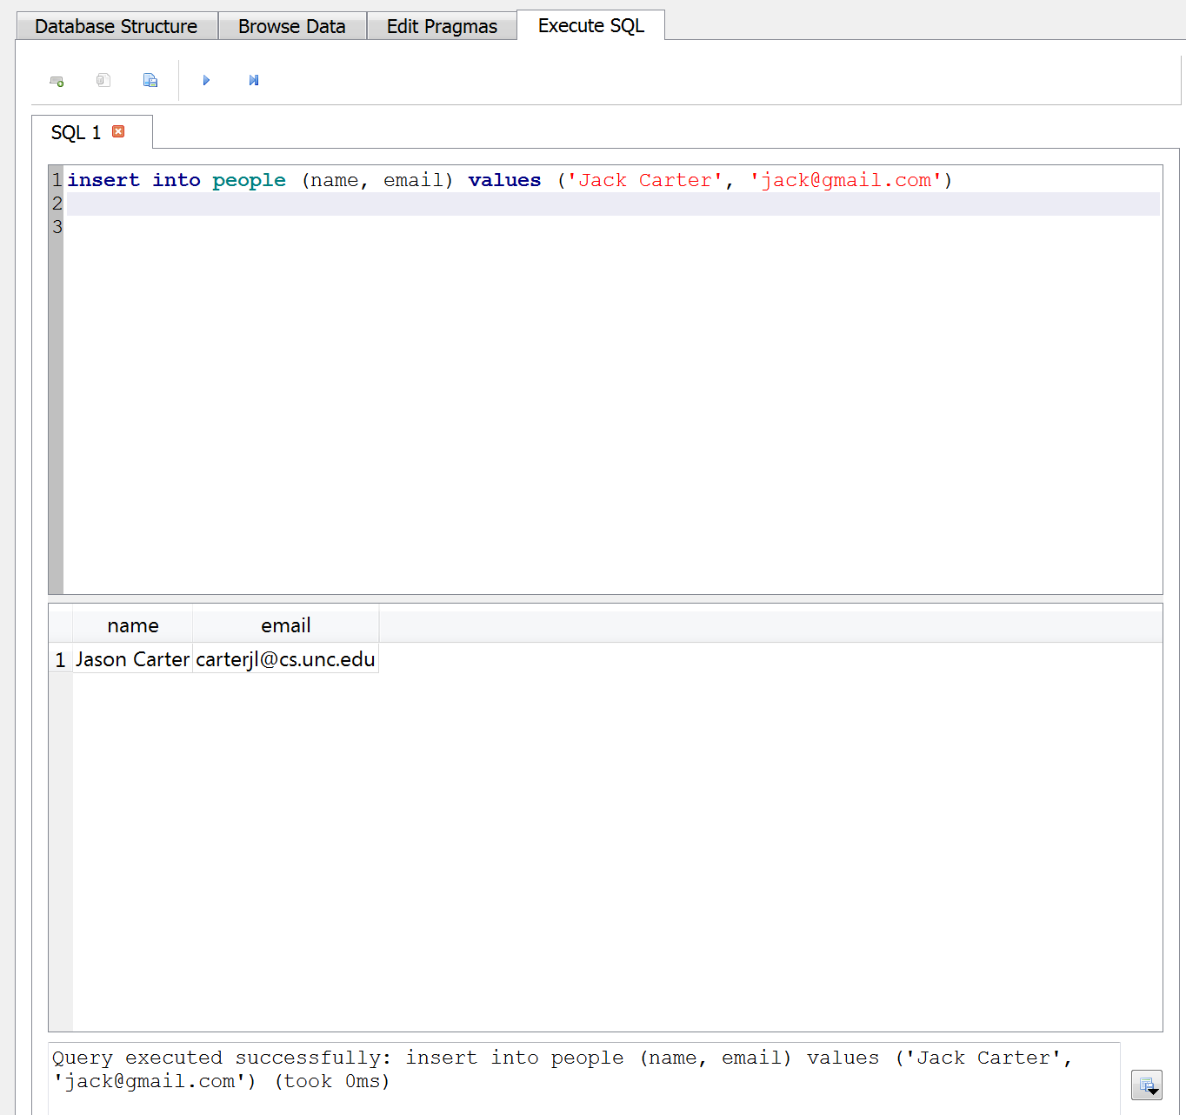
Executing An Insert Query

Slide 23
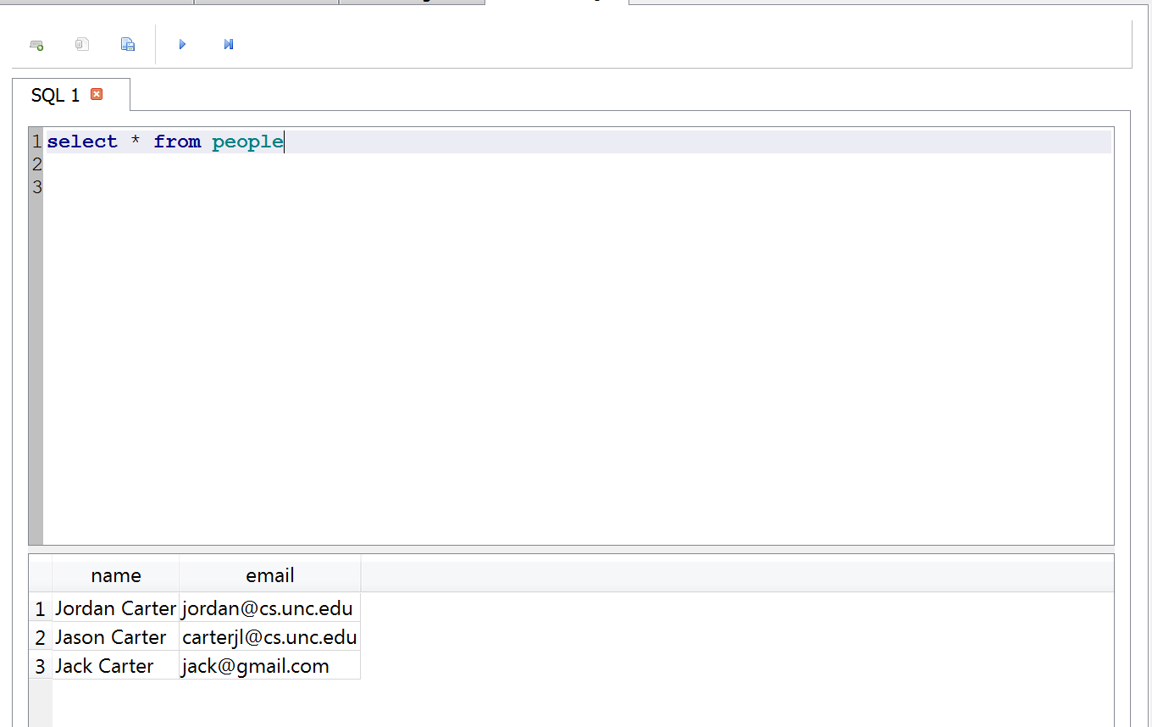
Viewing Results of Insert Query

Slide 24
Updating and Deleting Records From Databases
Update:
update table_name set column_name = “value” where column_name = “value”
update people set name= “John Carter” where email= “johncarter@gmail.com”
Delete:
delete from table_name where column_name = “value”
delete from people where name= “John Carter”

Slide 25
SQL Summary
select * from people
select * from people where email = ‘carterjl@cs.unc.edu’
insert into people (name, email) values (‘Jack Carter’, ‘jack@gmail.com’)
update people set name= “John Carter” where email= “johncarter@gmail.com”
delete from people where name= “John Carter”

Slide 26
This is not too exciting (so far)
Tables pretty much look like big fast programmable spreadsheet with rows, columns, and commands
The power comes when:
We have more than one table and we can exploit the relationships between the tables
Programmatically manipulate tables

Slide 27
Complex Data Models and Relationships

Slide 28
Database Design
Database design is an art form of its own with particular skills and experience
Our goal is to avoid the really bad mistakes and design clean and easily understood databases
Others may performance tune things later
Database design starts with a picture...

Slide 29
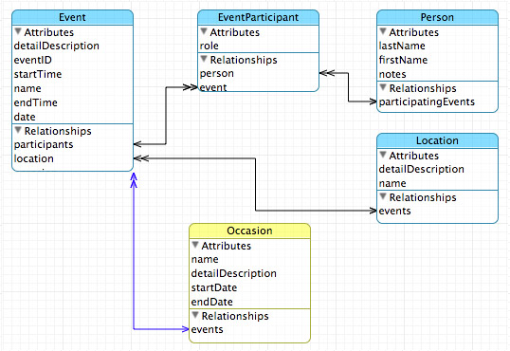

Slide 30
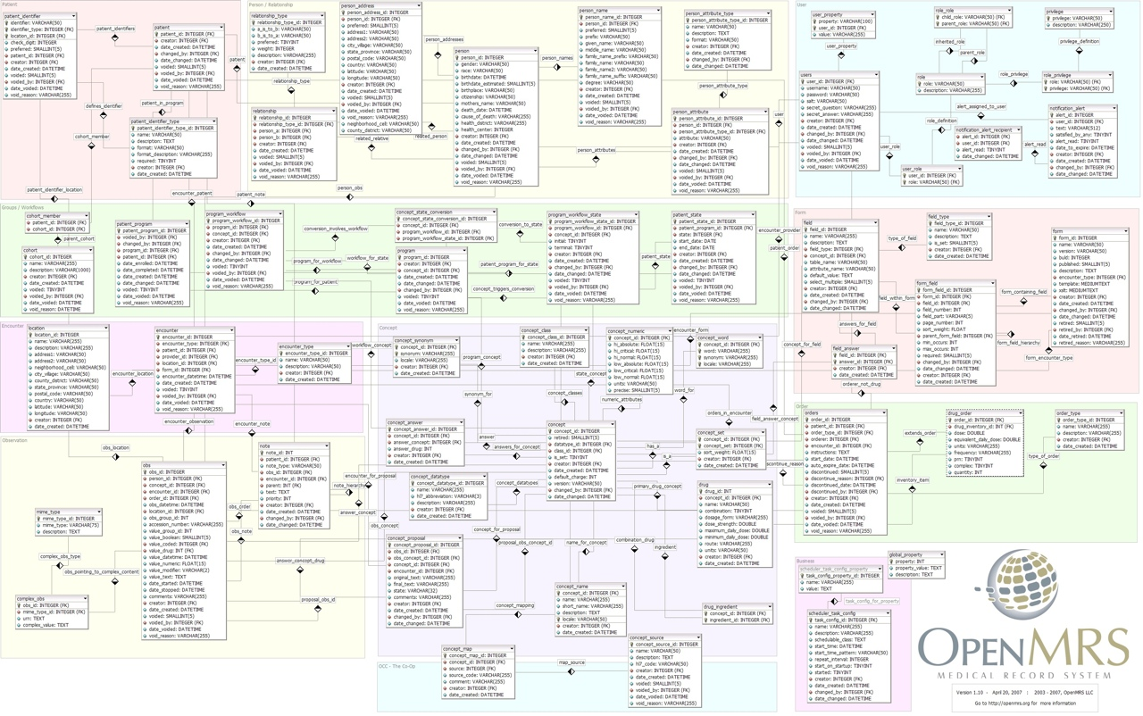

Slide 31
Programmatically Manipulate Tables

Slide 32
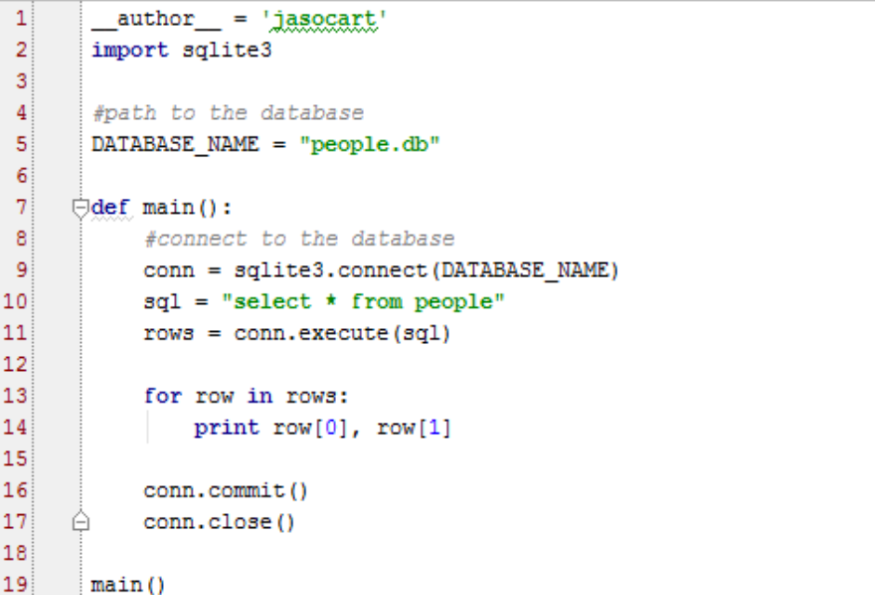
Retrieving All Records From A Database Table Using Python

Slide 33
Retrieving All Records From A Database Table Using Python Output

Slide 34
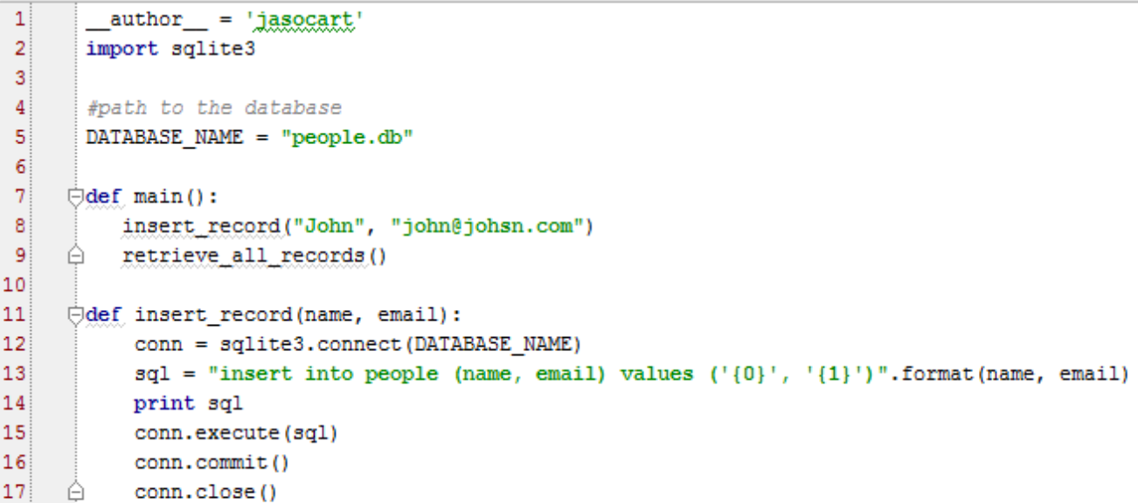
Inserting Data into A Database Table Using Python

Slide 35
Inserting Data into A Database Table Using Python Output

Slide 36
Practice
Create a database named Products.
Create a table named products. Create rows for products (product_id, product_name).
Write code that inserts data into the products table.
Write code that retrieves data from the products table

Slide 37
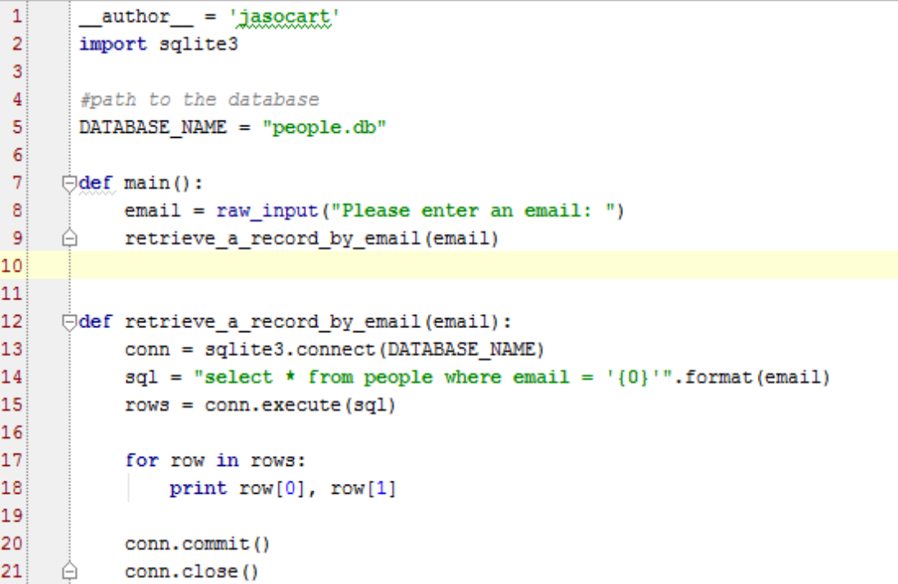
Retrieving Specific Records From A Database Table Using Python

Slide 38
Retrieving Specific Records From A Database Table Using Python Output

Slide 39
Practice
Write code updates a record (the product name) using a product id.
Write code deletes a record using a product id.

