Slide 1
Python Interpreter and Pycharm Community Edition

Slide 2
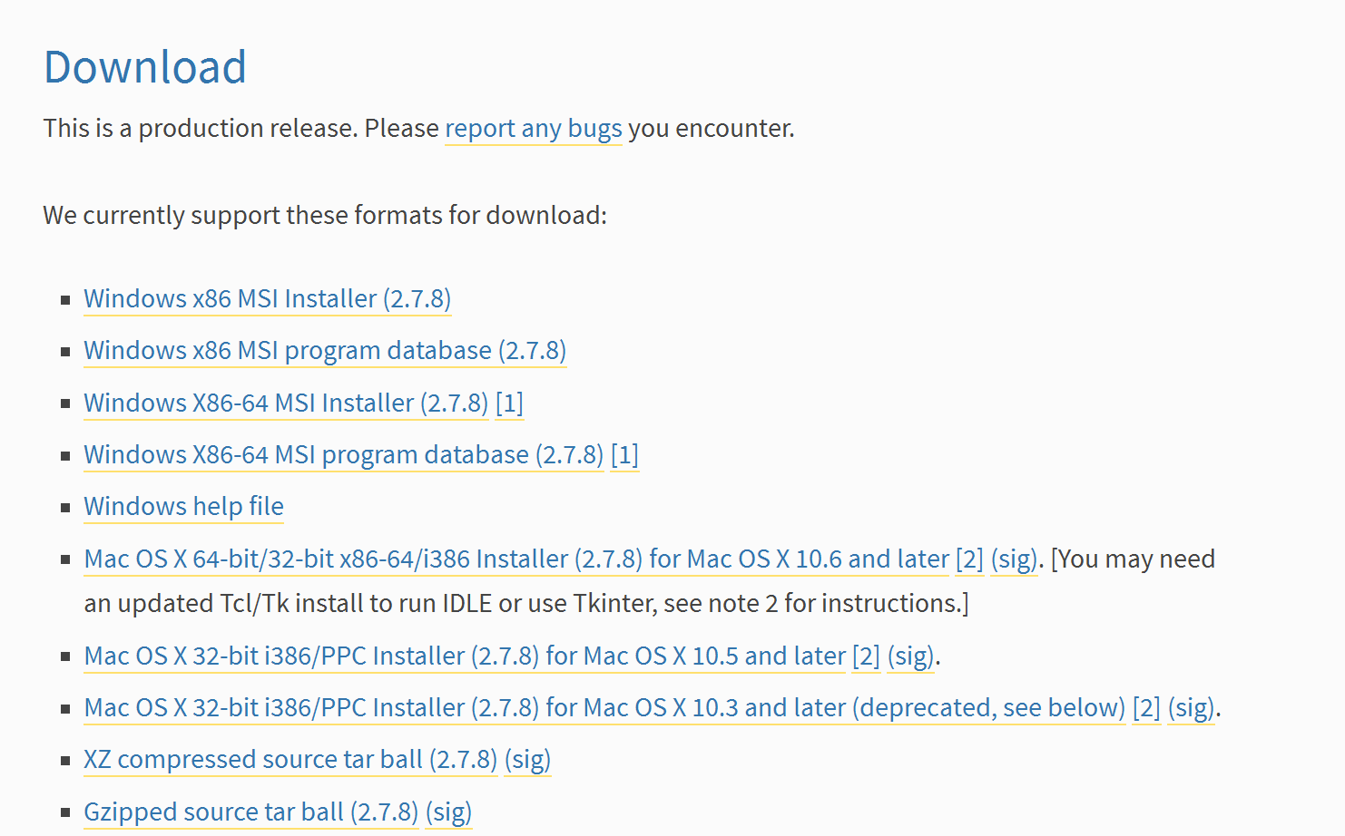
Download the Python Interpreter
In your browser go to https://www.python.org/download/releases/2.7.8/
Scroll Down to the Download Section
Choose the version of python that matches your OS
For windows choose the MSI installer and not the program database

Slide 3
Install Python Interpreter
Click next on all prompts until the software is installed

Slide 4
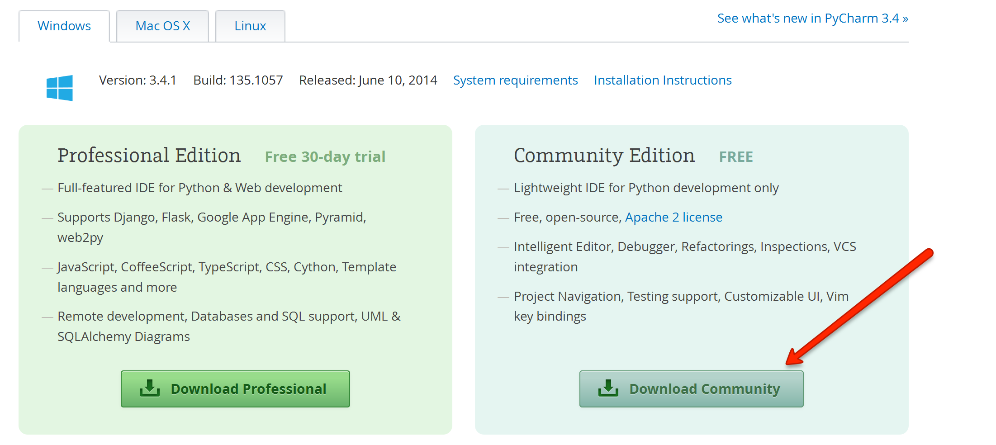
Download Pycharm Community Edition
In your browser go to http://www.jetbrains.com/pycharm/download/
Click the Download Community button on the right

Slide 5
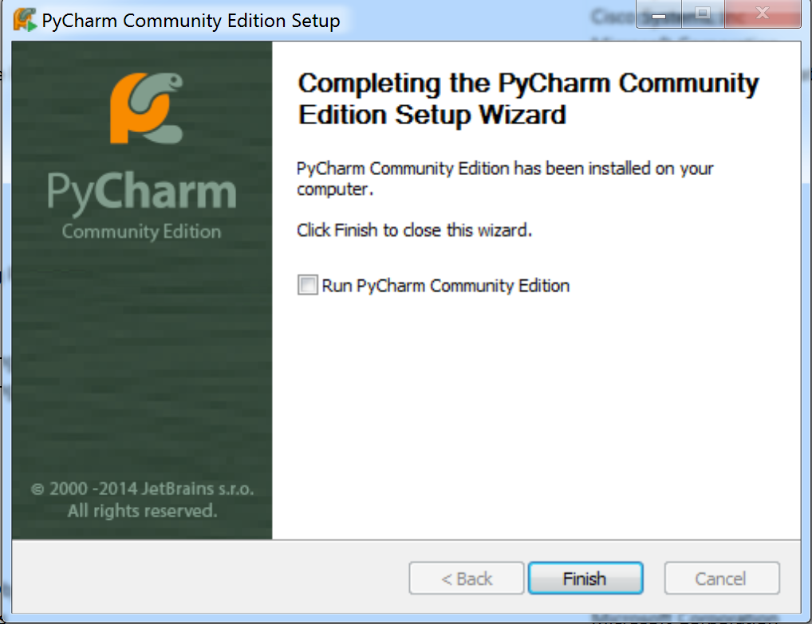
Install Pycharm Community Edition
Click next on all prompts until you get to the following screen

Slide 6
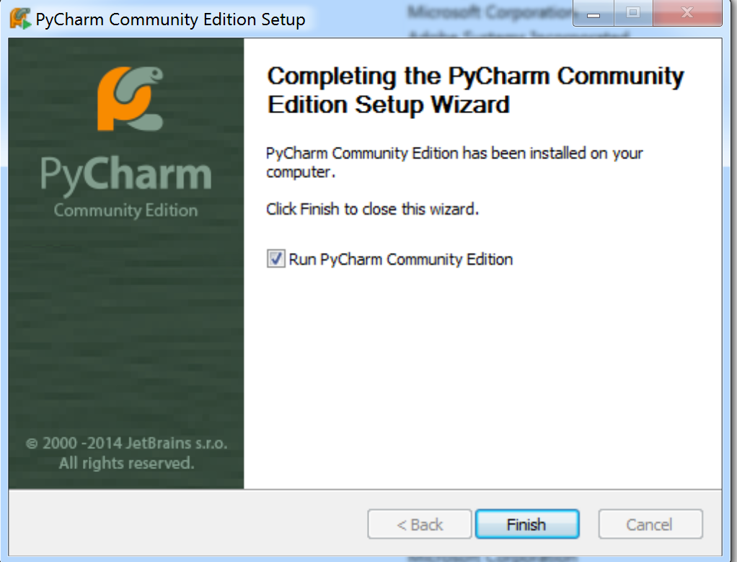
Install Pycharm Community Edition
Click the checkbox next to Run Pycharm Community Edition and then Click Finish

Slide 7
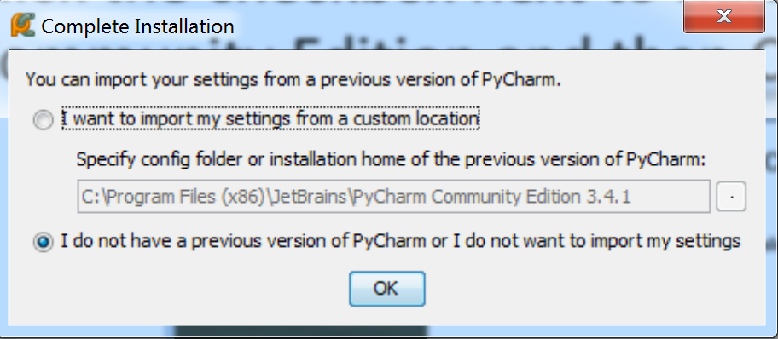
Install Pycharm Community Edition
Make sure the “I do not have a previous version of Pycharm or I do not want to import my settings” is selected and click the OK button

Slide 8
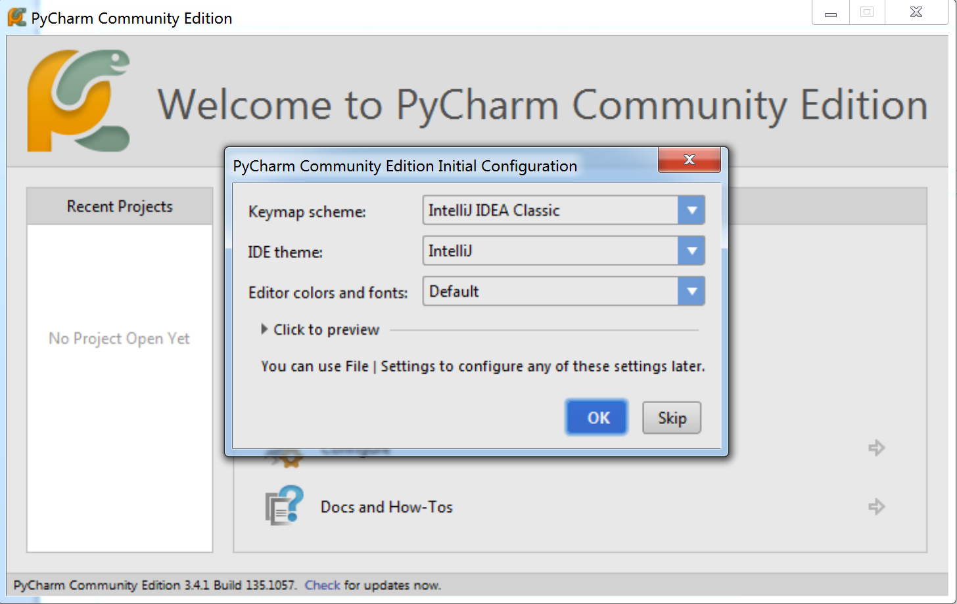
Install Pycharm Community Edition
Click the OK button

Slide 9
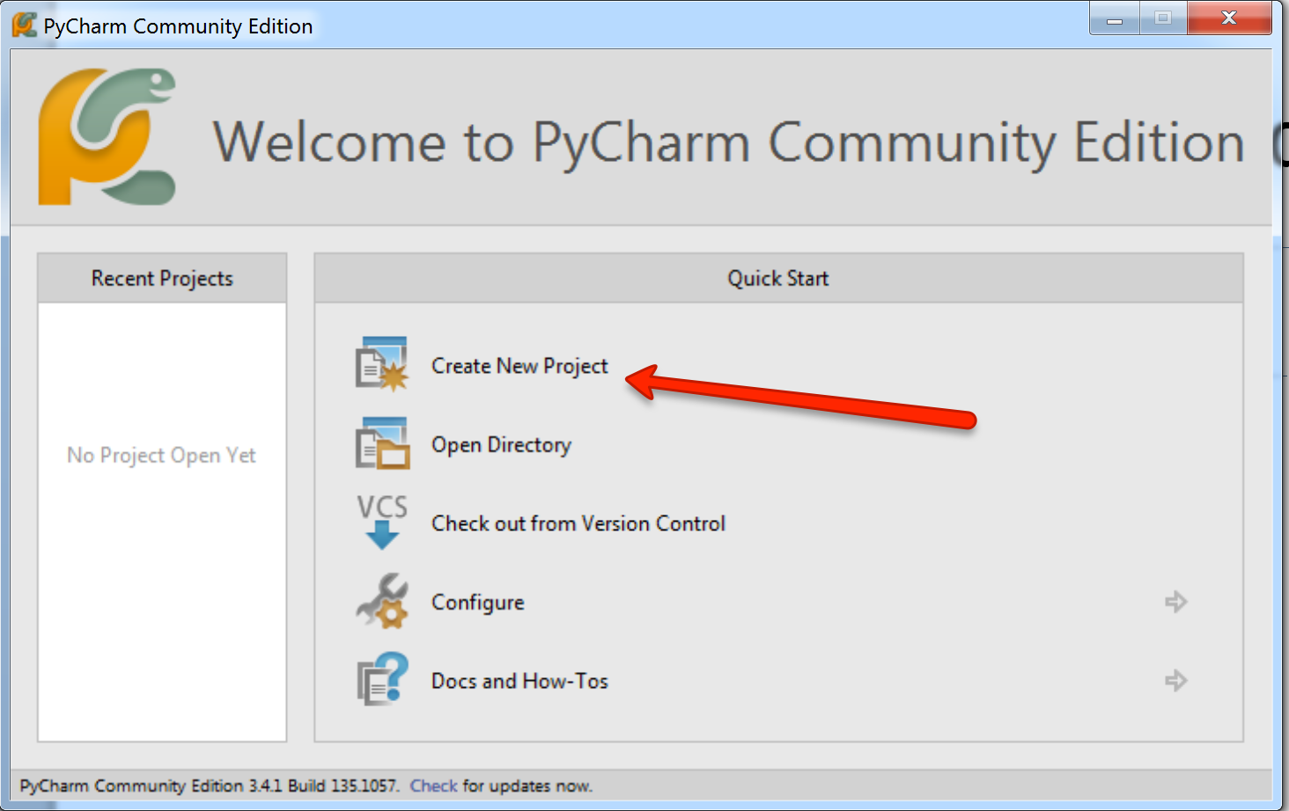
Install Pycharm Community Edition
Click Create New Project

Slide 10
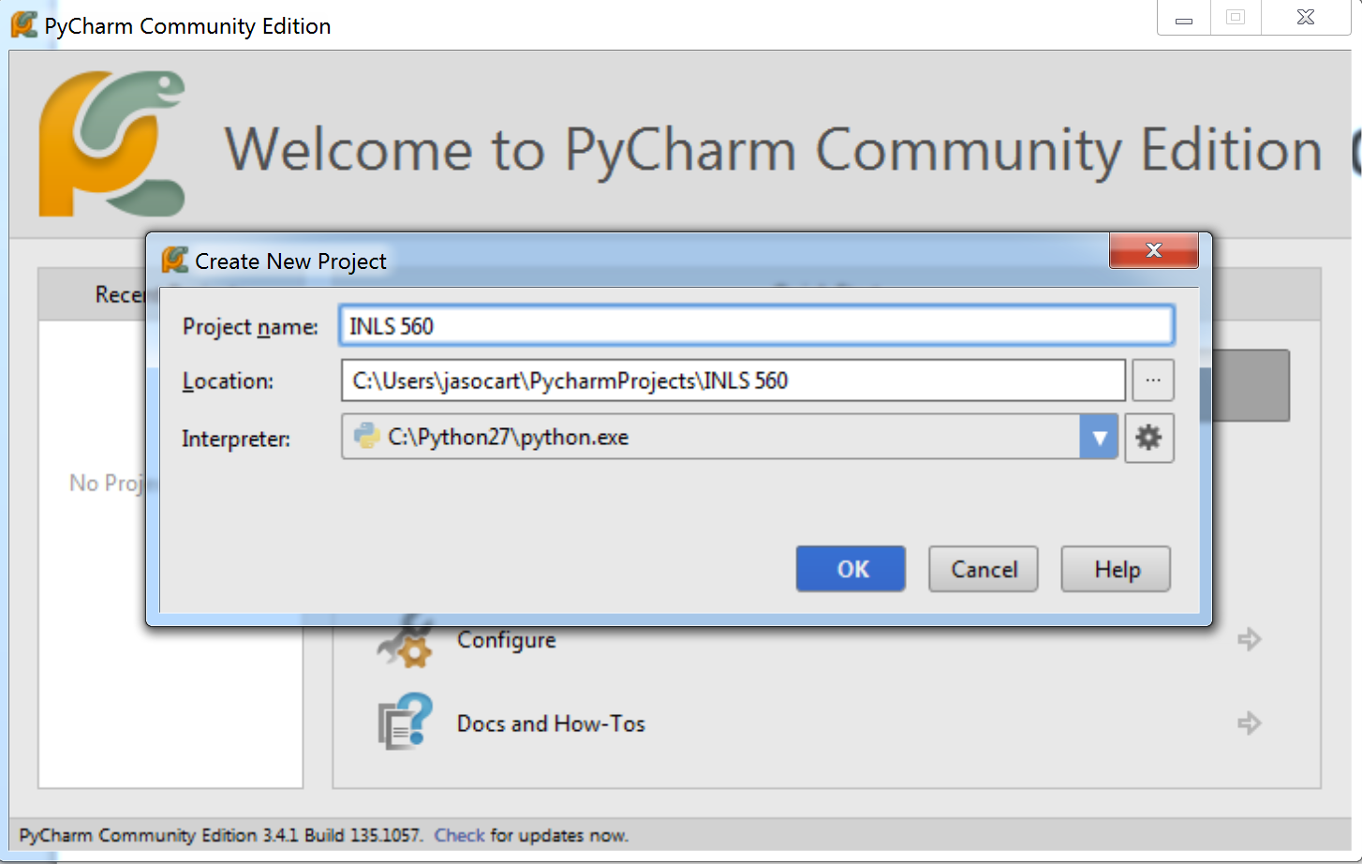
Install Pycharm Community Edition
In the Project Name textbox type a project name, in this screenshot the project name is INLS 560 and click the OK button

