Slide 1
Graphic Portrayal of Information
Making your data say something visually
Notes:
This is a follow-on to the earlier presentation on the Semiology of Graphics, Jacques Bertin’s groundbreaking theoretical work that provided what has been called a “grammar for graphics,” an identification of the visual variables that compose graphics, especially graphics that portray statistical or numerical information. The plan for today is to follow the path first blazed by Bertin, to see who have followed him in supplementing and complementing his thoughts, to see if any additional theorists have appeared or to see if Bertin’s work remains the primary graphics theory and subsequent work is better understood in the realm of application of Bertin’s concepts.

Slide 2
Graphic Portrayal of Information
Making your data say something visually
“The purpose of visualization, is insight, not pictures.”
Ben Shneiderman, founding director of the Human-Computer Interaction Laboratory at the University of Maryland
Notes:
This is a follow-on to the earlier presentation on the Semiology of Graphics, Jacques Bertin’s groundbreaking theoretical work that provided what has been called a “grammar for graphics,” an identification of the visual variables that compose graphics, especially graphics that portray statistical or numerical information. The plan for today is to follow the path first blazed by Bertin, to see who have followed him in supplementing and complementing his thoughts, to see if any additional theorists have appeared or to see if Bertin’s work remains the primary graphics theory and subsequent work is better understood in the realm of application of Bertin’s concepts.

Slide 3
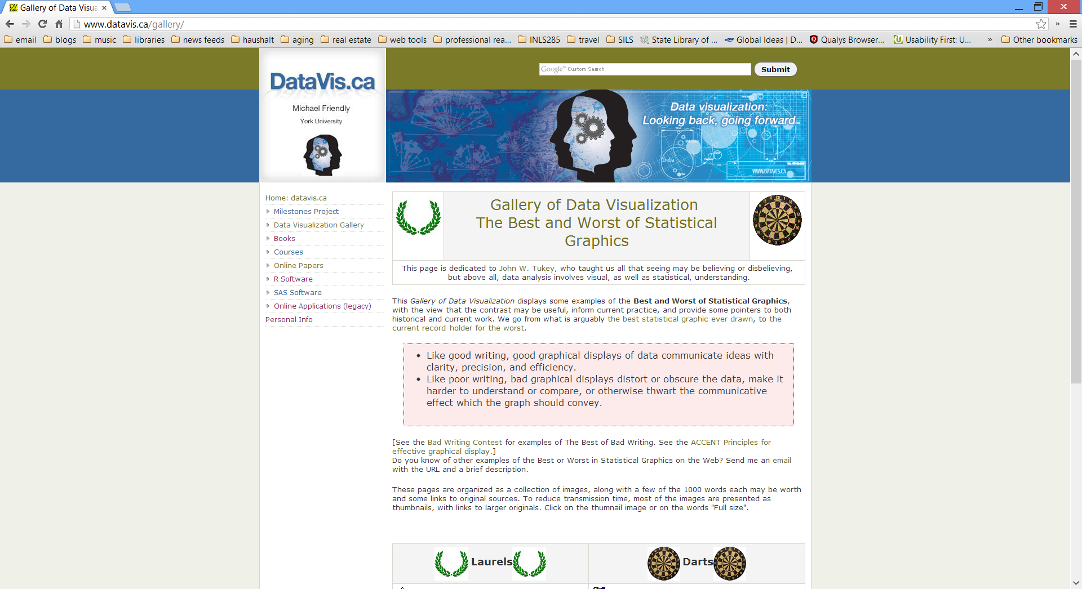
Why Graphics Theory Matters
Notes:
This comment from a web site at York University (Canada) provides us a good, concise statement of why it is useful to appreciate graphics theory. Just as a well-crafted sentence illuminates, so does a well-crafted graphic. And just as we are all too often confused and confounded by turgid prose, so are we all too often misled by overdone or poorly done graphical portrayals of data in graphical form. The author John Paulos contrasted the inability to understand math with the inability to understand the written word in his book Innumeracy. Much of what we see in graphical format falls into the same category and might be called Iggraphicy.

Slide 4
It matters because …
Like good writing
GRAPHICAL DISPLAYS OF DATA COMMUNICATE IDEAS
with
clarity
precision
efficiency

Slide 5
It matters because …
Like poor writing,
BAD GRAPHICAL DISPLAYS
distort or obscure the data
make it harder to understand or compare
or otherwise thwart the communicative effect which the graph should convey

Slide 6
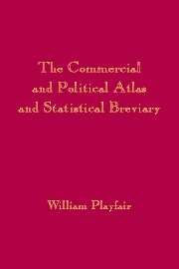
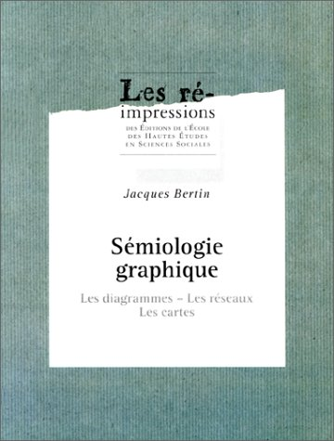
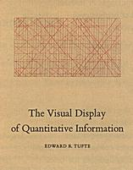
Three big names
William Playfair
The Commercial and Political Atlas (1786)
Jacques Bertin
The Semiology of Graphics (1967/1983)
Edward Tufte
The Visual Display of Quantitative Information (1983)
Notes:
Most people who are concerned with graphical portrayal of information tend to agree that graphics theory begins with the publication in 1786 of Playfair’s Commercial and Political Atlas. Edward Tufte points out that Playfair appears to have been among the earliest to use abstract visual properties such as line and area to represent data visually. Classical methods of plotting data followed from his example. Jacques Bertin, a cartographer by trade, identified basic elements of diagrams and described a framework for their design. Tufte, whose first book was influenced by his reading of the (at-that-time awaiting publication) English version of Bertin’s book, added to theory by emphasizing the need to maximize the density of useful information in graphics.

Slide 7
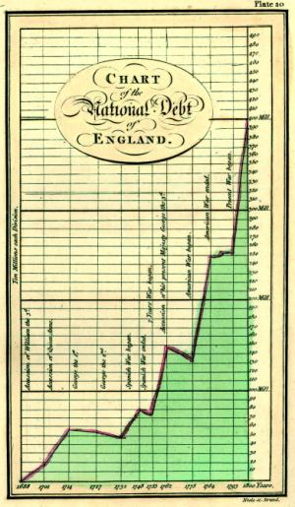
William Playfair’s Contributions
Playfair first published The Commercial and Political Atlas in 1786, in London. It contained 43 time series plots and one bar chart, a form apparently introduced in this work. It has been described as the first major work to contain statistical graphs.
Notes:
The logo of Western Michigan University’s statistics department (in black and white at the bottom of the slide) illustrates the singular importance of Playfair. Charts such as those shown were pretty much unknown before Playfair. According to Tufte, for Playfair, graphics were preferable for displays of data because graphics could show the shape of data in a comparative perspective.

Slide 8
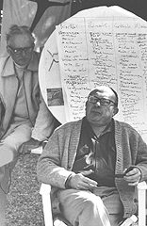
Jacques Bertin’s Contributions
in 1997
Jacques Bertin
Jacques Bertin’s Semiology of Graphics (1967/1983) systematically classified the use of visual elements to display data and relationships
Bertin's system consists of seven visual variables: position, shape , color hue, orientation, texture, size, and value, combined with a visual semantics for linking data attributes to visual elements.
Notes:
Born in 1918, the cartographer and geographer Jacques Bertin was last the Director of Studies at the French National Graduate School of Social Sciences (directeur d'études à l'École des Hautes Études en Sciences Sociales [EHESS]) and founder of the Graphics Lab at that school (Fondateur du Laboratoire de Graphique). In addition to his Semiology of Graphics, he is also well known for the book Graphics and Graphic Information Processing (1977/1981) and for numerous maps on topic of interest in France.
His Semiology of Graphics provided a way to describe the link between data and visual elements. Jock Mackinley of Stanford encapsulated Bertin’s theory in his own doctoral dissertation by stating that graphical presentations use graphical marks, such as points, lines, and areas, to encode information via their positional, temporal, and retinal properties. Bertin used perspective to achieve 3-D effects in static graphics, but modern graphics designers can use the capacities of computers to render graphics in virtual 3-D. Bertin also stated that in his conception, animation was something for moving pictures and was therefore not part of his classic graphics. He, however, also saw that computer capabilities would soon permit graphic designers to animate their designs.

Slide 9
Bertin’s Retinal Properties
so called because the retina of the eye is sensitive to them, independent of the location of the object
Notes:
For Bertin, all the retinal properties of graphics are variables that can be manipulated to enhance understanding. The eye is the tool that perceives these variables and their effect on the eye is the reason why they need to be considered in graphic design. (The graphic in this slide is an adaptation of a graphic used in a geography class at the University of Texas.)

Slide 10
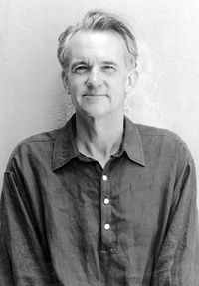
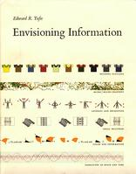
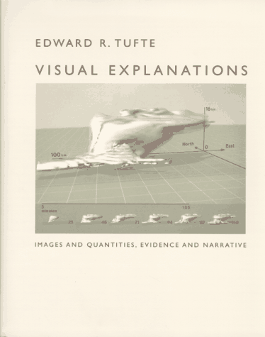
Edward Tufte
Notes:
Edward Tufte is a Professor Emeritus of statistics, information design, interface design and political economy at Yale University.. He got his B.S. and M.S. (in 1964) from Stanford University and his Ph.D. from Yale University in 1968. According to the biographical data on his page at Yale, he joined the Yale Faculty in 1977. Among Tufte's many books, these are well-known for their beauty and content. Unsatisfied with publishers, he wrote, designed, and published all three himself. Envisioning Information has won ten prizes for design and content (including awards from ACM-SIGGRAPH and ACM SIGDOC, the Phi Beta Kappa Award in Science, and the 1991 Best Graphic Design Award from International Design). Visual Explanations deals with scientific visualization, information design, and images as evidence. His latest book follows much of the same line, with a focus on particular good examples of information design. He has prepared evidence for several jury trials, and has worked on statistical and design matters for The New York Times, IBM, Hewlett-Packard, Lotus Development Corporation, Newsweek, CBS, NBC, and the Bureau of the Census. He is a fellow of the American Statistical Association, the Guggenheim Foundation, the Center for Advanced Study in the Behavioral Sciences, and the American Academy of Arts and Sciences..

Slide 11
Graphical Excellence
that which gives the viewer
the greatest number of ideas in the shortest time with the least ink in the smallest space
Notes:
Graphical Excellence = less is more

Slide 12
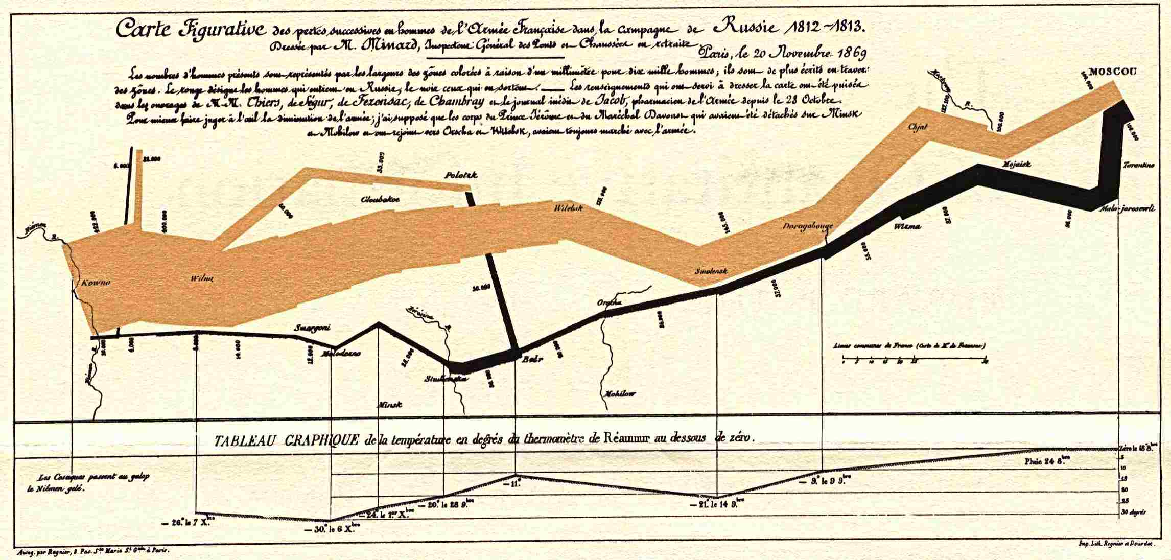
Graphical Excellence
that which gives the viewer
the greatest number of ideas in the shortest time with the least ink in the smallest space
Minard’s map of Napoleon’s march to and from Moscow
Notes:
Graphical Excellence = less is more

Slide 13
Graphical Integrity
representation of numbers
should be directly proportional to the numerical quantities represented
Notes:
Graphical Excellence = less is more

Slide 14
Graphical Integrity
representation of numbers
should be directly proportional to the numerical quantities represented
graphics must not quote out of context
Notes:
Graphical Excellence = less is more

Slide 15
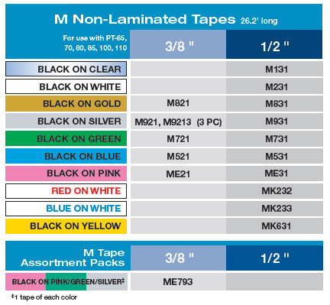
Graphical Integrity
representation of numbers
should be directly proportional to the numerical quantities represented
graphics must not quote out of context
clear, detailed, and thorough labeling should be used to defeat graphical distortion and ambiguity
Notes:
Graphical Excellence = less is more

Slide 16
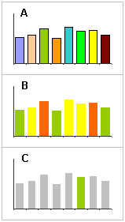
Graphical Integrity
representation of numbers
should be directly proportional to the numerical quantities represented
graphics must not quote out of context
clear, detailed, and thorough labeling should be used to defeat graphical distortion and ambiguity
show data variation, not design variation
Notes:
Graphical Excellence = less is more

Slide 17
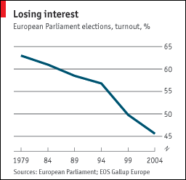
Graphical Integrity
representation of numbers
should be directly proportional to the numerical quantities represented
graphics must not quote out of context
clear, detailed, and thorough labeling should be used to defeat graphical distortion and ambiguity
show data variation, not design variation
Notes:
Graphical Excellence = less is more

Slide 18
Graphical Integrity
representation of numbers
should be directly proportional to the numerical quantities represented
graphics must not quote out of context
clear, detailed, and thorough labeling should be used to defeat graphical distortion and ambiguity
show data variation, not design variation
Notes:
Graphical Excellence = less is more

Slide 19
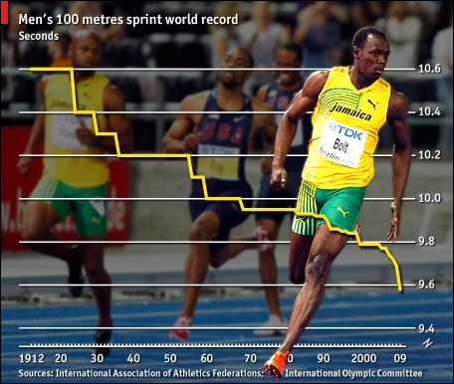
Graphical Integrity
representation of numbers
should be directly proportional to the numerical quantities represented
graphics must not quote out of context
clear, detailed, and thorough labeling should be used to defeat graphical distortion and ambiguity
show data variation, not design variation
Notes:
Graphical Excellence = less is more

Slide 20
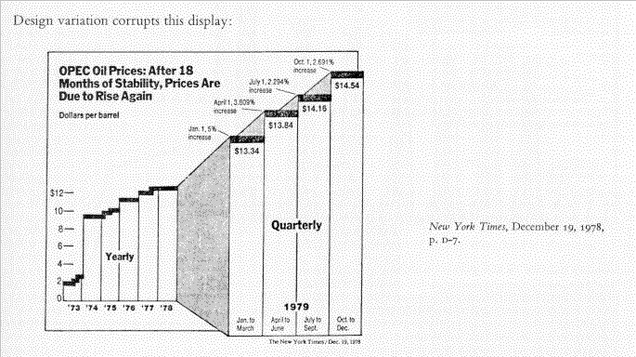
Graphical Integrity
show data variation,
not design variation
New York Times 19 Dec 1978
Notes:
Graphical Excellence = less is more

Slide 21
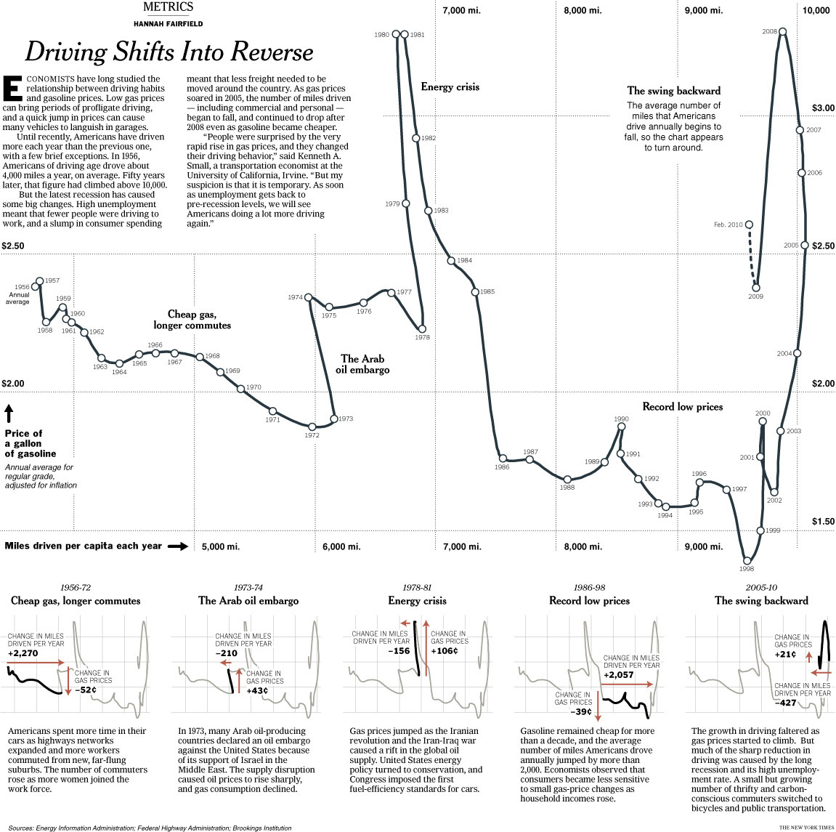
Graphical Integrity
clear, detailed, and thorough labeling
should be used to defeat graphical distortion and ambiguity
New York Times 02 May 2010
Notes:
Graphical Excellence = less is more

Slide 22
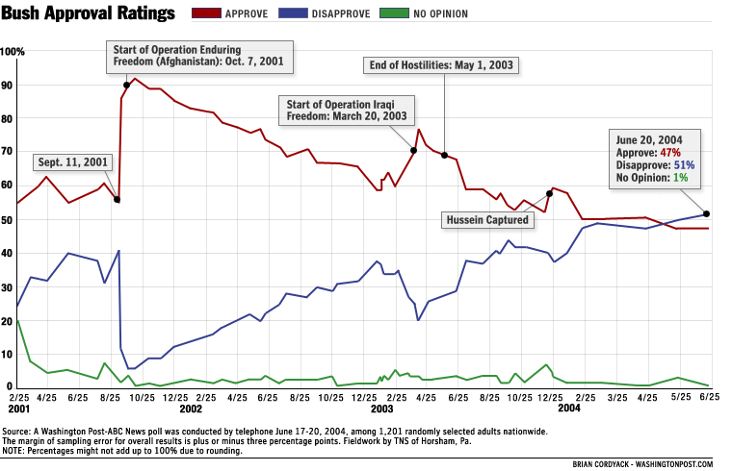
Graphical Integrity
clear, detailed, and thorough labeling
should be used to defeat graphical distortion and ambiguity
Washington Post
Notes:
Graphical Excellence = less is more

Slide 23
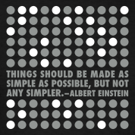
Graphical elegance
is found
in simplicity of design
Notes:
Graphical Excellence = less is more

Slide 24
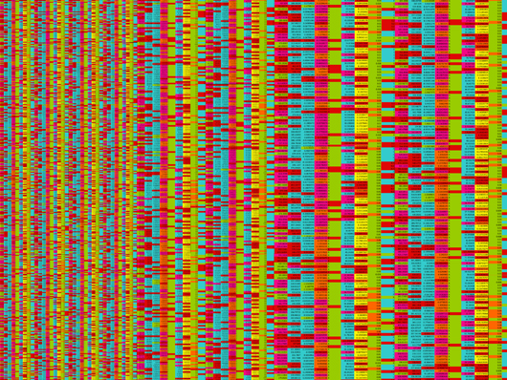
Graphical elegance
is found
in simplicity of design and complexity of data
Notes:
Graphical Excellence = less is more

Slide 25
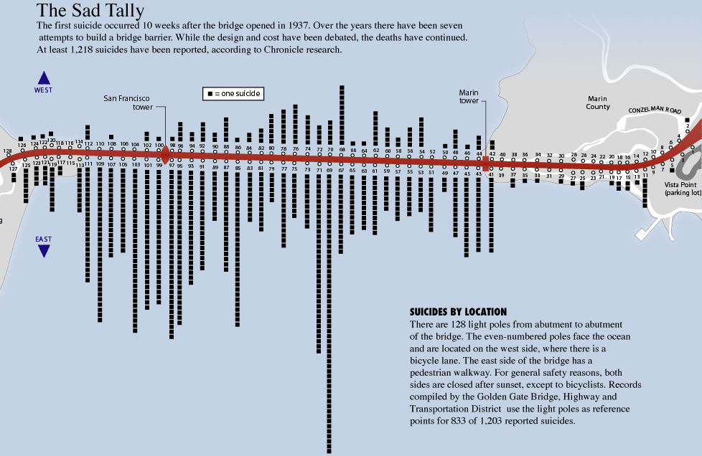
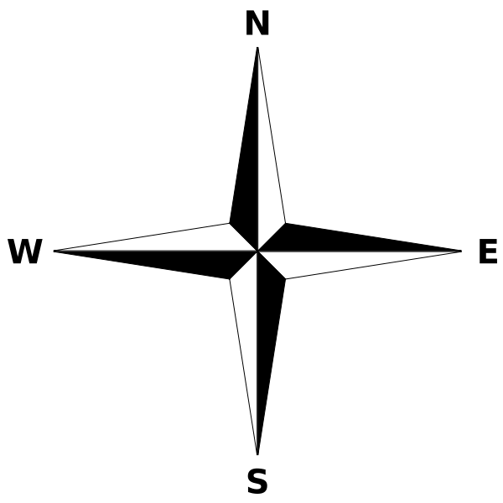
Graphical elegance
can be
elegant and artsy
Notes:
Graphical Excellence = less is more

Slide 26
Graphical elegance
can be
elegant and artsy
Notes:
Graphical Excellence = less is more

Slide 27
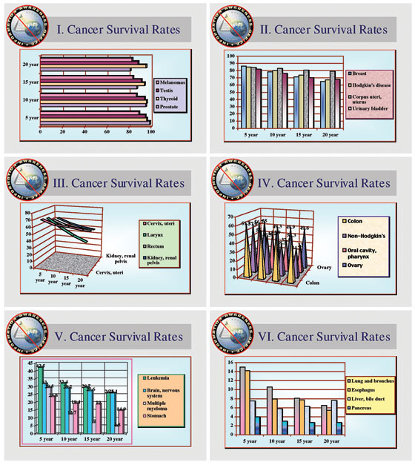
Graphical elegance
can be
elegant and unconfusing
Instead of this
Notes:
Graphical Excellence = less is more

Slide 28
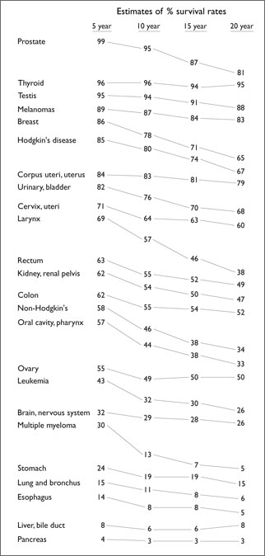
Graphical elegance
can be
elegant and unconfusing
the same data, more clearly
Notes:
Graphical Excellence = less is more

Slide 29
Envisioning Information
mostly a collection of good examples
and does not have much theoretical content
Notes:
Graphical Excellence = less is more

Slide 30
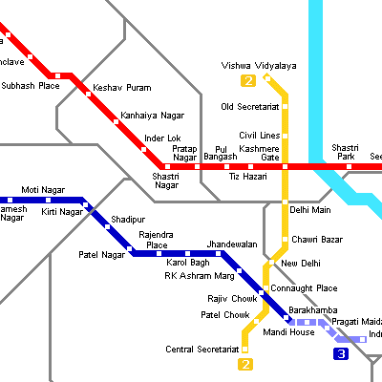
Envisioning Information
mostly a collection of good examples
and does not have much theoretical content
Escaping Flatland
Notes:
Graphical Excellence = less is more

Slide 31
Envisioning Information
mostly a collection of good examples
and does not have much theoretical content
Micro/macro readings
Notes:
Graphical Excellence = less is more

Slide 32
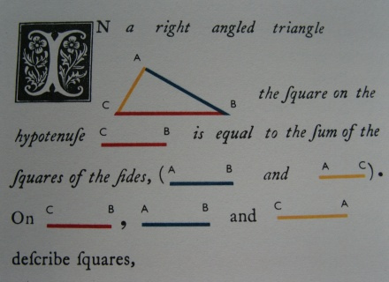
Envisioning Information
mostly a collection of good examples
and does not have much theoretical content
Layering and Separation
Notes:
Graphical Excellence = less is more

Slide 33
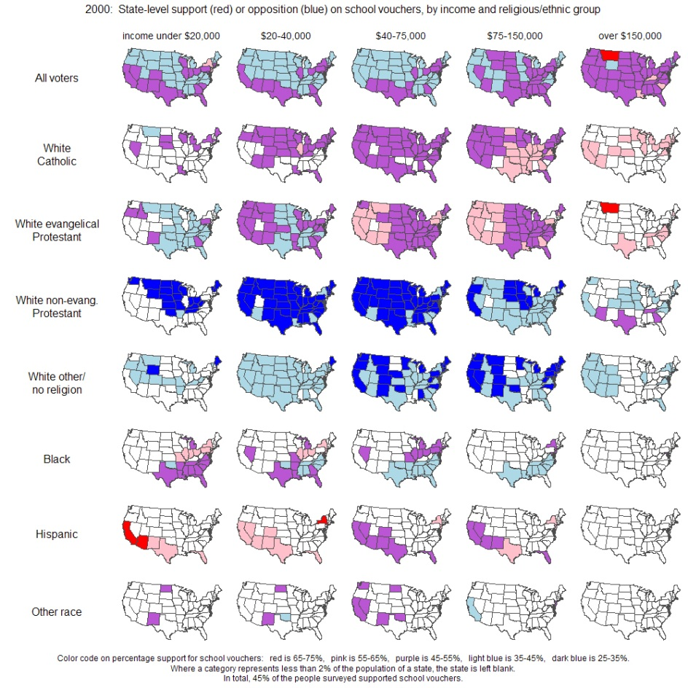
Envisioning Information
mostly a collection of good examples
and does not have much theoretical content
Small Multiples
Notes:
Graphical Excellence = less is more

Slide 34
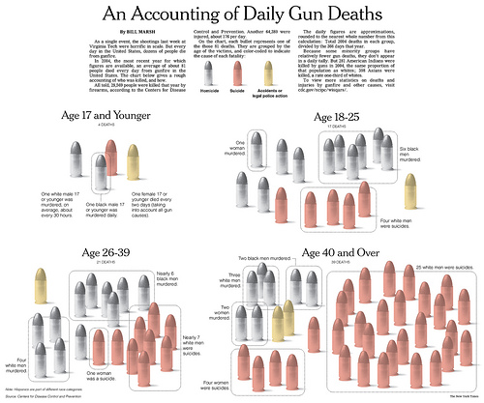
Envisioning Information
mostly a collection of good examples
and does not have much theoretical content
Color and Information
Notes:
Graphical Excellence = less is more

Slide 35
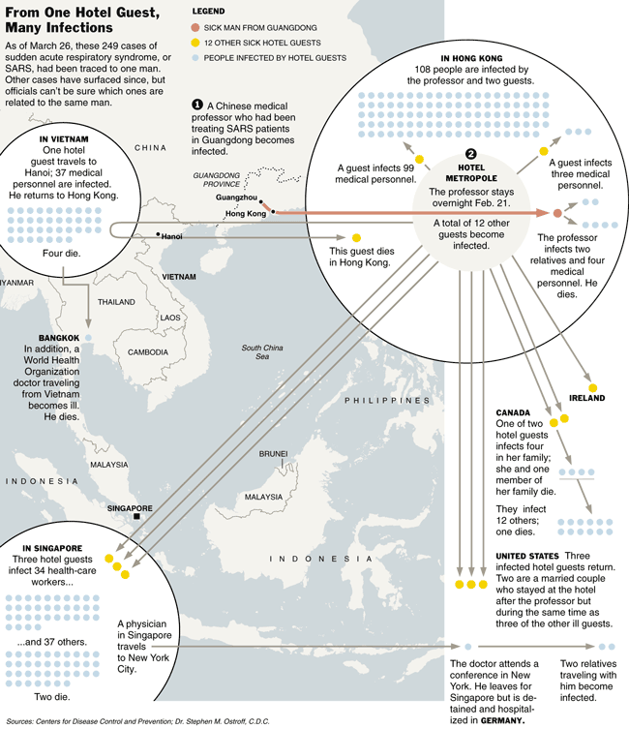
Envisioning Information
mostly a collection of good examples
and does not have much theoretical content
Narratives of Space and Time
Notes:
Graphical Excellence = less is more

Slide 36
Envisioning Information
most important concepts in this book
Notes:
Graphical Excellence = less is more

Slide 37
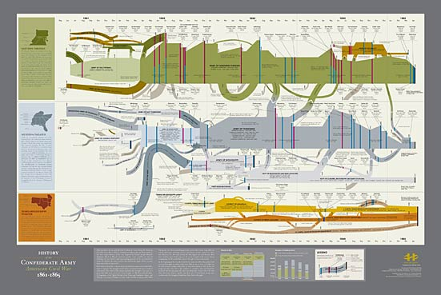
Envisioning Information
most important concepts in this book
suggestions for how to compress more data into the image
Notes:
Graphical Excellence = less is more

Slide 38
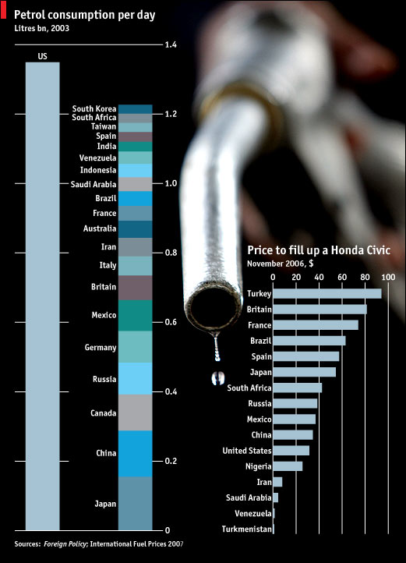
Envisioning Information
most important concepts in this book
admonition to always use direct labeling of a chart
Notes:
Graphical Excellence = less is more

Slide 39
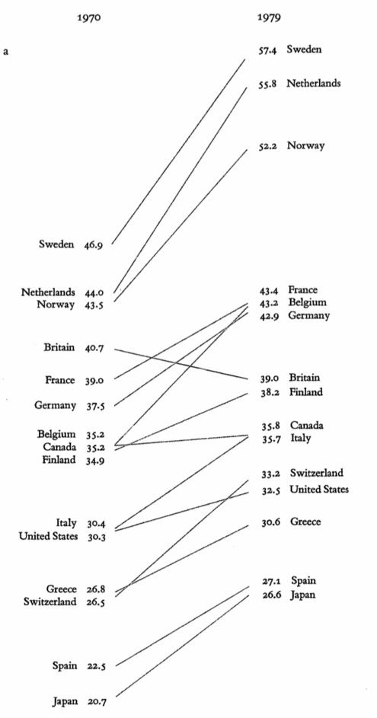
Tufte's Rules
Tone down secondary elements of a picture
layer the figure to produce a visual hierarchy
Notes:
Graphical Excellence = less is more

Slide 40
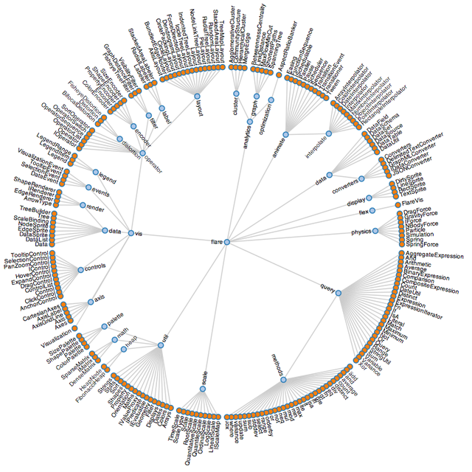
Tufte's Rules
Tone down secondary elements of a picture Replace coded labels in the figure by direct ones
Notes:
Graphical Excellence = less is more

Slide 41
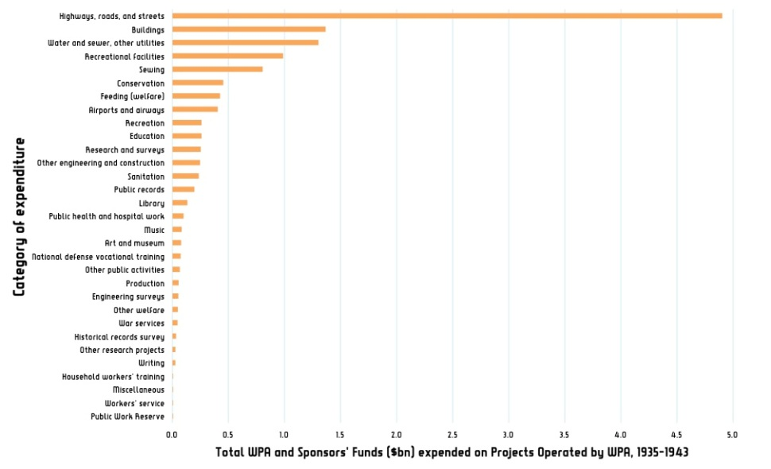
Tufte's Rules
Tone down secondary elements of a picture Replace coded labels in the figure by direct ones Produce emphasis by using the smallest possible effective distinctions
Notes:
Graphical Excellence = less is more

Slide 42
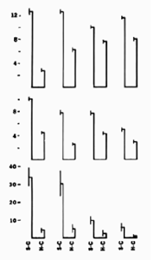
Tufte's Rules
Tone down secondary elements of a picture Replace coded labels in the figure by direct ones Produce emphasis by using the smallest possible effective distinctions Eliminate all unnecessary parts of a figure
Notes:
Graphical Excellence = less is more

Slide 43
Tufte's Rules
Tone down secondary elements of a picture Replace coded labels in the figure by direct ones Produce emphasis by using the smallest possible effective distinctions Eliminate all unnecessary parts of a figure Use small multiples
numerous repetitions of a single figure with slight variations
Notes:
Graphical Excellence = less is more

Slide 44
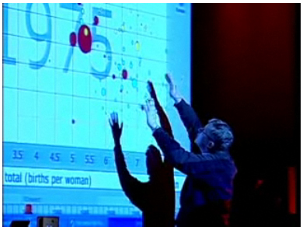
Tufte's Rules
Tone down secondary elements of a picture Replace coded labels in the figure by direct ones Produce emphasis by using the smallest possible effective distinctions Eliminate all unnecessary parts of a figure Use small multiples Make the graphics carry a story
Notes:
Graphical Excellence = less is more

Slide 45
Is this important?
It can be

Slide 46
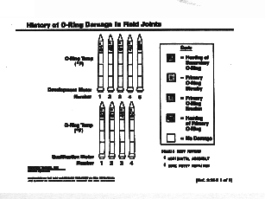
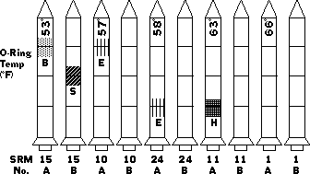
Theory in Practice

Slide 47
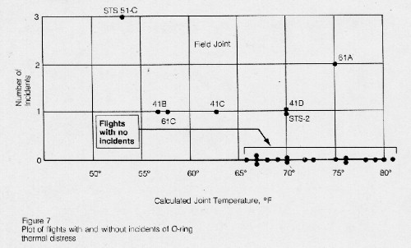
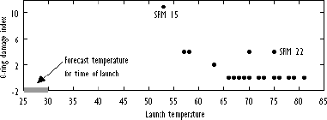
Theory in Practice

Slide 48
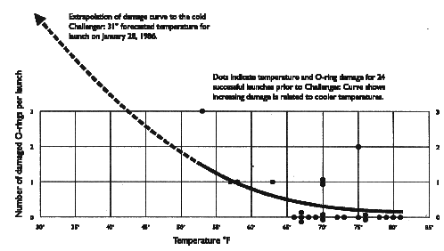
Theory in Practice

Slide 49
Effective graphical data portrayal
Can be critical in many situations

Slide 50
How display can alter one’s perception
GapMinder

Slide 51
Let’s spend 20 productive minutes

