Slide 1
Count Function in an Access Report
This series of slides will walk you through the process

Slide 2
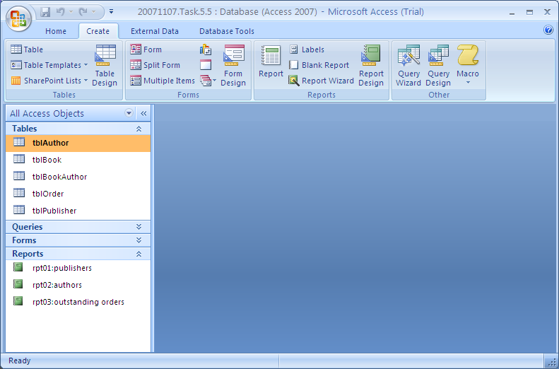
Create - to generate a report

Slide 3
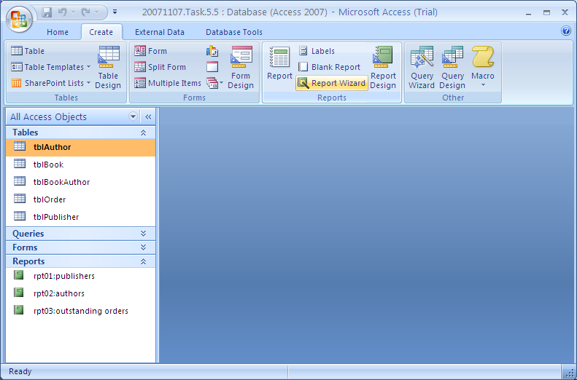
Best to start with the wizard

Slide 4
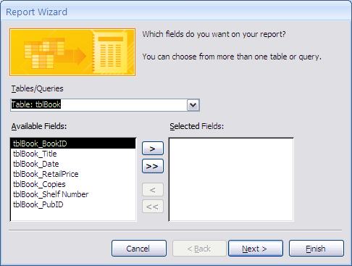
Select Report Wizard
and choose the table from where the data comes

Slide 5
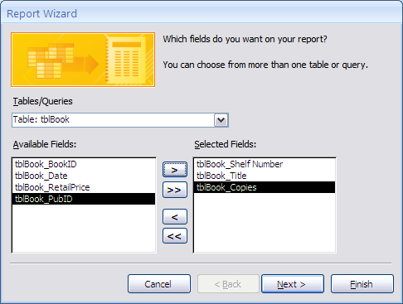
Select the fields to display on the report

Slide 6
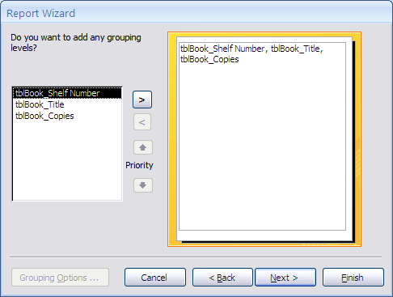
Apply grouping, if desired

Slide 7
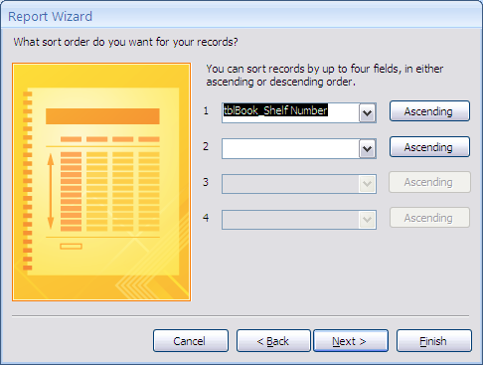
Sort the records to be displayed

Slide 8
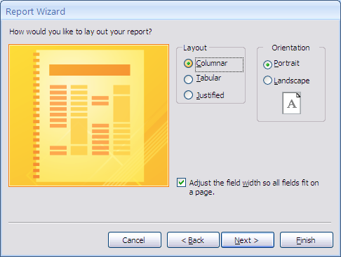
Select the layout you desire

Slide 9
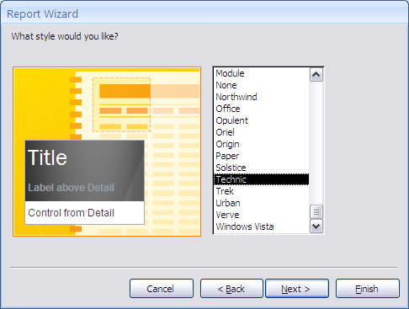
And the desired report look

Slide 10
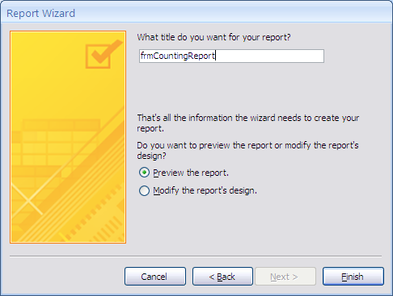
Then get ready to modify the report

Slide 11
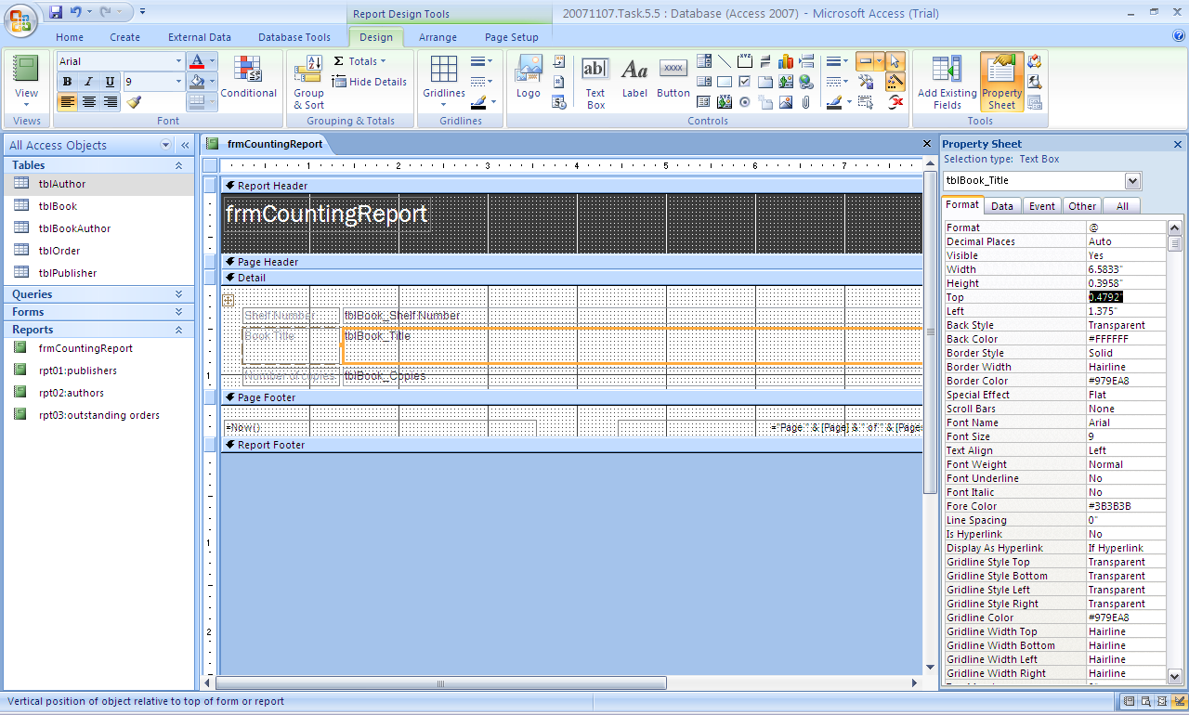
Open in design view
Make sure the displayed field will fit the data to be displayed in it

Slide 12
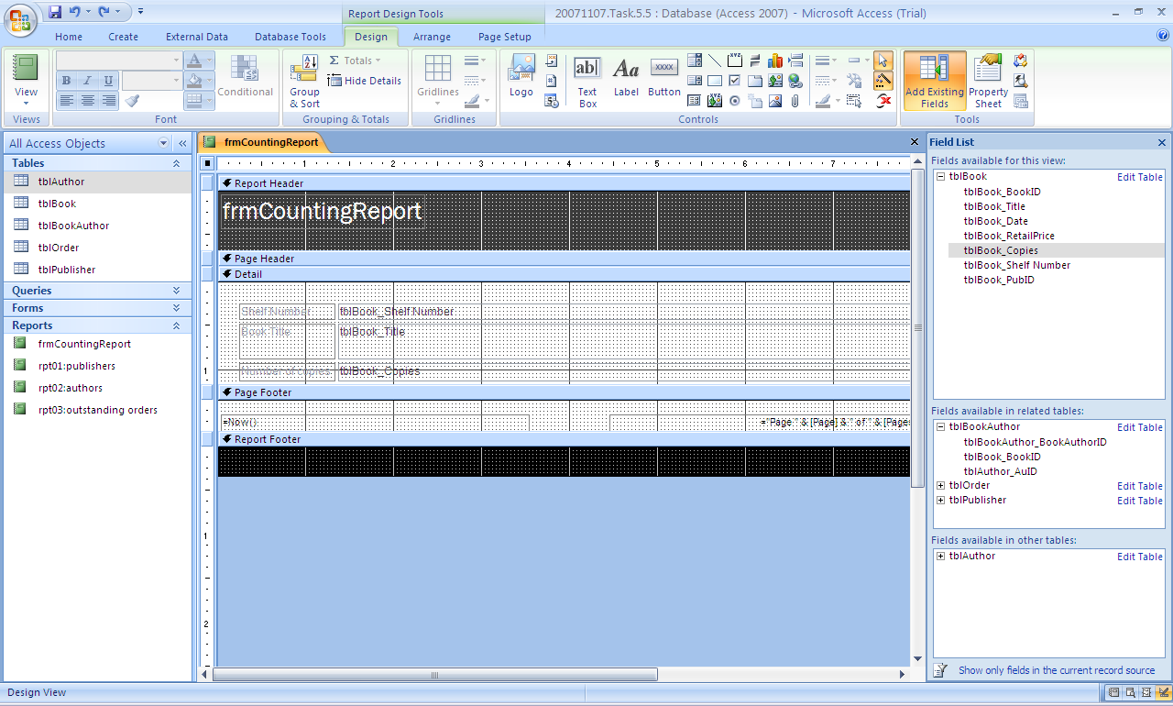
Note the field list
To find the data you need to pull into the newly revealed report footer

Slide 13
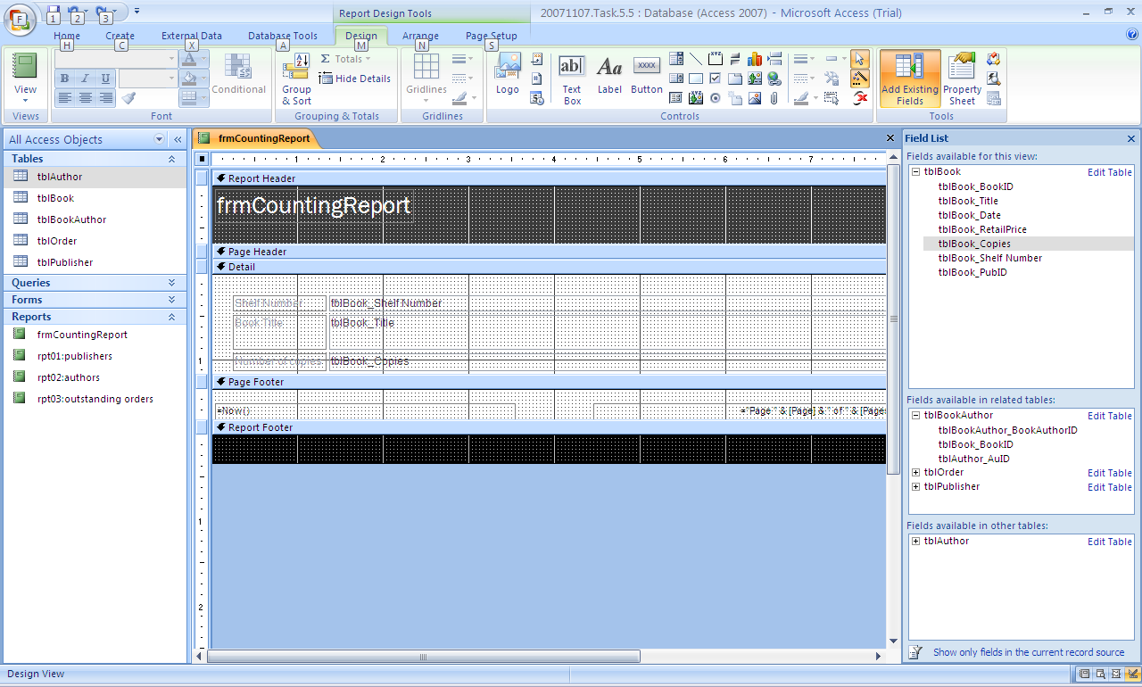
you will need to create some space in the Report (not the Page) Footer
drag down some working space in the report footer area

Slide 14
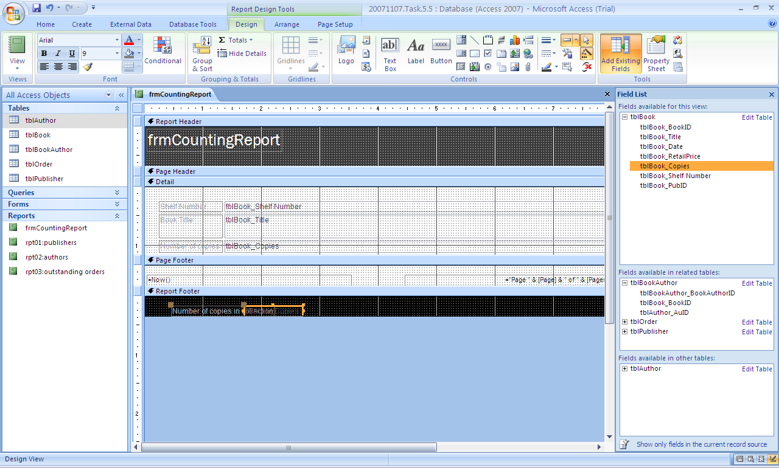
And drag the field you want to Count into the Report Footer
After highlighting it, keep the left button depressed and drag the field

Slide 15
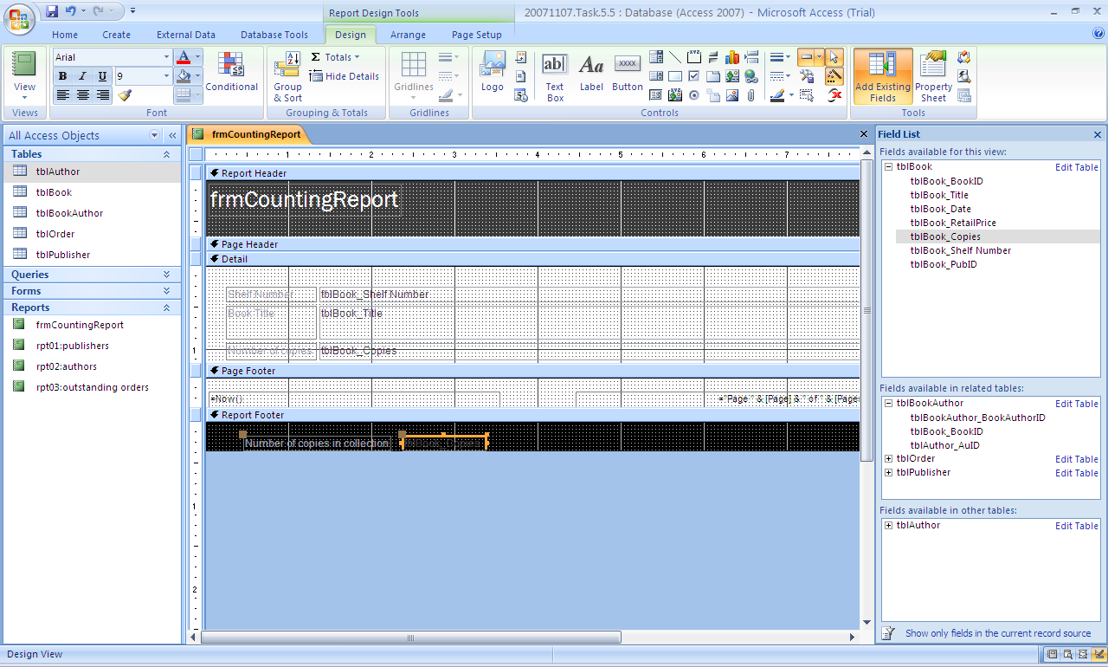
Move the right field name box a bit more to the right
Hold down the left button until you get a cross for a cursor

Slide 16
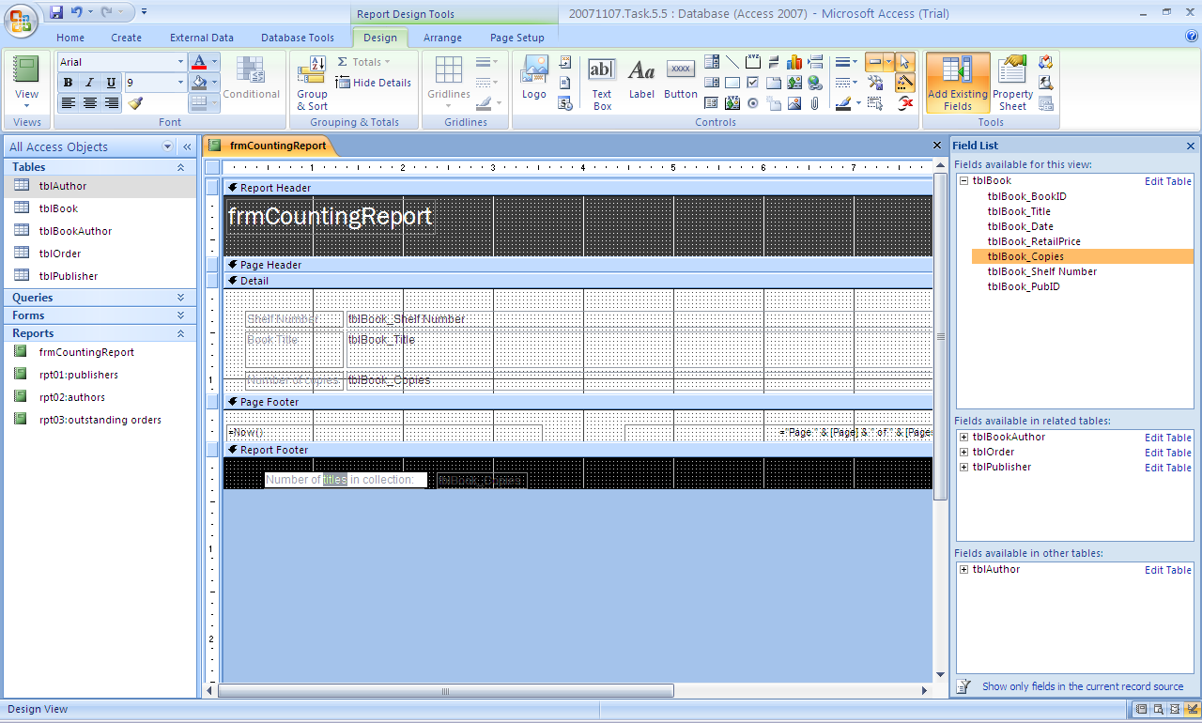
Edit the left Title box
put the proper title in the space available

Slide 17
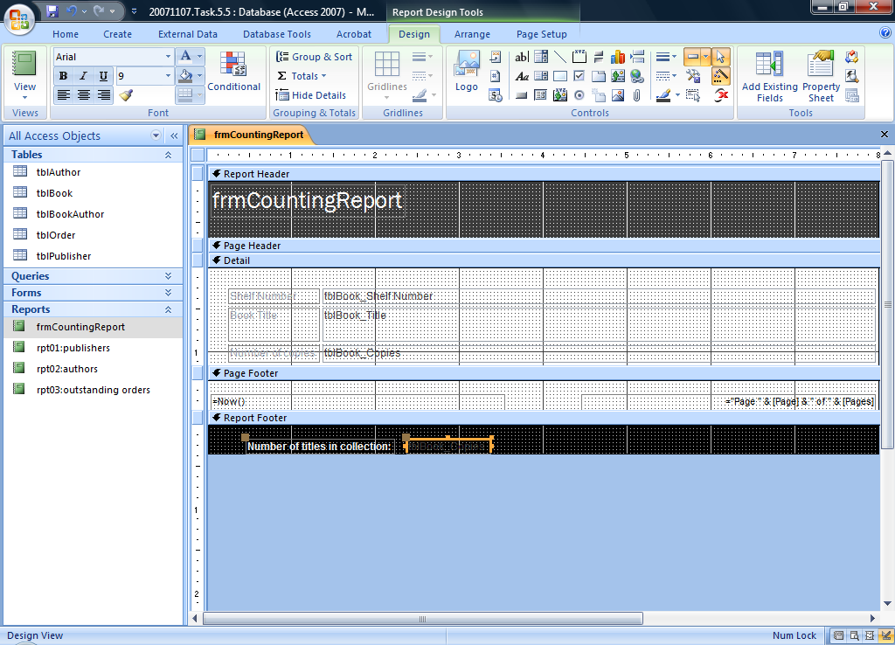
Then edit the right box
type in the function you want to apply to the pulled-in field
=Count([tblBook_Copies])
in this example
it should count the values you want counted

Slide 18
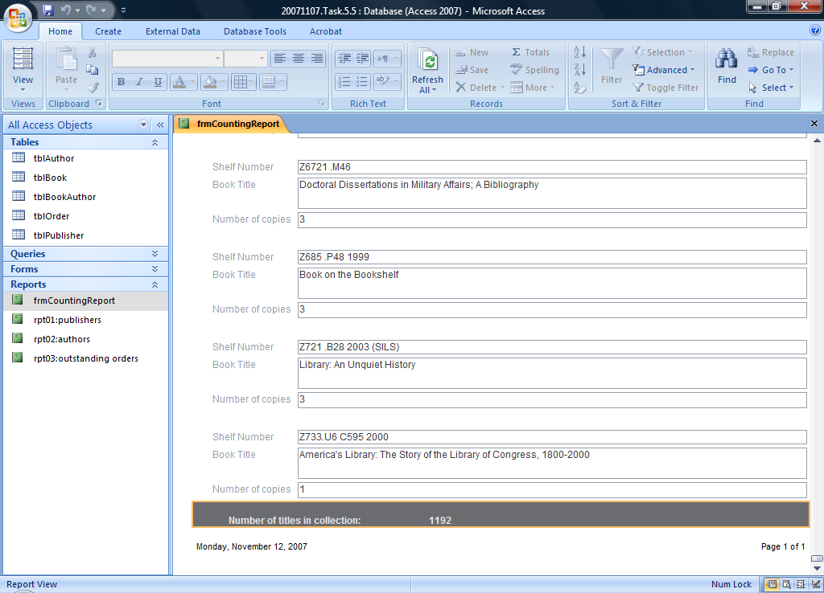
Check the result in print view

Slide 19
I could not find this in any documentation
But if you follow these steps, you can add the count (or any other) function into any part of a report

