Slide 1
INLS 151: Retrieving &
Analyzing Information

Slide 2
Types of Information Sources (Ford, 2012)
Social networking sites
Encyclopedias
Handbooks and manuals
Journal articles
Research reviews
Conference papers
Research theses and reports

Slide 3
Types of Info. Sources: Social networking sites
Examples: www.LinkedIn.com and
www.youtube.com
Useful for:
Establishing and maintaining relationships with others in your field of interest
Academia.edu
Keeping current on developments in a topic area
Research Gate
Finding tutorials and topic content:
Sage Channel (YouTube)
Subscription to Statistics (YouTube)

Slide 4
Types of Info. Sources: Encyclopedias
Non-academic example: www.wikipedia.com
Useful for broad view of general topics, though not a primary citation for papers
Can be good site for finding links to source materials
Buyer beware – anonymous authors and content; potential
for errors and misinformation
Think
Why do you think some university teachers advise so strongly against using Wikipedia for academic work?
Do you agree with them?
Is there any way Wikipedia can be helpful for academic work?
6

Slide 5
Types of Info. Sources: Encyclopedias
Academic and specialized
Some are free, some are by library subscription
Dynamically updated and scheduled updates by subject matter experts (SME’s)
Peer-reviewed
Examples: Stanford Encyclopedia of Philosophy,
Encyclopedia Britannica, UNC Libraries
6

Slide 6
Types of Info. Sources: Handbooks & manuals
Typically single volume, comprehensive “compendium” of information on particular topic
Provide ready reference
Handbook is generally for reference
Manual is typically a ‘how-to’ or procedural text
7

Slide 7
Types of Info. Sources: Journal articles
Used for more advanced, in-depth levels of research
(beyond what you found in encyclopedias, etc.)
Highest quality, research-based information about your topic. Often subscription-based
Most current information, though everyone in the topic
discipline may not agree with it or accept it
Often are reviewed by scholar peers (called peer-
reviewed)
Range from more general to highly specific
Examples: UNC Libraries
9

Slide 8
Types of Info. Sources: Research reviews
Can be specialized type of journal article called a
literature review or also comprehensive review
UNC Libraries
Can be a longer article found in a volume of ‘research reviews’, related to a specific topic
UNC Libraries
Advanced content
Not all disciplines provide research reviews but most
provide literature reviews
10

Slide 9
Types of Info. Sources: Conference Papers
Leading edge research
Specialized topics by specific
researchers
Advanced to highly advanced
UNC Libraries

Slide 10
Types of Info. Sources: Research Theses and
reports
Dissertations – provide extensive
literature reviews
Detailed experiments, including methodology, outcomes, and analysis
Highly advanced
UNC Libraries

Slide 11
Types of search tools (Ford, 2012)
General
Directories
Search engines (single and metasearch)
Searchable encyclopedias (non-academic)
Academic
Directories (library)
Search engines/databases
Multi-source (journals, conferences, academic books, etc.)
Specific to particular types of sources
Search encyclopedieas (academic)
14

Slide 12
Mapping Search Approaches & Techniques to Information Needs
Why You Need to Know This
Just as different types of information source (introduced in the previous chapter) are appropriate to different levels and stages of your work, so are different search approaches.
You need to be familiar with the different approaches available to you, and to be able to map them on to the different levels and stages through which you will pass as you generate your essay or research project report.
Within these broad search approaches, there is a variety of more specific search techniques that you can use, available in different search tools. Being familiar with these will help you find the information you need more easily and more effectively.
Ultimately, you need to be able to choose the most appropriate search approach and search techniques for the task on which you are engaged.

Slide 13
Directory-Based Browsing and Searching
Directories will allow you to do the following:
They offer you a list of broad subject categories generally arranged alphabetically, e.g. Arts, Business, Computers, etc.
They allow you to browse from the general to the more specific, by clicking on any of these categories to see what sub-categories it has, and again clicking on a sub-category to see what sub-sub-categories it has, and so on.
They also allow you to click in the reverse direction, to explore from the specific to the more general.
At each point, you can see the information sources that are listed under the particular sub-category that you have clicked on.
In some directories, such as the Open Directory, you are also shown related topics. These are topics that are neither broader nor more specific categories in relation to the topic you are looking at, but which may nevertheless be of interest. For example, a category:

Slide 14
For example, a category:
Business > Management > Ethics
may be related to other categories including:
Home > Consumer Information > Complaints
Society > Philosophy > Ethics > Applied > Professional Ethics
Yahoo Directory (http://dir.yahoo.com.libproxy.lib.unc.edu/)
Directories can be useful when you are new to a topic or subject and are not particularly familiar with its terminology, or how it is broken up into sub-topics.
The information you find in a directory should be of reasonable quality. This is because the websites listed in a directory have generally been selected by a human editor (as opposed to a computer algorithm).

Slide 15
Topic Similarity Searching
Topic similarity searching entails finding topics that are similar to the one(s) for which you are searching.
They may be displayed graphically – for example, as in Google's Wonder wheel.
Or they may be displayed textually, as for example topics listed under Google's Something different heading
They may also be presented as query expansion suggestions as you type in your search terms, as shown in

Slide 16
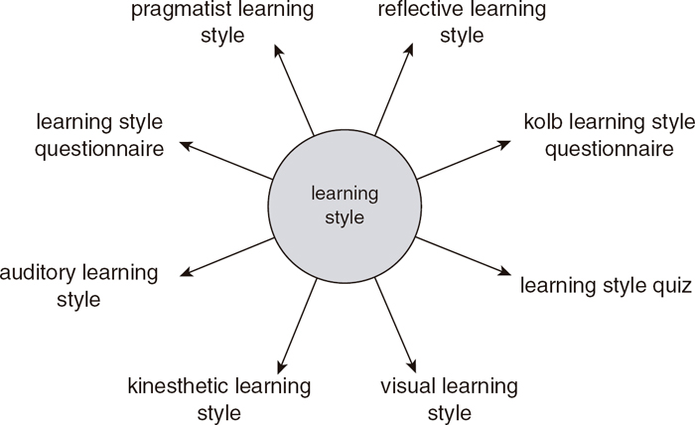

Slide 17
Document Similarity Searching
Assuming that you have found a document that is relevant to your needs, similarity searching enables you to find other documents that are similar to it.
This is done automatically for you. For example, in Google Scholar having found a useful document, you simply click Related articles and the similarity search will be performed automatically for you.
The automatic calculation of similarities between documents:
can be more subtle than your own manual searching;
may find documents that you may not have been able to find through manual searching;
can suggest to you words describing and relevant to your topic that you may not have thought of; and
can occasionally reveal a document that takes your research or thinking in a new direction that you hadn't anticipated.

Slide 18
Filtering
Filters allow you to restrict your search, for example, to particular subject areas or particular types of documents, by selecting from pre-defined categories offered to you by the search tool.
Filtering can save you time and effort in not having to wade through irrelevant documents trying to identify the ones meeting your requirements.
Post-search categories result from an analysis of what has actually been found. This can sometimes provide an interesting and useful analysis of the different facets of the topic as found in the literature.
Post-search categories produced by tools such as Web of Knowledge can be fine-grained and detailed, allowing you to rapidly home in on what is most relevant.
Post-search filtering, in which results are clustered into higher level subject (and other) categories, can make it easy to see potentially interesting search results which, if presented as the normal single sequence of items listed in order of relevance to your initial query, might appear very far down the list and be missed.

Slide 19
Citation Searching
Citation searching shows you – in relation to a particular document that you specify – other documents that have cited it in their references.
Citation searching is useful when you already know of a key source (e.g. a book or journal article) that is centrally relevant to your topic, and want to find more recent sources that build explicitly on this original source.
This can introduce you to the latest work relating to the topic. It is a way of asking ‘What later work has built on this previous work?’
Examples:
Google Scholar
Web of Knowledge
SciVerse

Slide 20
Boolean

Slide 21
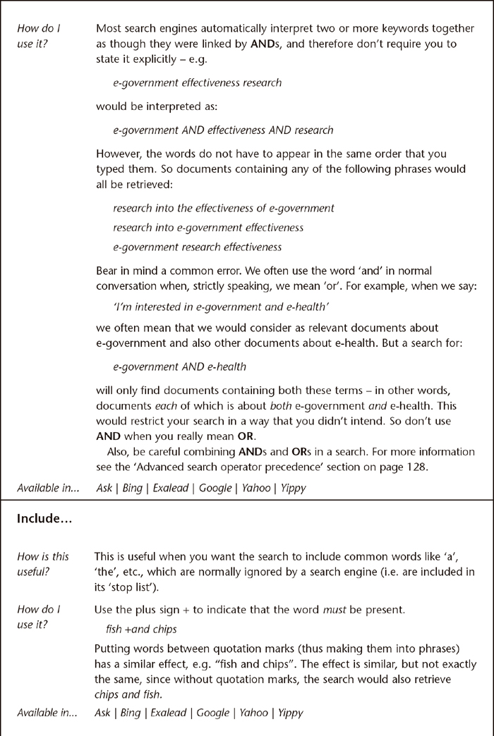

Slide 22
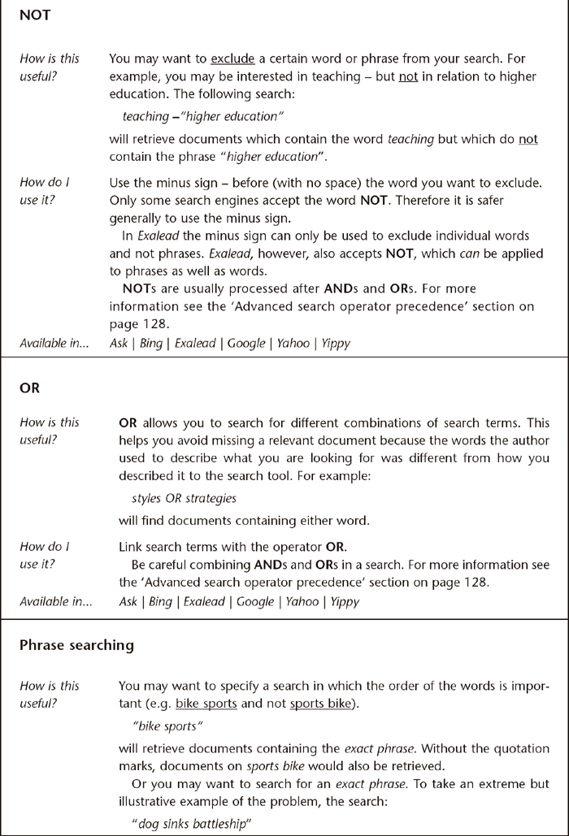

Slide 23
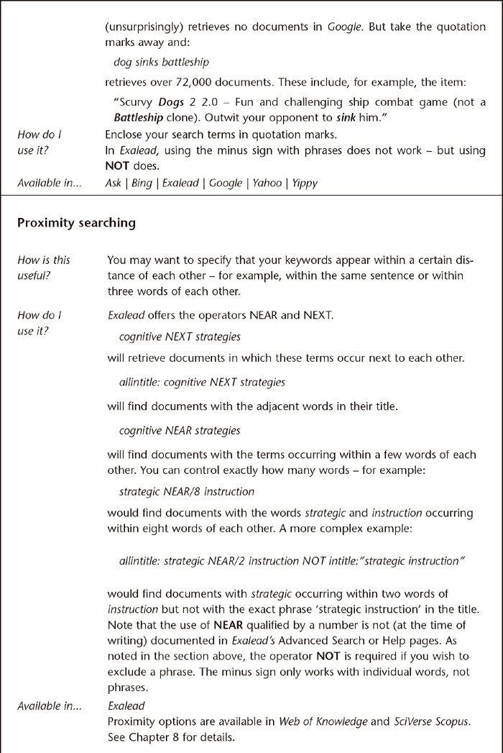

Slide 24
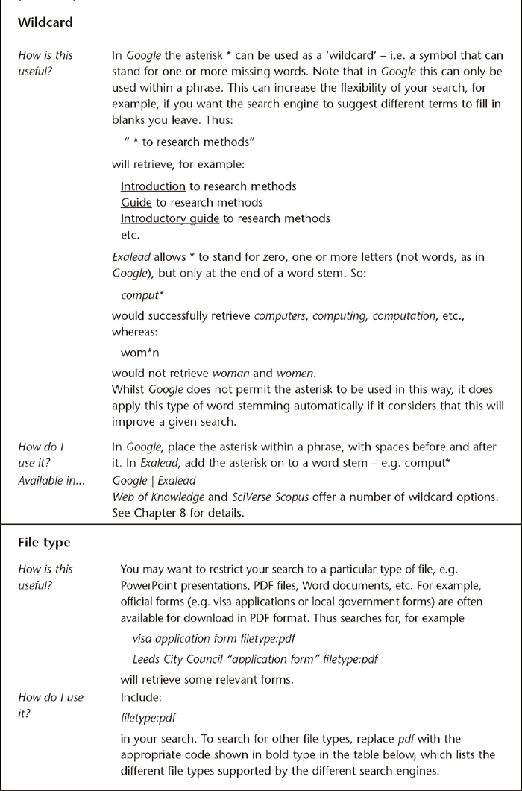

Slide 25
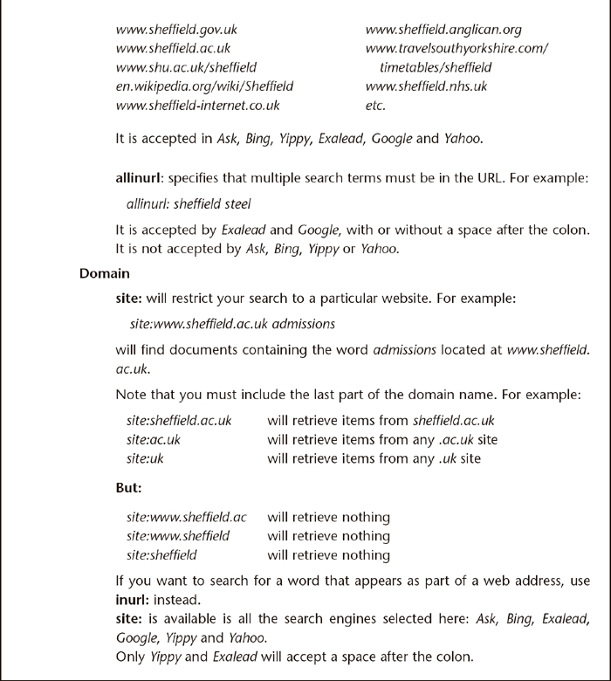

Slide 26
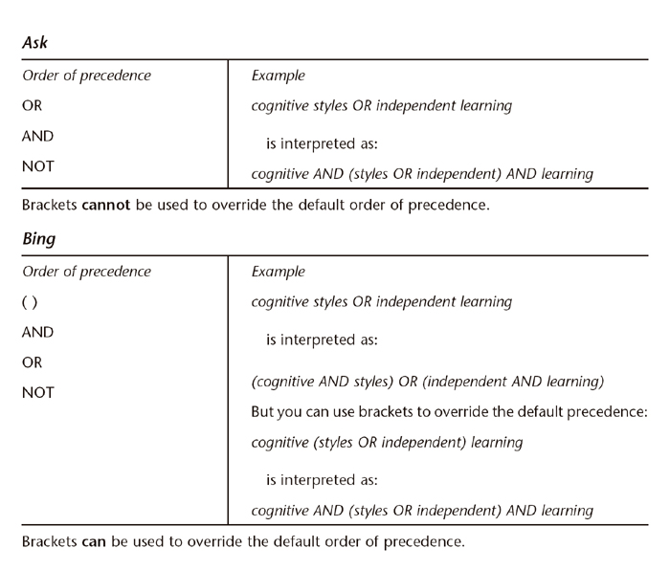

Slide 27
