Slide 1
INLS 200: Retrieving &
Analyzing Information

Slide 2
Mandalios (2013), “RADAR”
Relevance
Authority
Date
Appearance
Reason for writing
9

Slide 3
Relevance
HOW is the information that you found
relevant to your assignment?
Does it address a gap in your knowledge
related to the specific question?
Does it provide background information?
Does it develop the greater context of the issue?
10

Slide 4
Authority
WHO is the author (person or organization)?
What tells you that they are authoritative?
Credentials – education, awards, accolades/endorsements
Bachelors, Masters, Ph.D, M.D., J.D.
Awards – Nobel Prize prize winners (Daniel Kahnemann, Paul Krugman, Doris Lessing, Tenzin Gyato)
Well known? Respected? Does the author have good qualifications and experience?
Accolades/endorsements – Athletes (Diana Nyad, Tiger Woods, Michael Phelps)
Is other information available?
Google, Wikipedia, LinkedIn, University websites (CV)
11

Slide 5
Date
When was the information published?
Does the date matter?
Attitude research:
Gender differences in math and science
Difference between literature in 1964 versus 2012?
Public perception of same-sex marriage in the
U.S.
Difference between polls in 2000 versus 2013?
Events:
Progress toward rebuilding New Orleans in 2007
versus 2012?
12

Slide 6
Appearance
Does the information look serious and
professional?
Does it have citations and references?
Can you verify their accuracy?
Formal language?
Published for children?
Sales pitch?

Slide 7
Reason for Writing
To produce a well-balanced, well-researched, professional piece of work to add to a body of knowledge?
It is part of a debate, pro/con discussion, refuting/supporting a claim?
Is it propaganda or biased in some way?
May still be useful but important to recognize the bias
Was it written to sell something?

Slide 8
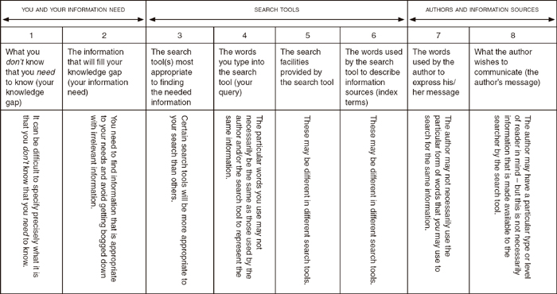

Slide 9
1) Get into groups of 3 or 4. 2) Evaluate the assigned resources using the RADAR method
http://www.dangersoffracking.com/
http://www.ufoevidence.org/ancientastronauts.htm
http://www.vrg.org/nutshell/nutshell.htm
http://www.snopes.com/music/artists/ladygaga.asp

Slide 10
Have a nice day!
22

