Slide 1
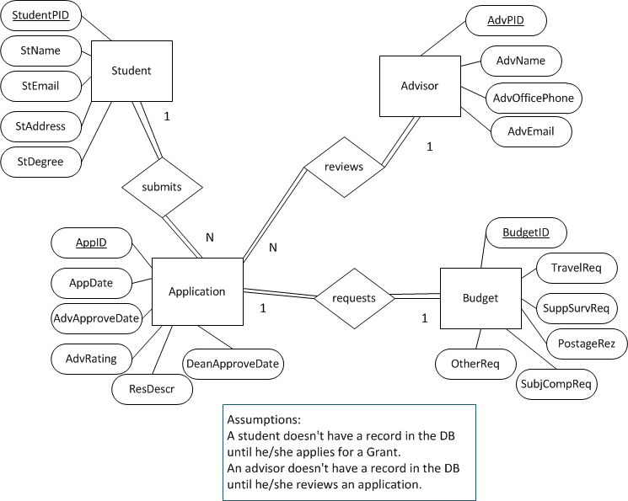
Carnegie Grant ER Exercise Solution

Slide 2
Carnegie Grant Schema
Student (StudentPID, StName, StEmail, St Address, StDegree)
Advisor (AdvPID, AdvName, AdvOfficePhone, AdvEmail)
Application (AppID, StudentPID, AdvPID, AppDate, AdvApproveDate, AdvRating, ResDescr, DeanApproveDate)
Budget (BudgetID, AppID, TravelReq, SuppSurvReq, PostageReq, SubjCompReq)

