Slide 1
Carnegie Grant CRUD
 | Create | Retrieve | Update | Delete
Student
Advisor
Application
Budget

Slide 2
Carnegie Grant CRUD
 | Create | Retrieve | Update | Delete
Student | When student submits application | StudentPID, SName | StEmail, StAddress, if change | Archive after student leaves SILS
Advisor | When advisor’s name appears on an application | AdvName | AdvEmail, if change | never
Application | When student submits application | Student PID, AdvPID, AppDate | Date fields, as approvals are gained | Archive after student leaves SILS
Budget | When student submits application | AppID | TravelReq, SuppSurvReq, PostageReq, SubjCompReq, if change | Archive after student leaves SILS

Slide 3
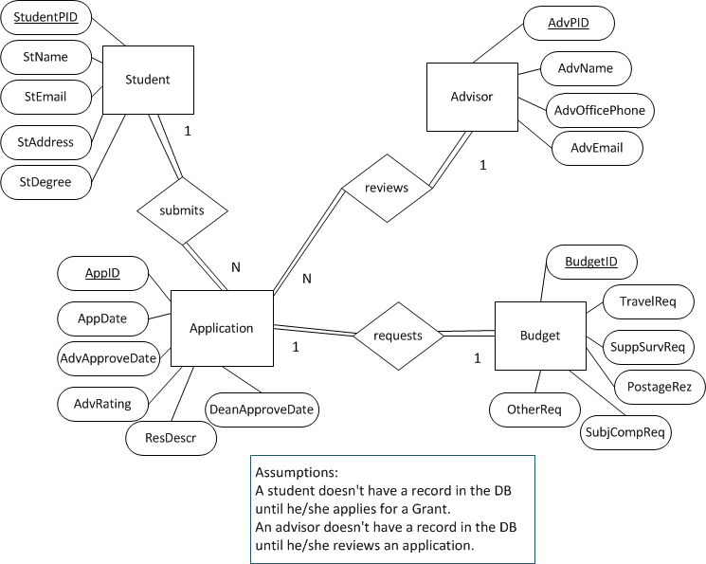
Carnegie Grant ER Exercise Solution

Slide 4
Carnegie Grant Schema
Student (StudentPID, StName, StEmail, St Address, StDegree)
Advisor (AdvPID, AdvName, AdvOfficePhone, AdvEmail)
Application (AppID, StudentPID, AdvPID, AppDate, AdvApproveDate, AdvRating, ResDescr, DeanApproveDate)
Budget (BudgetID, AppID, TravelReq, SuppSurvReq, PostageReq, SubjCompReq)

