Slide 1
JEOPARDY!
Click Once to Begin
User Education

Slide 2
People &
Places
Definitions
Numbers
Learning
Misc.
100 pt
100 pt
100 pt
100 pt
100 pt
200 pt
200 pt
200 pt
200 pt
200 pt
300 pt
300 pt
300 pt
300 pt
300 pt
400 pt
400 pt
400 pt
400 pt
400 pt
500 pt
500 pt
500 pt
500 pt
500 pt

Slide 3
Daily Double Graphic and Sound Effect!
Daily Double!!!
DO NOT DELETE THIS SLIDE! Deleting it may cause the game links to work improperly. This slide is hidden during the game, and WILL not appear.
In slide view mode, copy the above (red) graphic (click once to select; right click the border and choose “copy”).
Locate the answer slide which you want to be the daily double
Right-click and choose “paste”. If necessary, reposition the graphic so that it does not cover the answer text.

Slide 4
Wiggins and McTighe advocate backward design in instruction planning.
Place the following three phases in the appropriate order:
Determine acceptable evidence
Plan learning experiences and instruction
Identify desired results

Slide 5
Determine acceptable evidence
Plan learning experiences and instruction
Identify desired results

Slide 6
Meulemans and Carr (2013) want librarians to develop a professional value system that places primacy on meaningful collaboration (as opposed to a service model).
Describe one of their recommended steps/actions that librarians can implement toward this change.

Slide 7
Articulate your teaching philosophy
Craft and clarify our professional “policies”
Develop and practice responses (e.g. FAQs)

Slide 8
Char Booth (2011) and Heath and Heath (2007) warn against the “Curse of Knowledge” – in terms of library instruction, what does this mean?

Slide 9
The Curse of Knowledge is the state of being so expert that you have forgotten what it is like to not know something – or, in our case, to not know how to find or evaluate something (Booth, 2011, p. 4)

Slide 10
Developed the first index of citations to support
bibliometrics research.

Slide 11
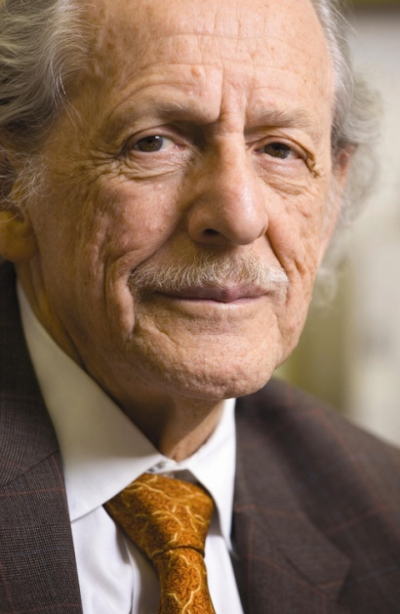
Eugene Garfield

Slide 12
Paul Zurkowski, President of the Information Industry Association, coined this term in the early 1970s in relationship to the workplace.

Slide 13
information literacy

Slide 14
The relatively permanent change in a person’s knowledge or behavior due to experience.

Slide 15
One definition of learning

Slide 16
A set of rules for ensuring quality.

Slide 17
Standard

Slide 18
One sentence that indicates what students should represent, demonstrate or produce as a result of what they learn.

Slide 19
Learning outcome

Slide 20
The integration of individual professional/clinical expertise with the best available external evidence and the values and expectations of the user/learner.

Slide 21
Evidence based practice

Slide 22
A collection of qualitative research methods that focus on the close observation of social practices and interactions.

Slide 23
Ethnography

Slide 24
Four approaches to library user education include this and library instruction, bibliographic instruction and information literacy instruction.

Slide 25
Library orientation

Slide 26
Daily Double!!!
Five competencies that describe an information literate person according to the ACRL.

Slide 27
Determine the extent of information needed
Access the needed information effectively and efficiently
Evaluate information and its sources critically
Use information effectively to accomplish a specific purpose
Understand the economic, legal, and social issues surrounding the use of information, and access and use information ethically and legally

Slide 28
Three theories of human learning

Slide 29
Behaviorism Cognitivism Humanism Social learning theory Multiple intelligences Brain-based learning

Slide 30
1. Direct explicit instruction 2. Cognitive apprenticeship 3. Cooperative / collaborative

Slide 31
Three models of teaching

Slide 32
Three characteristics of good instructional design

Slide 33
is learner-centered
is goal-oriented
focuses on real-world performance
focuses on outcomes that can be measured in a reliable and valid way
is empirical
typically is a team effort

Slide 34
According to this learning theory, content must have a personal meaning to the learner or it will not be learned

Slide 35
Humanism

Slide 36
The way in which each learner begins to concentrate on, process and retain new and difficult information.

Slide 37
Learning style

Slide 38
In the classroom, this learning theory may manifest through inquiry-oriented projects and opportunities for students to test hypotheses. Curiosity is encouraged.

Slide 39
Cognitivism

Slide 40
Learning theory focused on rewards and punishments. Responsibility for student learning rests squarely with the teacher. Classroom activity is typically lecture-based and highly structured.

Slide 41
Behaviorism

Slide 42
Behavior sparked by one's own interests or pure enjoyment.

Slide 43
Intrinsic motivation

Slide 44
The cutest carnivore in the world.

Slide 45
Pine marten

Slide 46
A national conference focusing on library instruction.

Slide 47
LOEX Library Orientation Exchange Conference

Slide 48
Bloom’s Taxonomy
of thinking and learning
highest
lowest

Slide 49
remembering
understanding
applying
analyzing
evaluating
creating
Bloom’s Taxonomy
of thinking and learning
highest
lowest

Slide 50
Assessing student learning Four methods of direct measurement

Slide 51
Knowledge test
One minute paper & variations
Bibliography analysis
Concept inventory
Standardized test

Slide 52
Four of the six principles of sticky ideas described by Heath & Heath.

Slide 53
Simplicity
Unexpectedness
Concreteness
Credibility
Emotions
Stories

