Slide 1
notes
let me know if you want feedback on your revised teaching philosophy
feel free to contact me about cover letters/resumes when you go out on the job market
keep in touch with each other – keep growing your network
please complete class evaluation online

Slide 2
For the things we have to learn before we can do them, we learn by doing them.
-Aristotle

Slide 3
thoughts on librarianship & user education*
*views expressed here are strictly those of
former reference and instruction librarian, Rachael Clemens

Slide 4
profession
respect
empathy
observe
be yourself
explore

Slide 5
P profession R respect E- empathy O observe B be yourself E explore
PRE-OBE*
*different from pre-out-of-body-experience phenomena

Slide 6
B be yourself E empathy E explore R respect O observe P profession
BEER-OP*
*but only really good beer

Slide 7
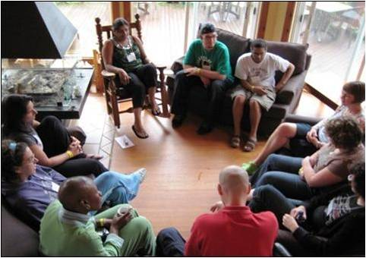
Profession

Slide 8
Respect
“Stupidest reference questions…”
“Why did they even hire me, if they don’t want to hear what I have to say?”
“Has this decision already been made? If so, why do you want our input?”
“I don’t feel safe raising the issue until after I get tenure”
Notes:
Demonstrate respect for people on a consistent basis – by falling into a habit of disrespect you ultimately sabotage your own integrity
We don’t know where someone is coming from – what challenges they might face (physically, cognitively, emotionally); or even what kind of day someone is having
One negative experience in a library far outweighs a positive experience

Slide 9
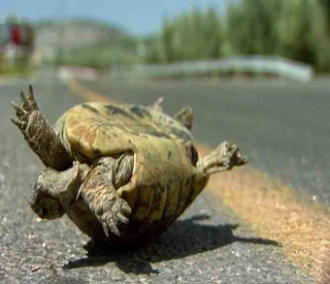
Empathy
Notes:
Remember what it feels like not to know or not to know how to do something
Place yourself in positions or situations where you don’t know everything (or anything) – where you are relying on someone else to guide your learning experience; carefully observe what they do.
This will make you a much better teacher

Slide 10
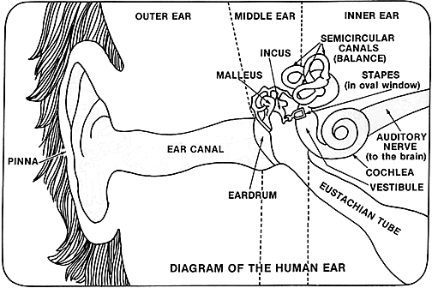
Observe
Notes:
Stop talking/teaching and listen. As Judge Judy says, put your listening ears on – there’s a reason God gave you two ears and only one mouth – listening is very important. I did a presentation recently where someone in the audience started asking me a question – but before he was finished I was already answering – ANOTHER QUESTION. So just wait…

Slide 11
Be Yourself
Notes:
Throughout your life already you’ve encountered many great teachers I’m sure – and it’s important to have strong role models – and adopt strategies and techniques for your own practice. But I think the strongest teachers are those that don’t set out to reinvent themselves but instead build on their own strengths, personality characteristics and even quirks.
Blind date story – dad’s exasperation with me for focusing so much on myself – the guy just wanted to go out for a fun evening. Just put on something and come on already.

Slide 12
Explore
ACRL Annual Immersion Program, LOEX
Toastmasters
State Library of North Carolina Master Trainers Program
Environmental interpretation
Marketing / advertising class
Train the trainer opportunities (e.g. vendors like RefWorks, PubMed or other electronic resource products)

Slide 13
PRE-OBE or BEER-OP

