Slide 1
Comments on Communications panel?
instruction observation reflections – points to share? (example from Barbara)
self evaluation / reflection on instruction experience project: due Dec 3 (last day of class)
revision / polished teaching philosophy: due Dec 10

Slide 2
user ed in non-traditional settings
opportunities for us to practice
user ed in non-library settings
opportunities for us to learn

Slide 3
user education in non-traditional settings: archives

Slide 4
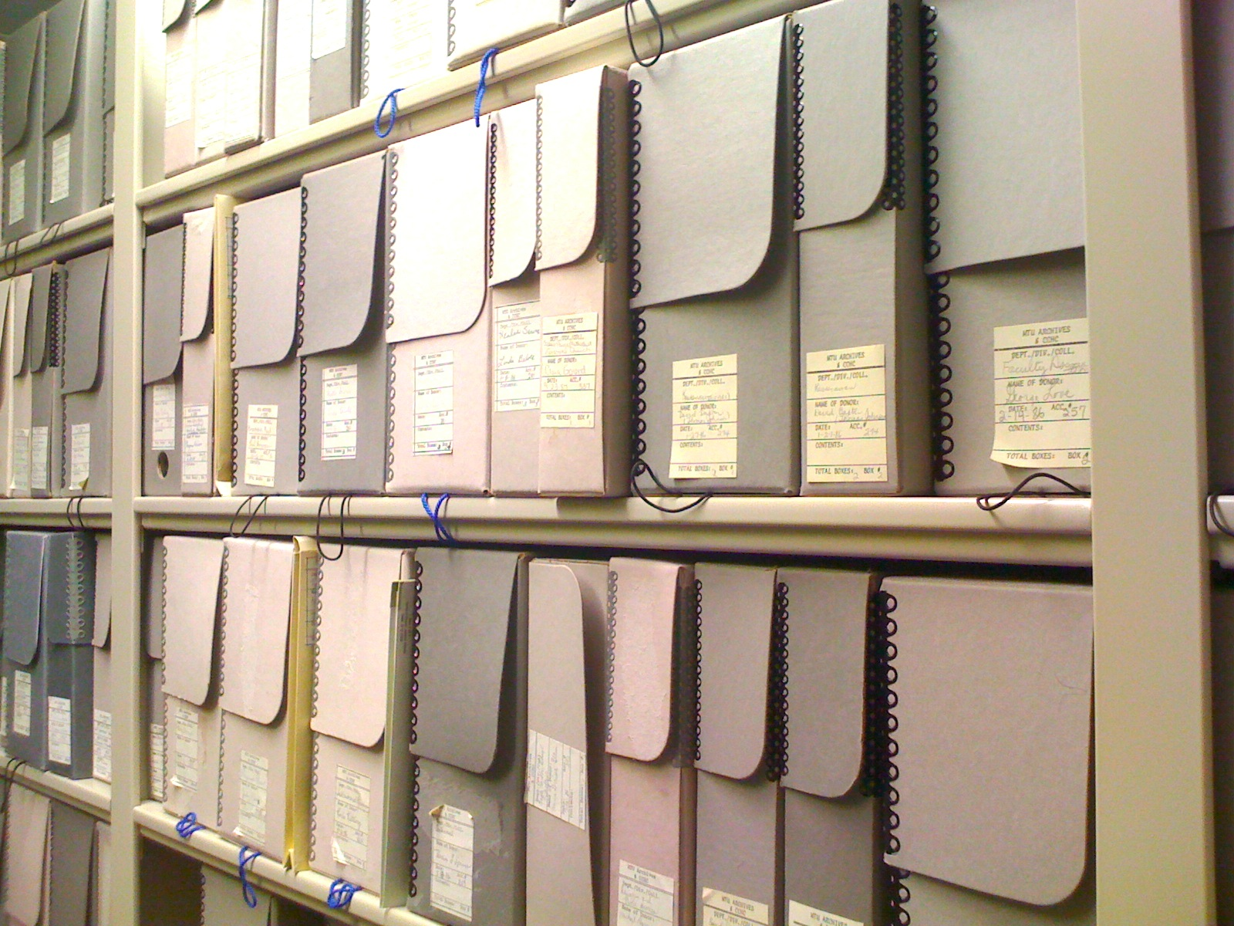
Advancing the use of archival records in the curriculum should be considered an important part of, rather than an alternative to, the ‘administrative duties’ of the archivist.
Greene, M.A. (1989). Using college and university archives as instructional materials: A case study and an exhortation. The Midwestern Archivist, 14(1), 32.

Slide 5
SAA Guidelines for College & University Archives
Academic archives should also serve as an educational laboratory where students may learn about:
A particular subject
The different types of available resources
The proper procedures and techniques for using primary archival resources in their research projects
http://www.archivists.org/governance/guidelines/cu_guidelines4.asp

Slide 6
NARA
The National Archives and Records Administration (NARA) began extensive programs to integrate historic documents into primary and secondary school curricula in 1977
Carini, P. (2009). Archivists as educators: Integrating primary sources into the curriculum. Journal of Archival Organization, 7(1), 41-50.

Slide 7
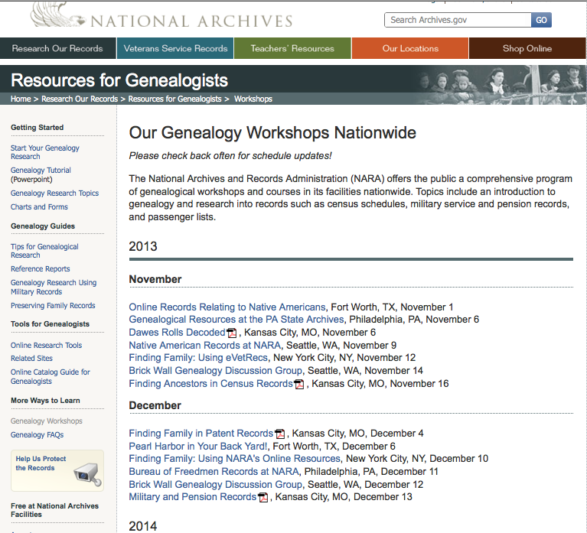

Slide 9
challenges for instruction in archives
define a set of competencies – archival intelligences (Yakel & Torres)
what is primary source literacy?
focus on structure and process of using archival materials
focus on archival document(s) first

Slide 10
user education in non-traditional settings: museums & special collections

Slide 11
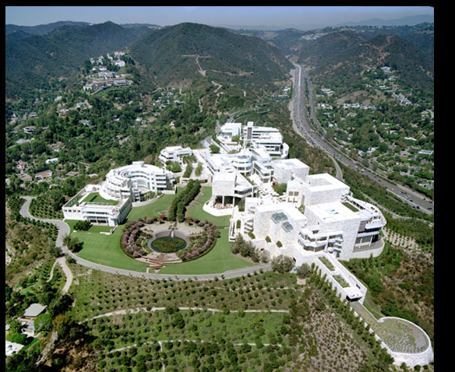
The Getty Museum, Research Library, Conservation Labs
Teach specialized workshops for the local community and researchers
Teach professional development workshops (preservation, disaster preparedness, etc.)
Develop online instruction tutorials / modules for collections
Craft lesson plans using primary sources in collaboration with teachers

Slide 12
The Huntington Library, Art Collections, and Botanical Gardens
Work with local schools and homeschoolers to facilitate tours and classes
Work with K-12 teachers to design effective assignments and lesson plans

Slide 13
What do you think the teaching take-aways are from this article for those of us with no intention of teaching archives?
-Nicole

Slide 14
One thing the article mentioned was that reference librarians were often unaware of archival resources, and were in need of user education in this field. She also suggested archivists might benefit from more exposure to librarian's user education expertise. Similar situations might arise for other specialties (e.g. non-law librarians might not be aware of the tools needed for Shepherdizing cases).
That prompted me to think about a few questions:
As librarians, what is the best way to reach out to other librarians/archivists about user education in your specialty?
As librarians, what is the best way of making sure you stay "up-to-date" about the resources available in your library, even if they are ones in an area you are unfamiliar with?
-Rob

Slide 15
On page 120, the author posits a question: "What are the essential building blocks required to create the greatest amount of self-sufficiency possible in researchers using primary sources?"
My question: How do we determine if an archives user (or any user) WANTS to be self-sufficient? I know this is an over-arching goal of library service and instruction in general, but is there a way to determine in the reference interview if the librarian is just wasting their time on instruction for a one-off project. OR would forced instruction in this specialized case be one reason why a person might not come back to an archival library? Or are we not catering to "that type" of library user anyways?
-Meredith

Slide 16
user education in non-traditional settings: games & learning

Slide 17
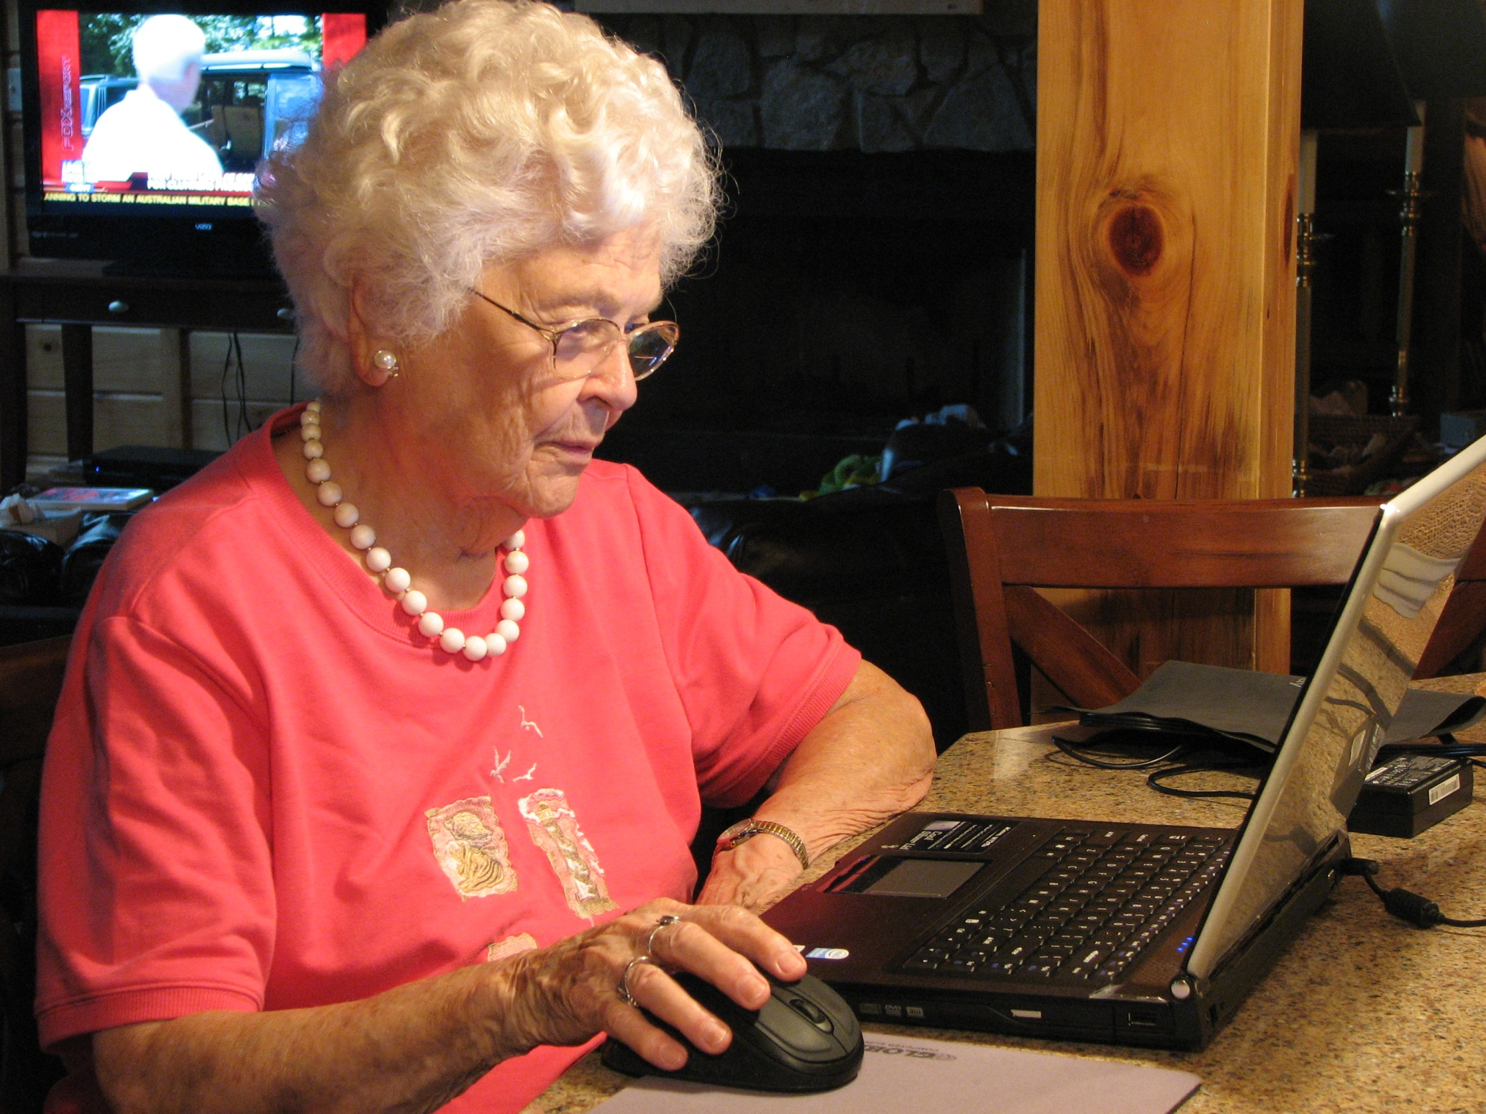
GAMING WITH GRANDMA

Slide 18
Gaming & Info Literacy
Connected Learning Research Network
Gaming in Libraries – free online course with Dr. Scott Nicholson, Syracuse iSchool: http://www.gamesinlibraries.org/course/
Games – Learning - Society
Second Life

