Slide 1
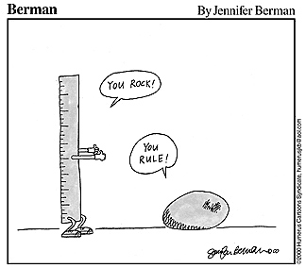
assessment cont’d
tues oct 15

Slide 2
notes
status reports [handout]
instruction experience project
context description and needs assessment (due Tuesday)
what / who / where / when
strategy(ies) to assess student learning
specific learning outcomes & instructional design plan due Tues Oct 29
publicity signs, workshop handouts, etc.

Slide 3
successful instruction includes a number of common features
active participation
practice
individual differences
feedback
realistic context
social interaction

Slide 4
assessment-informed model of teaching
define learning outcomes (desired by teachers and/or learners) well in advance.
assess progress toward outcomes, by and for both teacher and learner, continually during learning.
evaluate attainment of outcomes rigorously as each learning opportunity concludes.
session-by-session, semester-by-semester, program-by-program

Slide 5
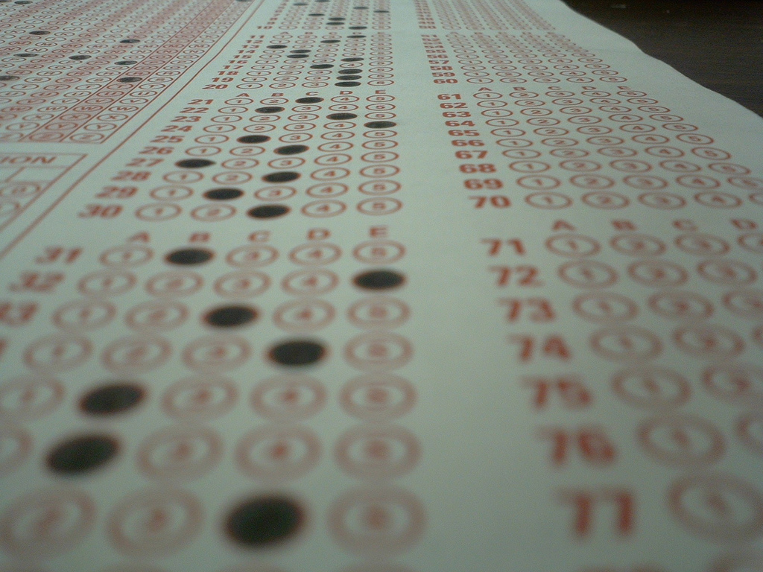
 | Strongly agree | Agree | Neutral | Disagree | Strongly Disagree
The librarian was prepared for the session.
The librarian was organized.
The librarian included time to practice the skills that were introduced.
The librarian explained and demonstrated search strategies that were relevant to my research needs.
The librarian was knowledgeable and responsive to questions.
The handout was helpful.

Slide 6
Direct and Indirect Measures
Direct: Students demonstrate an expected learning outcome
Indirect: Students report their perception of how well a given learning outcome has been achieved
Direct is always preferable

Slide 7
Assessment - sample size
Use any convenient sample that will give you useable information
Make sure that groups of interest are represented
Sample size is important only if you plan to publish your results (+ IRB)
Do you want to generalize to the entire “student” population?

Slide 8
Easy assessment methods
knowledge test
one minute paper & variations
bibliography analysis
concept inventory
standardized test
query faculty for feedback

Slide 9
Knowledge tests
tests knowledge/skills before and/or after library instruction session
can be given at end of library session or later in semester (Qualtrics, Doodle, Sakai)
can use clickers to gather data during library session (Polleverywhere)
Sample questions:
Identify one difference between a library catalog and a database?
The Boolean operator “or” narrows a search statement (true/false).

Slide 10
One minute paper & variations
Sample questions:
What is the most important thing about library research you learned today?
3-2-1 (three things you learned, two things you’re still confused about, one thing you’d change about session)
What is one question you still have?
In your research, what will you do differently after today’s session?

Slide 11
Using Blackboard, Sakai, other CMS
Tests: are graded, can look at individual results
Surveys: not graded, results are aggregated
Assignments: allow students to upload documents (e.g. reference list, literature review)

Slide 12
Bibliography analysis
Look for citations from scholarly/peer reviewed journals
Look for citations for books and journals owned and/or accessed through UNC libraries
Look for articles retrieved from UNC databases

Slide 13
Concept inventory
Make a checklist of 3-12 important concepts students need to master
Ask student to explain each concept in a sentence or two. If a concept is unfamiliar, they should leave blank
Count good responses for each concept, then plan future instruction

Slide 14
Standardized tests
I-Critical Thinking (previously I-Skills) from ETS http://www.ets.org/iskills/about
Information Literacy Test (developed at James Madison University – now commercial)http://www.madisonassessment.com/assessment-testing/information-literacy-test/
SAILS (Standardized Assessment of Information Literacy Skills – Kent State) https://www.projectsails.org/

Slide 15
Using assessment information
rewrite learning outcomes
change what you do/how you teach
work collaboratively with colleagues (librarians, discipline faculty, local service agencies, local school teachers)
revise assessment measures
reporting (team, annual report, admin)
share the news in the library and on campus or community

Slide 16
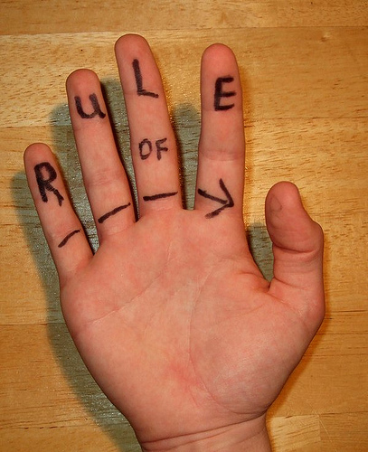
don’t do it if you are not going to use it

Slide 17
Resources
ACRL Value of Academic Libraries: http://www.acrl.ala.org/value/
Common Core State Standards Initiative: http://www.corestandards.org/
Student Learning Outcomes Assessment (University of Virginia) http://www.web.virginia.edu/iaas/assess/assessment.shtm
Angel, Thomas (1993). Classroom assessment techniques
Neely, Teresa (2006). Information literacy assessment: Standards-based tools and assignments
Radcliff, Carolyn et.al (2007). A practical guide to information literacy assessment for academic librarians.

Slide 18
Questions for you to ask at job interviews:
How does assessment and/or evaluation work here?
How would I be evaluated?
[job performance, scholarly activities, service]
Is there a mentorship program? Can you tell me more about it?
What kinds of support is available for professional development?
Another suggestion: talk about what classes/programs you would like to develop – not what you could do

