Slide 1
http://cfe.unc.edu/e-learning/showcase.html

Slide 2
Information & Library Science Library
Z711.25.C65 L53 2009

Slide 3
Qualtrics | Laura | Tues Nov 12
Camtasia | Nicole
Mooc’s | Meredith
Wix | Barbara
Concept Mapping | Jessica
ManyEyes | Robert
PollEverywhere | Rachael
 | Jonathan

Slide 5
Follow-up on Jonathan’s class on teaching…

Slide 7
Notes:
Poll Title: According to UBD there are 6 "facets to understanding". They are: http://www.polleverywhere.com/multiple_choice_polls/cYReQeG1mHZ3o6v

Slide 8
challenges
Need to install program to create a poll
Must use MS PPT
Depends on connection speed…

Slide 9
Opportunities
Participants may respond anonymously
Different types of polls (T/F, Multiple choice, free-text)
Poll is embedded within PPT presentation and updates in real time
A free text poll allows participants to send free-form text responses or short answers instead of pre-defined choices
Can display your audience's answers in real time on a projector for everyone to see, or just on a laptop in front of the presenter

Slide 10
Tuning Protocol
The Tuning Protocol is a structured process that allows for reflection and meaningful feedback about a project, a text, a performance, or any work in progress.
The Tuning Protocol assumes that the presenter or presenters want to improve the work in question and that the participants will deliver thoughtful, substantive feedback.
It is like tuning up a car or an orchestra—it assumes that attention to improvement matters.
Notes:
The Annenberg Institute for School Reform at Brown University first developed the Critical Friends model for collegial dialogue

Slide 11
how can I tune-up this instruction session?

Slide 12
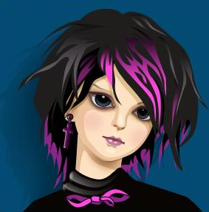

Slide 16
1 | Facilitator | Reviews the process at the outset, even if everyone is familiar with it. Sets time limits and keeps time carefully. Participates in discussions but is on the lookout for others who want to get in conversations.
2 | Presenter or presenter team | Prepares an issue for consultancy. Is clear about the specific questions that should be addressed. Presents the issue to participants – participants are silent during this period. Unlike most discussions of this nature, the presenter does not participate in the group discussion. Sits outside the group and does not maintain eye contact during the discussion but rather takes notes and gauges what is helpful and what is not. Later, is specific about the feedback that was helpful.
3 | Participants to Presenter | Probing or clarifying questions brief
4 | Participants | Address the issue brought by the presenter and give feedback that is both warm (positive) and cool (critical). The feedback should be given in a supportive tone and discussants should provide practical suggestions.
5 | Presenter | Presenter response to group feedback
6 | Facilitator + all | Debrief: Facilitator leads discussion, critiquing the process

Slide 17
After asking clarifying questions, participants offer three levels of feedback:
1. warm | respondents describe what they see working or what they like in a work.
2. cool | respondents consider aspects of the work that might be improved or clarified by framing their response in the form of a question: "I wonder if…?" or "Have you thought about…?"
3. hard | respondents ask deeper questions that get at larger, structural aspects of the work.

Slide 18
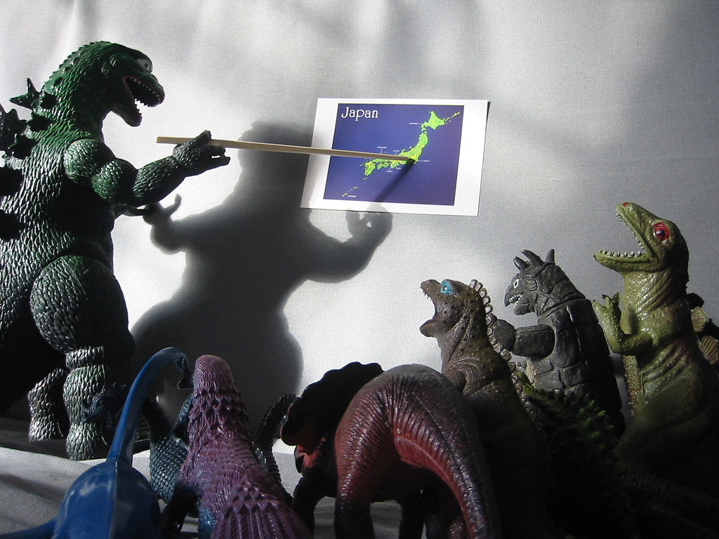
less about training
Image credit: Introduction to Monstering from WorldIslandInfo
http://www.flickr.com/photos/76074333@N00/318034222/in/set-72057594137055528

Slide 19
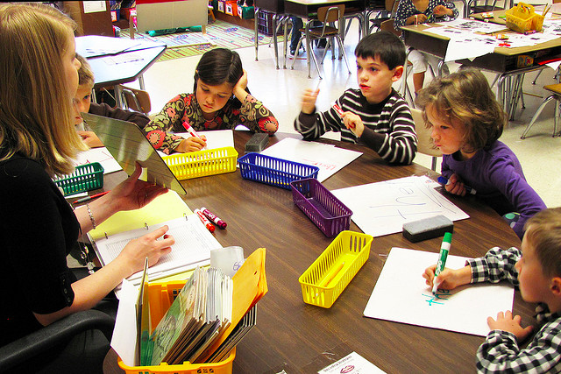
more about facilitating
Image credit: First grade class from WoodleyWonderWorks
http://www.flickr.com/photos/wwworks/4005631298/in/set-72157627432819304

