Slide 1
instruction experience project: context description and needs assessment component
Due by Oct 22
Context Description
Needs Assessment
topic (will be more specific in learning outcomes)
format
details
publicity
your needs & how can i help?

Slide 2
normative need
expressed need
comparative need
anticipated need
Observed / expressed need
Learner characteristics
Target learners
who
context in which learners will use the skills
tools available to the learners
characteristics that might affect the decisions you make regarding the development of an effective learning environment
might include:
cognitive abilities
previous experiences
motivational interests
personal learning styles
Notes:
The Needs Assessment is undertaken to identify the goals for an instructional project. In doing so you are trying to identify the gap between the desired goals and the current status. This gap is referred to as a need (hence the term "Needs" Assessment). Burton and Merrill (1991) have summarized six types of educational needs:
Normative need - A discrepancy between an individual�s or group�s present state and a given norm or standard. Normative needs exist if, for example, a student's score on the SAT is lower than the national standard or average or if general education courses at a college do not meet state requirements.
Felt need - A felt need is an individual desire or want that an individual has to improve either his or her performance. Asking people what they want is frequently used in identifying felt needs. One, however, should be cautious in using this type of data since perceptions of possibilities, social acceptance, and availabilities as well as personal attributes may influence what people say they want. When searching for felt needs, designers must be aware of needs that are motivated by a desire other than performance improvement.
Expressed need or demand - A felt need becomes an expressed need when people put what they want into actions. For example, if more students sign up for an online course than the seat limit, then there may be an expressed need for more sections of the course. Expressed needs are often identified in suggestion boxes and in-house publications with a question-and-answer or suggestion column.
Comparative need - A discrepancy between what one group has and what another group, with similar characteristics, has. A comparative need is present when two groups with similar characteristics do not receive a similar service. College A in a given state, for instance, has a modern computer laboratory, whereas College B in the same state does not. A comparative need may thus exist.
Anticipated or future need - A discrepancy between what is presently available and the projected demands of the future. Undoubtedly, the identification of anticipated needs is critical in educational planning since this may help equip students with necessary knowledge and skills to deal with "what will be" rather than "what is". Identifying such needs should be part of any planned change so training can be designed prior to implementation of the change. For example, a school principal and supervisors might decide to implement a new instructional technique (e.g., cooperative learning) next year. An anticipated need is the knowledge teachers require to use the cooperative learning method effectively in a classroom.
Critical-incident need - Critical-incident needs emerge when failures that may be rare but have significant consequences happen. Shootings in Columbine High and other schools prompted needs for security measures to be taken in public schools as well as education on violence to be received by the public. Critical incident needs are identified by analyzing potential problems. For example, chemical plants and petroleum refineries often develop employee training programs for handling emergencies such as fires, explosions, or spills. Other critical incident needs are identified by asking "what if.' questions; for example, what would happen if the main computer or phone system failed?
Burton, J. K., & Merrill, P. F. (1991). Needs assessment: Goals, needs and priorities. In L. J. Briggs, K. L. Gustafson, & Tillman, M. H. (Eds.), Instructional design principles and applications (pp. 17-43). Englewood Cliffs, NJ: Educational Technology Publications.

Slide 3
instruction experience project: context description and needs assessment component
Due by Oct 22
Needs Assessment
Think about an instructional need that you can address
You may already have the expertise/knowledge or you might immerse yourself and quickly become an expert
For our project keep the scope small, tight and reasonable
Who are the learners that you will be designing for? Include any learner characteristics that might affect the decisions you make regarding the development of an effective learning environment. These might include cognitive abilities, previous experiences, motivational interests, and personal learning styles
What makes you think that the need can be addressed by instruction?

Slide 4
interesting…BUT when/how could I use this information in my practice?
…learning styles

Slide 5
At the end of the chapter, the author recommends that teachers focus on content not on the students. This seems to be good advice, particularly for librarians because it is rare that we would have the opportunity to truly get to know our students and how they learn.
How could the different learning styles, for example visual-auditory-kinesthetic, be applied to the content of information literacy?
-Laura

Slide 6
Provide variety in your instruction
Reflection on learning styles may prompt you to create more diverse lesson plans – hopefully more engaging to all
When a misunderstanding arises in the classroom use your knowledge of learning styles to reflect upon how you are presenting material
Trying new approaches and forcing yourself to experiment ultimately makes you a better teacher. It also helps prevent boredom and burnout especially with repetitive topics (r.c.)

Slide 7
A few examples…
Visual learner benefits from visual presentation of information, looking things up, writing things down, and “seeing” the words (forming word pictures in the brain)
Consider providing handouts of content, use videotapes, slide presentations, illustrations, posters, and other visual props

Slide 8
A few examples…
Kinesthetic learner benefits from taking things apart, making things work, using their hands and tactile stimulation
Consider using 3 dimensional models and replicas, laboratory sessions, scenarios and role-play
e.g. internet model

Slide 9
A few examples…
Auditory learner benefits from oral presentation of information: discussion, listening, and verbalizing
Consider using lectures, oral presentations and class discussions to stimulate learning
Encourage students to audiotape lesson

Slide 10
VISUAL
Take the PubMed Tutorial Building the Search on your own and look at PubMed handout provided.
Write down the steps as they are recommended.
On your own, conduct a search to find information on bipolar disorder.
AUDITORY
In your small group take the 5 short PubMed Tutorials linked under Searching PubMed.
Together construct a search to find information on bipolar disorder. Discuss strategies/questions with colleagues
KINESTHETIC
In small group spend a few minutes playing with the PubMed database.
As a group construct a flowchart on paper on the steps one should take to find information on bipolar disorder
Don’t take any of the tutorials

Slide 11
YIKES!
No need to memorize the different learning styles or fit learners into neat categories Most of us fall into multiple categories anyway.
We are talking about learning styles to demonstrate that people learn in different ways, which will assist you in being sure that you present material in various ways to accommodate all learners. If something seems not to work, try a different style.
How do I address all these different styles?

Slide 12
bad teachers often focus on "me" (themselves)
average teachers focus on "it" (the task at hand)
good teachers focus on "them" (the students)
Keeping the "me, it, them" progression in mind helps me keep things well within the learner-centered teaching model.
-former student, Tim Cook

Slide 13
building relationships
Students do not care how much you know until they know how much you care.
“No significant learning occurs without a significant relationship.”
-Dr. James Comer PhD, Yale University

Slide 14
what do we mean by relationships?
a successful relationship occurs when emotional deposits are made to the student, emotional withdrawals are avoided and students are respected.
are there boundaries to the relationship?
establish high expectations
honor students as human beings worthy of respect and care.

Slide 15
creating relationships
Deposits | Withdrawals
Seek first to understand | Seek first to be understood
Keeping Promises | Seeking Promises
Clarifying expectations | Violating expectations
Loyalty to the absent | Disloyalty , duplicity
Apologies | Pride, arrogance, conceit
Open to feedback | Rejecting feedback
Steven Covey’s “ The Seven Habits of Highly Effective People”

Slide 16
Few understand the courage it takes to return to a place where he/she failed yesterday, the day before and in all probability will fail again the next day.
Unattributed quote

Slide 17
PechaKucha
pronouncing
brief overview
rules of the game:
20 slides
20 seconds each (transition automatically)
may have animation within a slide but maintain total slides and time
active library instruction
fairly comical example (not technically a PechaKucha)

Slide 18
instructional design
Notes:
Definitions of Instructional Design
Instructional Design as a Process:
Instructional Design is the systematic development of instructional specifications using learning and instructional theory to ensure the quality of instruction. It is the entire process of analysis of learning needs and goals and the development of a delivery system to meet those needs. It includes development of instructional materials and activities; and tryout and evaluation of all instruction and learner activities.
Instructional Design as a Discipline:
Instructional Design is that branch of knowledge concerned with research and theory about instructional strategies and the process for developing and implementing those strategies.
Instructional Design as a Science:
Instructional design is the science of creating detailed specifications for the development, implementation, evaluation, and maintenance of situations that facilitate the learning of both large and small units of subject matter at all levels of complexity.
Instructional Design as Reality:
Instructional design can start at any point in the design process. Often a glimmer of an idea is developed to give the core of an instruction situation. By the time the entire process is done the designer looks back and she or he checks to see that all parts of the "science" have been taken into account. Then the entire process is written up as if it occurred in a systematic fashion.

Slide 19
analyzing learning needs
developing goals
designing delivery system
developing materials & activities
executing/conducting
assessing product and outcomes
instructional design

Slide 20
learning objectives for today…
we will explore and consider models and strategies for designing instruction
to explore these instructional design strategies we will apply them to simulated instruction needs

Slide 21
instructional design is…
the systematic development of instructional specifications using learning and instructional theory to ensure the quality of instruction.
the entire process of analysis of learning needs and goals and the development of a delivery system to meet those needs.
includes development of instructional materials and activities; and tryout and evaluation of all instruction and learner activities.

Slide 22
steps in instructional design
needs assessment
prioritize needs and evaluate appropriateness
develop overarching goals
examine context and collaboration – placement of your role in the learning process
identify learning outcomes
plan instruction + activities that support learning outcomes
assessment at several points
revisit and revise steps 1-7

Slide 23
characteristics of instructional design
is learner-centered
is goal-oriented
focuses on real-world performance
focuses on outcomes that can be measured in a reliable and valid way
is empirical
typically is a team effort
Gustafson, K.L. & Branch, R.M. (2002) What is instructional design? In Trends and Issues in Instructional Design and Technology, R.A. Reiser and J.V. Dempsey, eds.
Notes:
Is learner-centered – so can include self and group study, technology-based instruction, and teacher-based instruction, or a mix of these.
Is goal-oriented – goals of the “client” (in our case, the course instructor) and also everyone working on the project. In our case, we also want to include goals of information literacy.
Focuses on real-world performance – not just ability to recall information or apply rules on a contrived task, but instructional design focuses on preparing learners to perform the behaviors expected of them in the real world, to demonstrate the skills and knowledge they are expected to have in actual situations. For example, can students actually find X number of high-quality sources for their term paper.
Focuses on outcomes that can be measured in a reliable and valid way – creating valid and reliable assessment instruments. [Valid - actual performance. Reliable – consistent across time and individuals.]
Is empirical – collect data at several points: During analysis: what they know and what they need to learn. Formative assessment (tryout) identifies revisions needed. After implementation, data from the results indicate whether the instruction is effective. In our example, we question the instructor on background, needs, and expectations of the class. We have exercises or activities or questions during the class to help them learn and also to gauge understanding. Finally, the students’ bibliographies will tell us if they learned how to use the research skills we taught them.
Typically is a team effort – at minimum, communication with the instructor. Designing online instruction usually requires several people.

Slide 24
instructional design models
procedural and conceptual models
based on theory (learning theory, systems theory) or practice (company, military, software development)
4 examples

Slide 25
Merrill’s First Principles of Instruction
Problem/Task-centered:
Learning is promoted when learners are engaged in solving real-world problems
ACTIVATION of prior experience
DEMONSTRATION of skills
APPLICATION of skills
INTEGRATION of these skills into real-world activities

Slide 26
model of Gagné & Briggs
“…instruction is a set of events external to the learner, which are designed to support the internal processes of learning.”(Gagné)
instructional events
gaining learners’ attention
informing the learner of the objective
stimulating recall of prerequisites
presenting stimulus material
providing learning guidance
eliciting performance
providing feedback
assessing performance
enhancing retention and transfer
Gagne, R.M., Wager, W.W., Golas, K.C., & Keller, J.M. (2005). Principles of Instructional Design (5th ed.). Belmont, CA: Wadsworth/Thomson Learning, Inc.

Slide 27
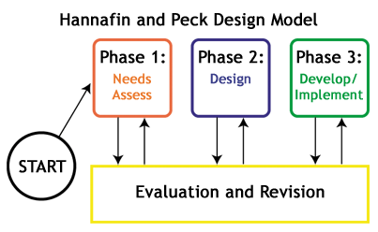

Slide 28
ARCS
Keller, J.M. (1987). Development and use of the ARCS model of motivational design. Journal of Instructional Development, 10(3), 2-10.
Major categories | Definitions | Process questions
Attention | Capturing the interest of learners; stimulating the curiosity to learn | How can I make this learning experience stimulating and interesting?
Relevance | Meeting the personal needs/goals of the learner to effect a positive attitude | In what ways will this learning experience be valuable for my students?
Confidence | Helping the learners believe/feel that they will succeed and control their success | How can I via instruction help the students succeed and allow them to control their success?
Satisfaction | Reinforcing accomplishment with rewards (internal and external) | What can I do to help the students feel good about their experience and desire to continue learning?

Slide 29
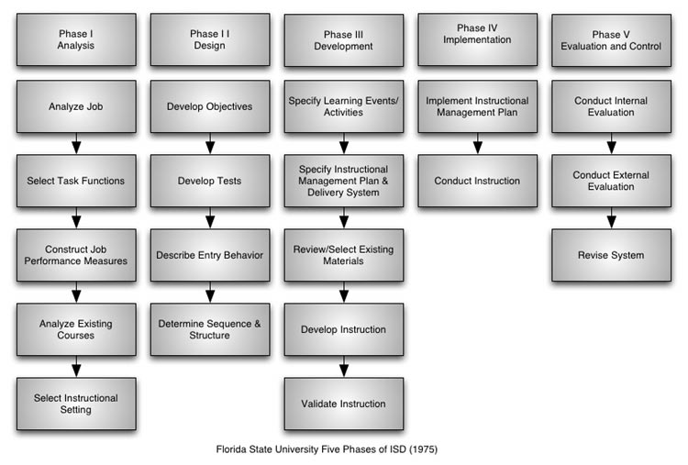

Slide 30
ADDIE
Developed for the U.S. Army as part of the Instructional Systems Development (ISD)
Analysis | Analysis of the environment, learner and tasks; what is the learning objective?
Design | Designing a plan for developing instruction; how will learners accomplish the learning objective?
Development | Development of the instructional activities
Implement | Implementation of the design
Evaluate | Evaluation of the learner performance and effectiveness of the design; ensuring quality
Iterative, not linear
Notes:
Analysis
Conduct a needs assessment
Identify a performance problem
State a goal
Design
Write instructional objectives
Identify type of content to be learned
Select instructional strategies according to the content type
Select media
Development
Prepare student and instructor materials (both print and non-print) as specified during design
Implementation
Deliver the instruction in the setting(s) for which it was designed
Evaluation
Formative and summative as well as revision
Instructional design involves many steps, and ADDIE is a generic, short-hand description of the process. If you go online, you will find different versions of what is involved in the Design segment, and that is because people are putting in various parts of the process they see as important.
Finally, instructional design process is
Iterative, not linear – Steps are presented sequentially for convenience, but instructional designers move back and forth between analysis, design, and formative evaluation and revision. This is its strength.

Slide 31
how or when might an instructor determine that prior knowledge of a given topic is non-existent or insufficiently present (for the activation phase of learning)?
-Kerry
how do you know what to teach?

Slide 32
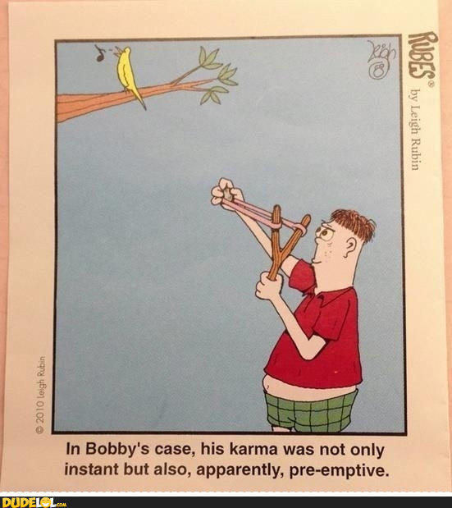
preemptive measures

Slide 33
Preemptive Measures:
Instruction Request Form IUB
Instruction Request Form UC Berkeley
Instruction Request Form Phoenix College

Slide 34
Instruction Librarians:
The folks in Library Systems are fielding an increasing number of requests for assistance in using the latest version of MS Office. It seems a workshop would be a more efficient approach to assist all library faculty and staff in increasing their productivity software skills.
Would you please put together a professional development workshop to address this need?
Thanks!
-University Librarian

Slide 35
analyzing learning needs
developing goals
designing delivery system
developing materials & activities
executing/conducting
assessing product and outcomes
instructional design

Slide 36
To all librarians:
We have received an increasing number of requests for genealogical information – folks who are trying to put together a family history and need to know more about potential resources and how to access/use them.
Tom improve our outreach and service to the community, I would like for us to offer a class on genealogy research techniques and tips.
Would you please put together a workshop to meet this need?
Thanks!
-Public Library Director

Slide 37
analyzing learning needs
developing goals
designing delivery system
developing materials & activities
executing/conducting
assessing product and outcomes
instructional design

Slide 38
constraints and barriers in IL
Time
Room layout
Lateness
Lack of motivation
Vast material
to cover
Need for
assessment
Lack of continuity
with students

Slide 39
design challenges
lecture/demonstration
discovery learning/reporting back

Slide 40
advantages of lecture/ demonstration
control of time management
control over coverage of content
control over order of content
can focus on content, specific resources

Slide 41
advantages of discovery learning/reporting back
✓ | active
✓ | peer dynamics
✓ | hands-on
✓ | students responsible for own learning
✓ | enhanced intrinsic motivation (due to reporting back)
✓ | learning in order to teach creates more motivation than learning in order to be tested
✓ | failure useful – creates teachable moments

Slide 42
potential solutions
combining lecture/demonstration with reporting back and assessment
tools: ppt for instructions
whiteboard for navigation cues
1 page handout for tips
LibGuide for more information
polleverywhere for assessment

Slide 43
design
write instructional objectives
identify type of content to be learned (facts, concept, rule/principle, procedure)
select instructional strategies according to the content type
select media (instructor speaking, simulation, worksheets, multimedia, web-based instruction, etc.)
Notes:
I will discuss each of these steps in more detail.

