Slide 1
miscellaneous
comment on reviewing / editing
address learning objectives / mission of the institution and/or library itself
address specific requirements in a job description
incorporate a quote that inspires or reflects your beliefs on teaching
don’t rehash your CV
avoid starting every sentence with “I”
don’t make empty statements…”I use active learning

Slide 2
be yourself

Slide 3
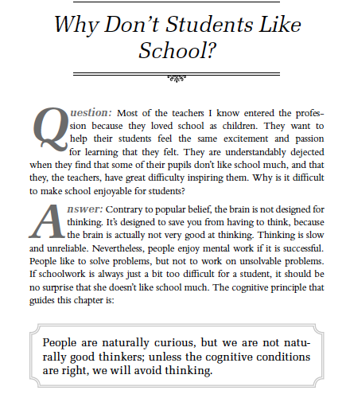

Slide 4
People ’s minds are not especially well - suited to thinking; thinking is slow, effortful, and uncertain. For this reason, deliberate thinking does not guide people ’ s behavior in most situations. Rather, we rely on our
memories, following courses of action that we have taken before.
Nevertheless, we find successful thinking pleasurable. We like solving
problems, understanding new ideas, and so forth. Thus, we will seek
out opportunities to think, but we are selective in doing so; we choose
problems that pose some challenge but that seem likely to be solvable,
because these are the problems that lead to feelings of pleasure and
satisfaction.
For problems to be solved, the thinker needs adequate information from the environment, room in working memory, and the required facts and procedures in long - term memory.
p. 18

Slide 5
If we try to make our questions less complicated for students so that they appear solvable in order for them to be more engaged, are we losing value of our lesson? How can we make questions/problems more approachable and solvable to students without intimidating their thinking process, causing them to shut down? How can we successfully teach users through this process of posing questions (creating curiosity) and allowing them to reach the answers themselves (therefore gaining that satisfaction) rather than just telling them the answers?
-Jessica

Slide 6
In your educational experience, you have probably encountered material that seemed so overwhelming that it was hard to even begin trying to comprehend it. What made the material so overwhelming?
-Jonathan

Slide 7
I disagree with Willingham's basic premise that brains aren't designed to think, particularly when the examples given in support of the premise are overly simplistic. Moreover, Willingham consistently uses only one narrow type of "thinking" to illustrate the premise: logic games and math problems, which bore me to tears. The idea that the number grid would engage most people, whereas the geometry problem would not, is doubly-biased: first, Willingham assumes that most people like numbers, and also assumes that they like one kind of number game more than another. Neither game would interest me enough to waste even a second on it.
The kind of learning I enjoy tends not to so strictly involve "problem solving" -- or at least I don't think of it that way. Give me a text in a foreign language I don't know but can read, a dictionary, a basic grammar, and a couple of hours, and I'll tell be able to tell you what the gist of the text is. Assuming that's a different kind of problem solving, then yes, I can recall a ton of specific examples where what I was learning enabled me to solve the problems: every translation I've ever had to do. Does that work? But they're more fun when they're not imposed on me by a professor.
-Barbara

Slide 8
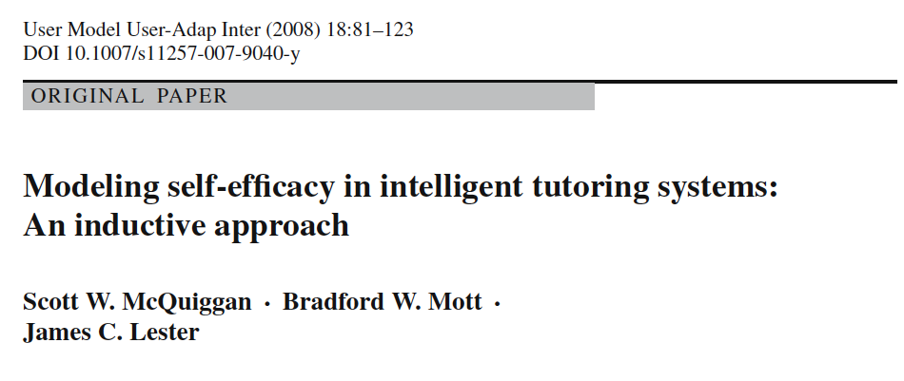
Affect has begun to play an increasingly important role in intelligent tutoring systems.
Self-efficacy is an affective construct that has been found to be a highly accurate predictor of students’ motivational state and their learning effectiveness (Zimmerman 2000).
Defined as “the belief in one’s capabilities to organize and execute the courses of action required to manage prospective situations” (Bandura 1995), self-efficacy has been repeatedly demonstrated to directly influence students’ affective, cognitive, and motivational processes (Bandura 1997).

Slide 9
The General Self-Efficacy Scale (GSE)

Slide 10
1 = Not at all true 2 = Hardly true 3 = Moderately true 4 = Exactly true
1 | I can always manage to solve difficult problems if I try hard enough.
2 | If someone opposes me, I can find the means and ways to get what I want.
3 | It is easy for me to stick to my aims and accomplish my goals.
4 | I am confident that I could deal efficiently with unexpected events.
5 | Thanks to my resourcefulness, I know how to handle unforeseen situations.
6 | I can solve most problems if I invest the necessary effort.
7 | I can remain calm when facing difficulties because I can rely on my coping abilities.
8 | When I am confronted with a problem, I can usually find several solutions.
9 | If I am in trouble, I can usually think of a solution.
10 | I can usually handle whatever comes my way.

