Slide 1
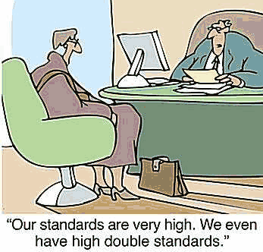

Slide 2
ACRL Immersion Program
Location TBD
$2000 est.
Application available September/October 2013
Application deadline: probably December 1, 2012

Slide 3
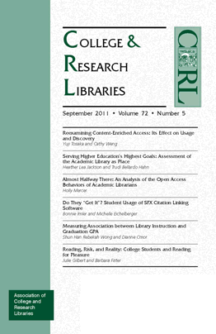
professional development
ACRL Association of College and Research Libraries
bi-annual conference http://www.ala.org/acrl/conferences
look at past conference presentation material
next: March 25-28, 2015 in Indianapolis, Indiana
professional standards
white papers & reports
scholarly
news-y

Slide 4
professional development
LOEX Library Orientation Exchange
annual conference
look at past conference presentation material http://www.loexconference.org/past-future.html
next conference: May 8-10, 2014 in Grand Rapids, MI http://www.loexconference.org/
call for proposals will probably be this month (Sept)
clearinghouse of library instruction materials (e.g. online tutorials, copyright resources, etc. – needs updating)
Loex Quarterly http://www.emich.edu/public/loex/

Slide 5
information literacy

Slide 6
information literacy

Slide 7
standards
information literacy

Slide 8
standards
information literacy

Slide 9
learning outcomes
standards
information literacy

Slide 10
learning outcomes
A learning outcome is one sentence that indicates what students should represent, demonstrate or produce as a result of what they learn (Maki, 2004)
What do I want students to learn today?
Maki, P. (2004). Assessing for learning: Building a sustainable commitment across the institution. Sterling, VA: Stylus.

Slide 11
learning outcomes
following today’s class activities we should be able to readily list the ACRL’s Information Literacy Competency Standards for Higher Education
we should be able to map sample lesson plan learning objectives to ACRL Info Literacy standards, performance indicators and outcomes

Slide 12
standards
information literacy

Slide 13
simple definition | a set of rules for ensuring quality
ISO International Organization for Standardization | a document established by consensus and approved by a recognized body that provides for common and repeated use, rules, guidelines or characteristics for activities or their results, aimed at the achievement of the optimum degree of order in a given context.

Slide 14
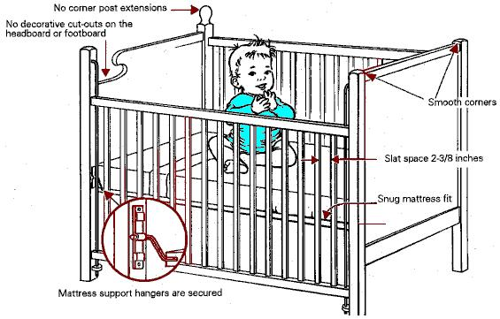

Slide 15
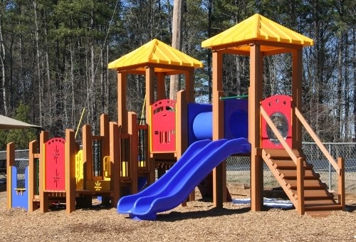

Slide 16
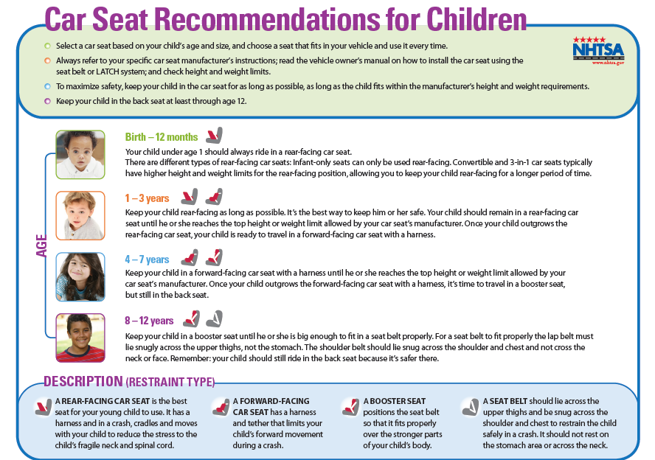

Slide 17
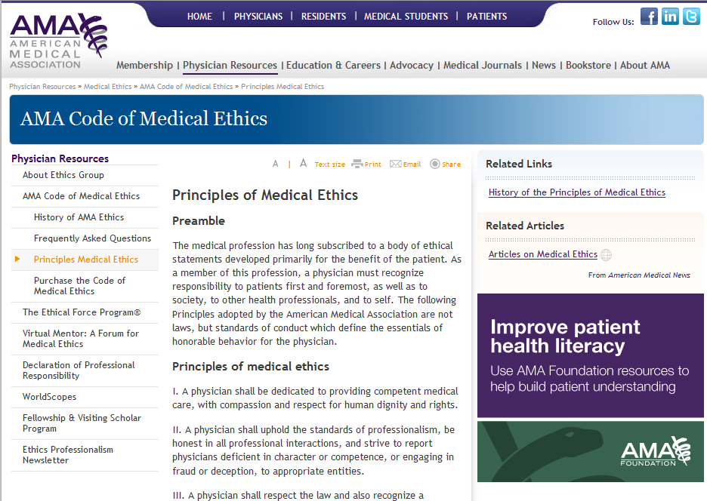

Slide 19
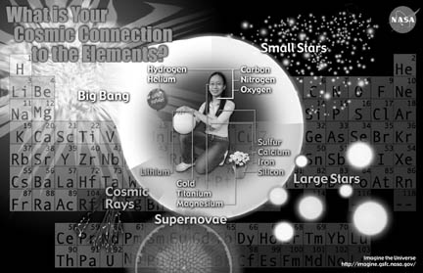
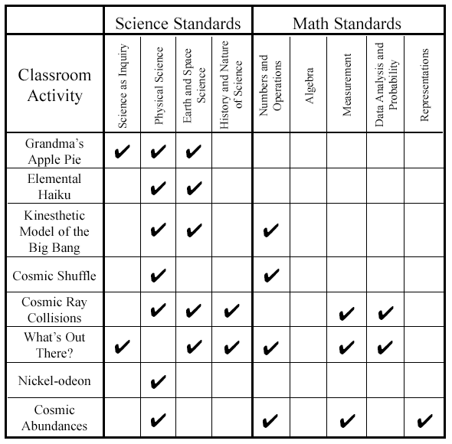
information and activity booklet from NASA for grades 9-12

Slide 20
standards
ACRL Information Literacy Competency Standards for Higher Education [handout]
American Association of School Librarians (AASL)
SCONUL Seven Pillars Model for Information Literacy (handout)
Big 6 (Michael Eisenberg) – popular in K-12
UNESCO

Slide 21
INFORMATION LITERACY STANDARD 2:
The information literate student accesses needed information effectively and efficiently.
ACRL Information Literacy Standards
PERFORMANCE INDICATOR 2:
The information literate student constructs and implements effectively-designed search strategies.
OUTCOME B: Identifies keywords, synonyms and related terms for the information needed
OUTCOME D: Constructs a search strategy using appropriate commands for the information retrieval system selected

Slide 22
lesson plans activity
gather into groups of 2 or 3
read through the sample lesson plan
which standard(s), performance indicator(s) and possibly outcome(s) do you think the librarian had in mind when designing the lesson? Write these down (e.g. Standard 1, PI 3,4)
any thoughts on the lesson plan execution, appropriateness, or assessment measures?

Slide 23
instruction activity #1
Information Literacy Standard 2: The information literate student accesses needed information effectively and efficiently.
Performance Indicator 2: The information literate student constructs and implements effectively-designed search strategies.
instruction activity #2
Information Literacy Standard 3
Outcome B: Identifies keywords, synonyms and related terms for the information needed
Outcome D: Constructs a search strategy using appropriate commands for the information retrieval system selected
Performance Indicator 1:
Outcome C
Outcome D
mapping instruction/learning to ACRL Information Literacy Standards

Slide 24
other voices…criticism…different perspectives
librarians are currently bound by an educational concept of what information literacy is and how it manifests itself

Slide 25
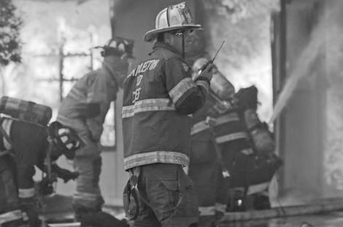
other voices…criticism…different perspectives
Notes:
Annemaree Lloyd - Australia

Slide 26
other voices…criticism…different perspectives
librarians are currently bound by an educational concept of what information literacy is and how it manifests itself
“we need to explore other contexts and practices that facilitate becoming information literate, in order to understand the role of information literacy outside educational settings” (p. 82)
Lloyd, A. (2005). Information literacy: Different contexts, different concepts, different truths? Journal of Librarianship and Information science, 37(2), 82-88.

Slide 27
Firefighter study (Lloyd, 2004) focused on how firefighters locate, access and use information to learn about their work practices
textual sources which facilitate the formation of an institutional view of practice
social sources which facilitate formation of an intersubjective view of practice
physical and sensory sources that facilitate embodied learning

Slide 28
“Information literacy can be seen as a transformative agent which, in the workplace, enables transformation from novice to expert and from individual worker to team member.
The act of becoming information literate is the act of learning how information resides in the landscape and learning the context-specific practices required to access it.”
Lloyd, A. (2005). Information literacy: Different contexts, different concepts, different truths? Journal of Librarianship and Information science, 37(2), 82-88.

Slide 29
Other voices…
information literacy research in the community area may have implications for social justice and action (public library example)
shift away from recognizing information literacy primarily as a textual practice – consider “oral sources”

