Slide 1
instruction experience opportunities
[2 handouts]

Slide 2
What does a TEACHING LIBRARY look like?

Slide 3
Palmer: Instruction is primary function of academic library
instruction as marketing
citizens understand university efforts to “make knowledge” and the value of libraries in the process
librarians teach processes, not necessarily content like discipline faculty – support “learn how to learn”

Slide 5
The A.C. Buehler Library supports the vision and mission of Elmhurst College to make a difference in the lives of students so that they can make a difference in the world. http://public.elmhurst.edu/leadership/9744312.html As a teaching library, the Library is committed to an active role in the preparation of students for a lifetime of purposeful learning for professional excellence in an information technology based society.
The A. C. Buehler fulfills its mission by:
Teaching students to be successful, ethical information users.
Facilitating access to information resources through a variety of user-centered information services.
Selecting, organizing, and efficiently managing a collection of books, periodicals, electronic resources, and multimedia materials.
Encouraging and supporting faculty and students in the use of emerging learning technologies
Providing a welcoming, collaborative space for the community of scholars
Cooperating with regional, national, and international libraries and library organizations
We value:
Information literacy learning and teaching as central to library programs, services, management
Central, highly visible role of the college library within the campus community
Collaboration, innovation, creativity, and risk taking
Intercultural learning and multicultural diversity
Teaching role of librarians and libraries
Technology leadership role of librarians and libraries
Ethical use of information, privacy, Library Bill of Rights
Library best practices
Continuous professional growth and development for all library staff
Cooperation among libraries and librarians

Slide 6
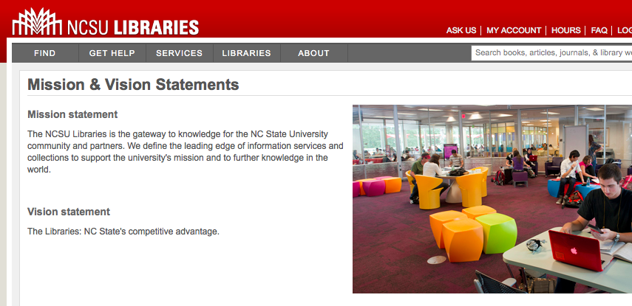

Slide 7
Argument: The nature of teaching 'information literacy' is outmoded. Instead, librarians should focus on teaching 'research literacy.' Presumably, this means lessening the time spent on teaching tools [e.g. databases, discovery tools, etc.] and increasing the time spent on teaching research construction and refinement [e.g. literature in scholarly communication context].
How does a librarian teach "meta-cognition processes" (Palmer) in single-instruction sessions? And what sorts of risks does the marginalization of tools knowledge acquisition pose?
research tools
research concepts

Slide 9
ACRL Immersion Program
Location TBD
$2000 est.
Application available September/October 2013
Application deadline: probably December 1, 2012

Slide 10
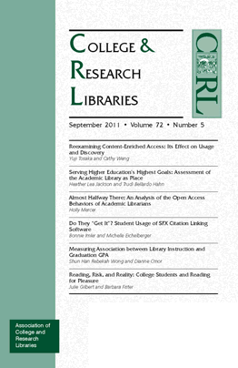
professional development
ACRL Association of College and Research Libraries
bi-annual conference http://www.ala.org/acrl/conferences
look at past conference presentation material
next: March 25-28, 2015 in Indianapolis, Indiana
professional standards
white papers & reports
scholarly
news-y

Slide 11
professional development
LOEX Library Orientation Exchange
annual conference
look at past conference presentation material http://www.loexconference.org/past-future.html
next conference: May 8-10, 2014 in Grand Rapids, MI http://www.loexconference.org/
call for proposals will probably be this month (Sept)
clearinghouse of library instruction materials (e.g. online tutorials, copyright resources, etc. – needs updating)
Loex Quarterly http://www.emich.edu/public/loex/

