Slide 1
couple of notes…
discussion facilitator assignment
  no “right way”
  10 Rules for Leading a Discussion (handout)
updated schedule – look at website

Slide 2
learning outcome for class today:
discern between four different approaches to instruction

Slide 3
Instruction

Slide 4
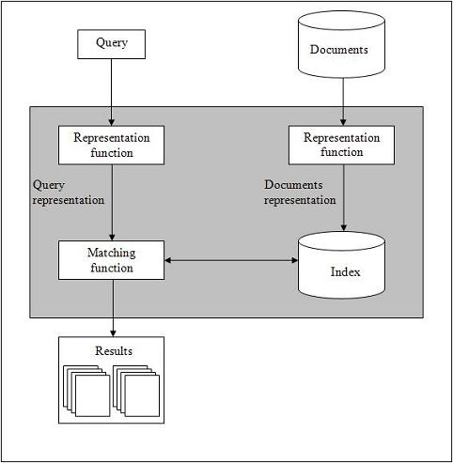
Information Retrieval
Vallez, M. & Pedraza-Jimenez, R. (2007) Natural Language Processing in Textual Information Retrieval and Related Topics . Hipertext.net, 5. http://www.hipertext.net

Slide 5

Information Retrieval
Vallez, M. & Pedraza-Jimenez, R. (2007) Natural Language Processing in Textual Information Retrieval and Related Topics . Hipertext.net, 5. http://www.hipertext.net
Vallez, M. & Pedraza-Jimenez, R. (2007) Natural Language Processing in Textual Information Retrieval and Related Topics . Hipertext.net, 5. http://www.hipertext.net

Slide 6
Interactive Information Retrieval
Vallez, M. & Pedraza-Jimenez, R. (2007) Natural Language Processing in Textual Information Retrieval and Related Topics . Hipertext.net, 5. http://www.hipertext.net
Vallez, M. & Pedraza-Jimenez, R. (2007) Natural Language Processing in Textual Information Retrieval and Related Topics . Hipertext.net, 5. http://www.hipertext.net

Slide 7
Interactive Information Retrieval
USER
Relevance feedback
Q&A systems
Filtering
Recommenders
Collaborative search
Personalization
Visualization tools
Clustering
Vallez, M. & Pedraza-Jimenez, R. (2007) Natural Language Processing in Textual Information Retrieval and Related Topics . Hipertext.net, 5. http://www.hipertext.net
Vallez, M. & Pedraza-Jimenez, R. (2007) Natural Language Processing in Textual Information Retrieval and Related Topics . Hipertext.net, 5. http://www.hipertext.net

Slide 8


Library Orientation
Library Instruction
Bibliographic Instruction
Information Literacy Instruction

Slide 9
Orientation

Slide 10
The relative position or direction of something; the bearing or lie of a thing.
Oxford English Dictionary

Slide 11
The process of familiarizing a new or prospective student, recruit, etc., with the content of a course, the basics of a subject, the nature of college life, etc. Also: a course intended to provide such familiarization.
Oxford English Dictionary

Slide 12
Jefferson National
Expansion Memorial
U.S. National Park Service

Slide 13
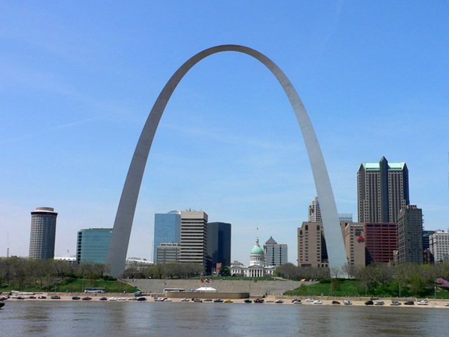

Slide 14

Pollak Library
\'pä-l&k\

Slide 15
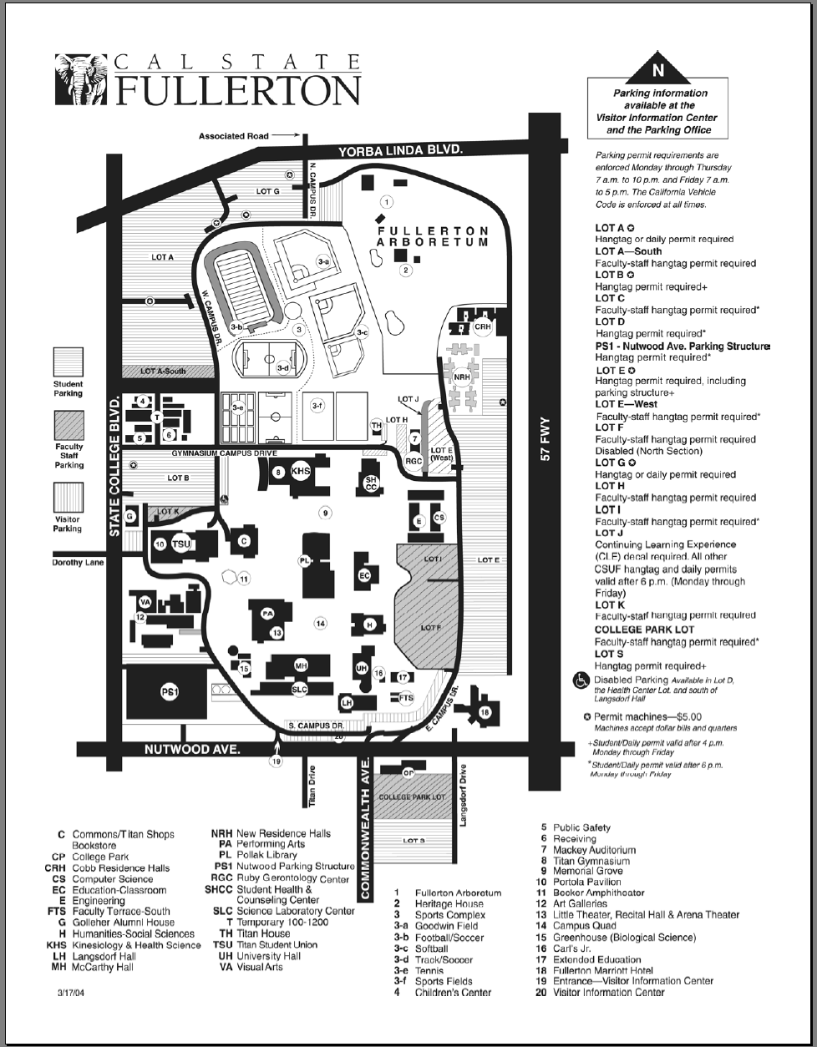

Slide 16
Quick Facts
Over 1.3 million books (+ 26,000 e-books)
Access to 5000+ journals (print and/or electronic)
Over 200 bibliographic databases
32,294 Interlibrary Loan requests filled for CSUF folks in 2005/06 (avg. delivery 7.69 days)
Approximately 6000 items are placed on reserve each term by roughly 370 instructors

Slide 17
Quick Facts
599 faculty-requested library instruction sessions reached 18,023 students in 2005/06
1800+ reference questions answered each week
Library at CSUF Irvine Campus

Slide 18
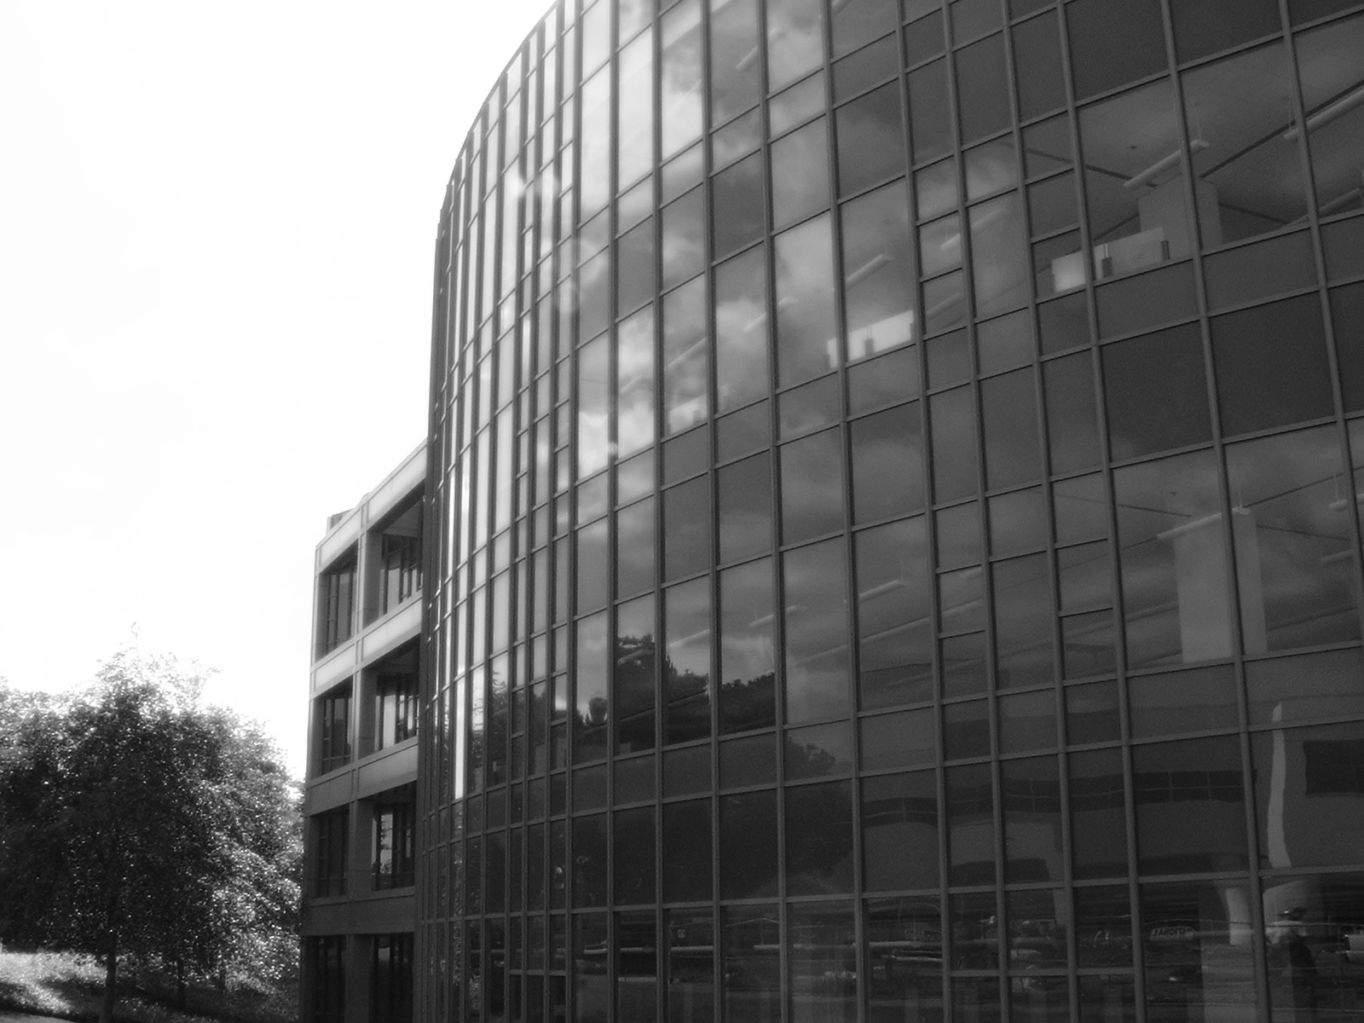
Mission & Culture of the Library
Uphold the University's commitment to making learning preeminent
Make the support of academic programs its primary focus, with a strong secondary goal of fostering lifelong learning
Actively engage in developing information literacy skills in students

Slide 19
Resources & Services
Library Catalog
Databases
SFX
ILLiad
Course Reserves
Reference
Library Instruction
RefWorks

Slide 20
Audio self-paced tour of library
Example of student project

Slide 21
Library Instruction

Slide 22
Explanation of library materials
Focus on tools and mechanics
Library-specific procedures

Slide 23
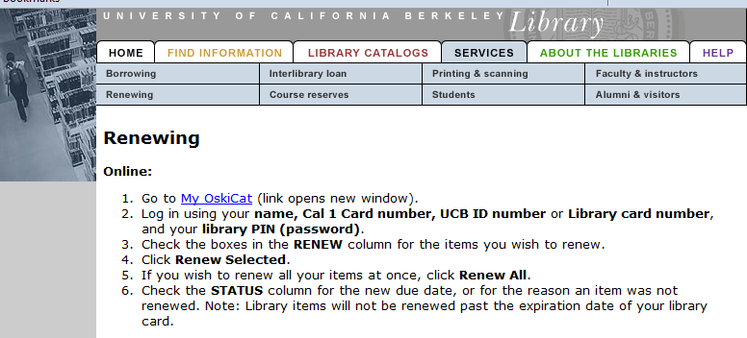

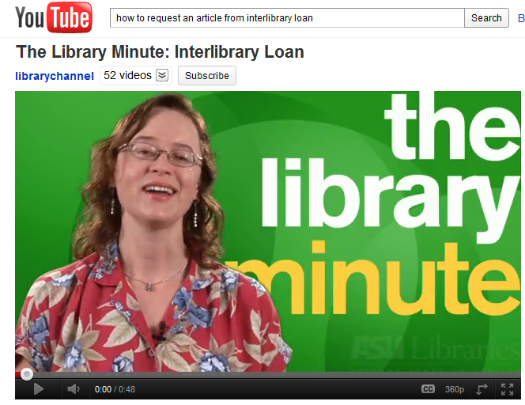

Slide 24
Bibliographic Instruction

Slide 25
Focus on principles rather than specific tools
Facts and methods

Slide 26
BIBLIO
METRICS
Books
Publications
Bibliography
Count
Measurement
Math / Statistical Analysis

Slide 27
Alan Pritchard 1969
Coined the term "bibliometrics"
"the application of mathematics and statistical methods to books and other media of communication“
Journal of Documentation (1969) 25(4):348-349

Slide 28
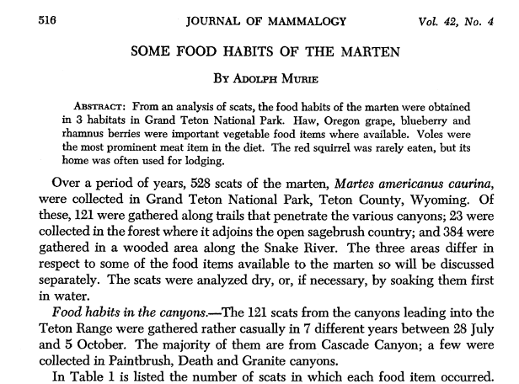
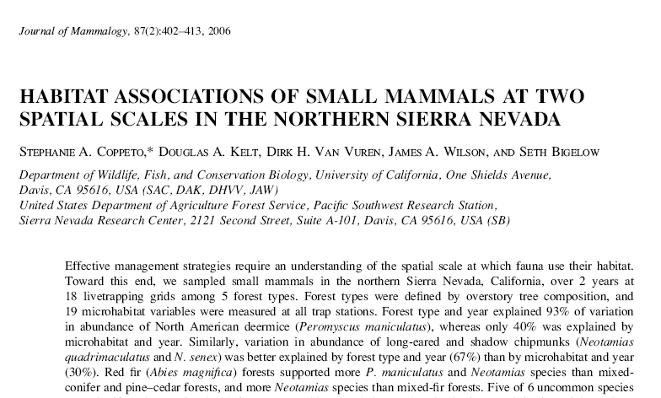
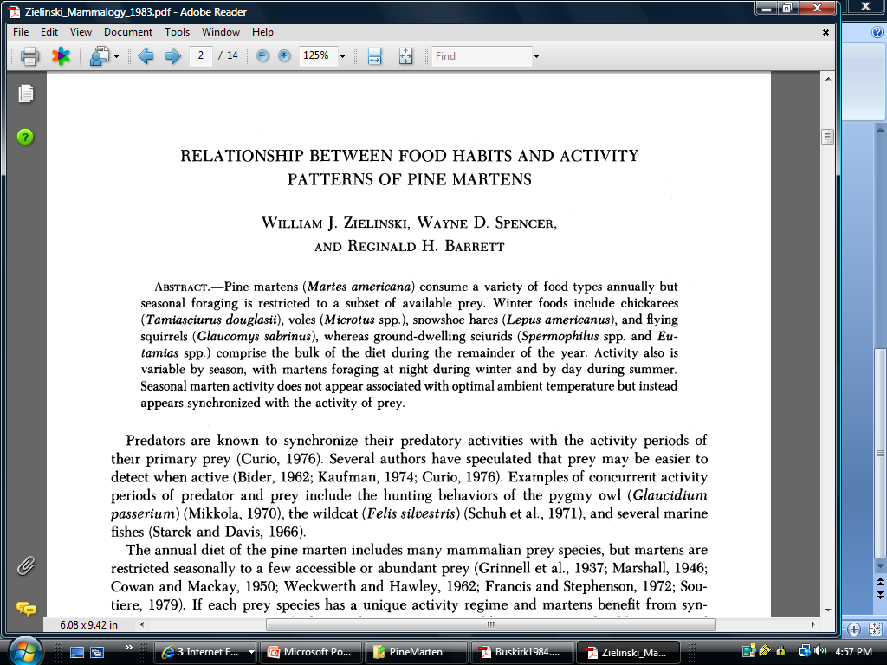
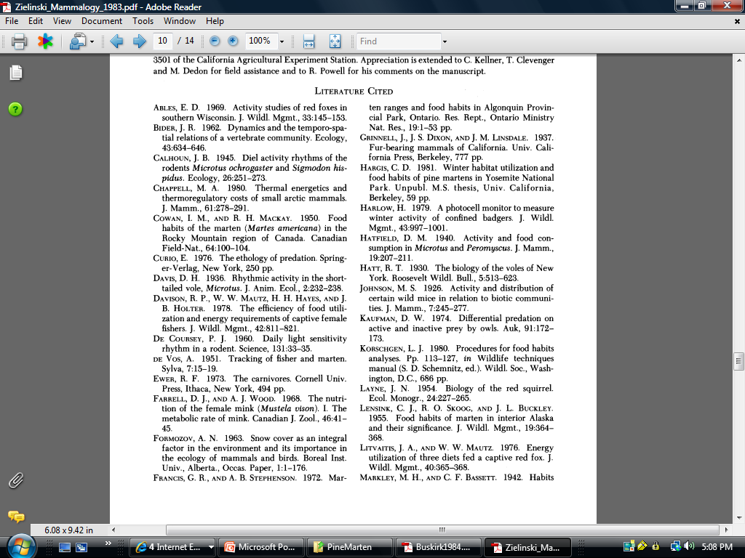
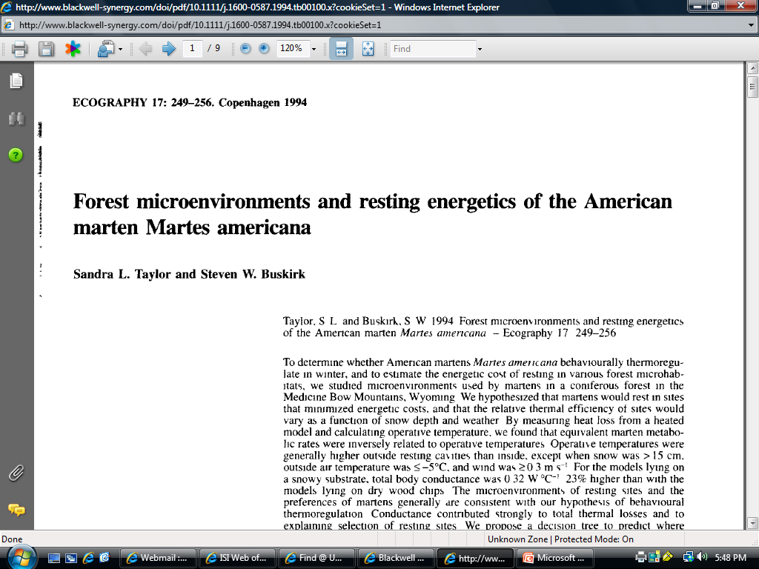
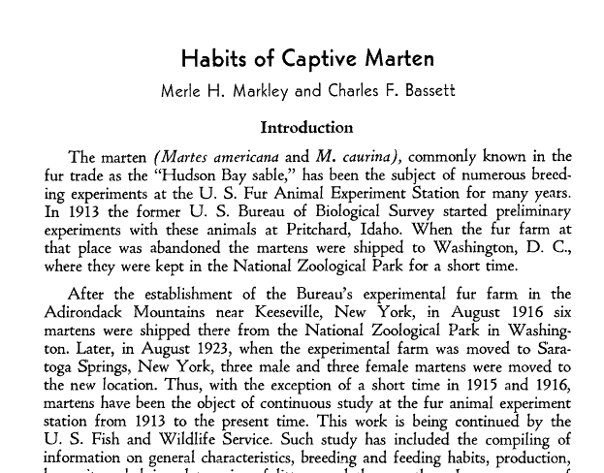
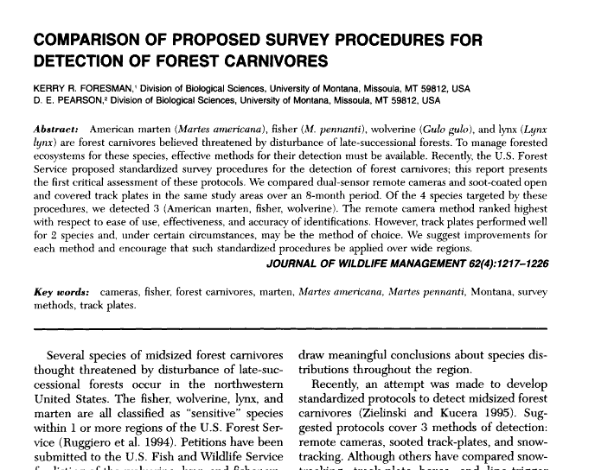
Journal of Mammalogy, Vol. 64, No. 3. (Aug., 1983), pp. 387-396.

Slide 29
CITED
CITING

Slide 30
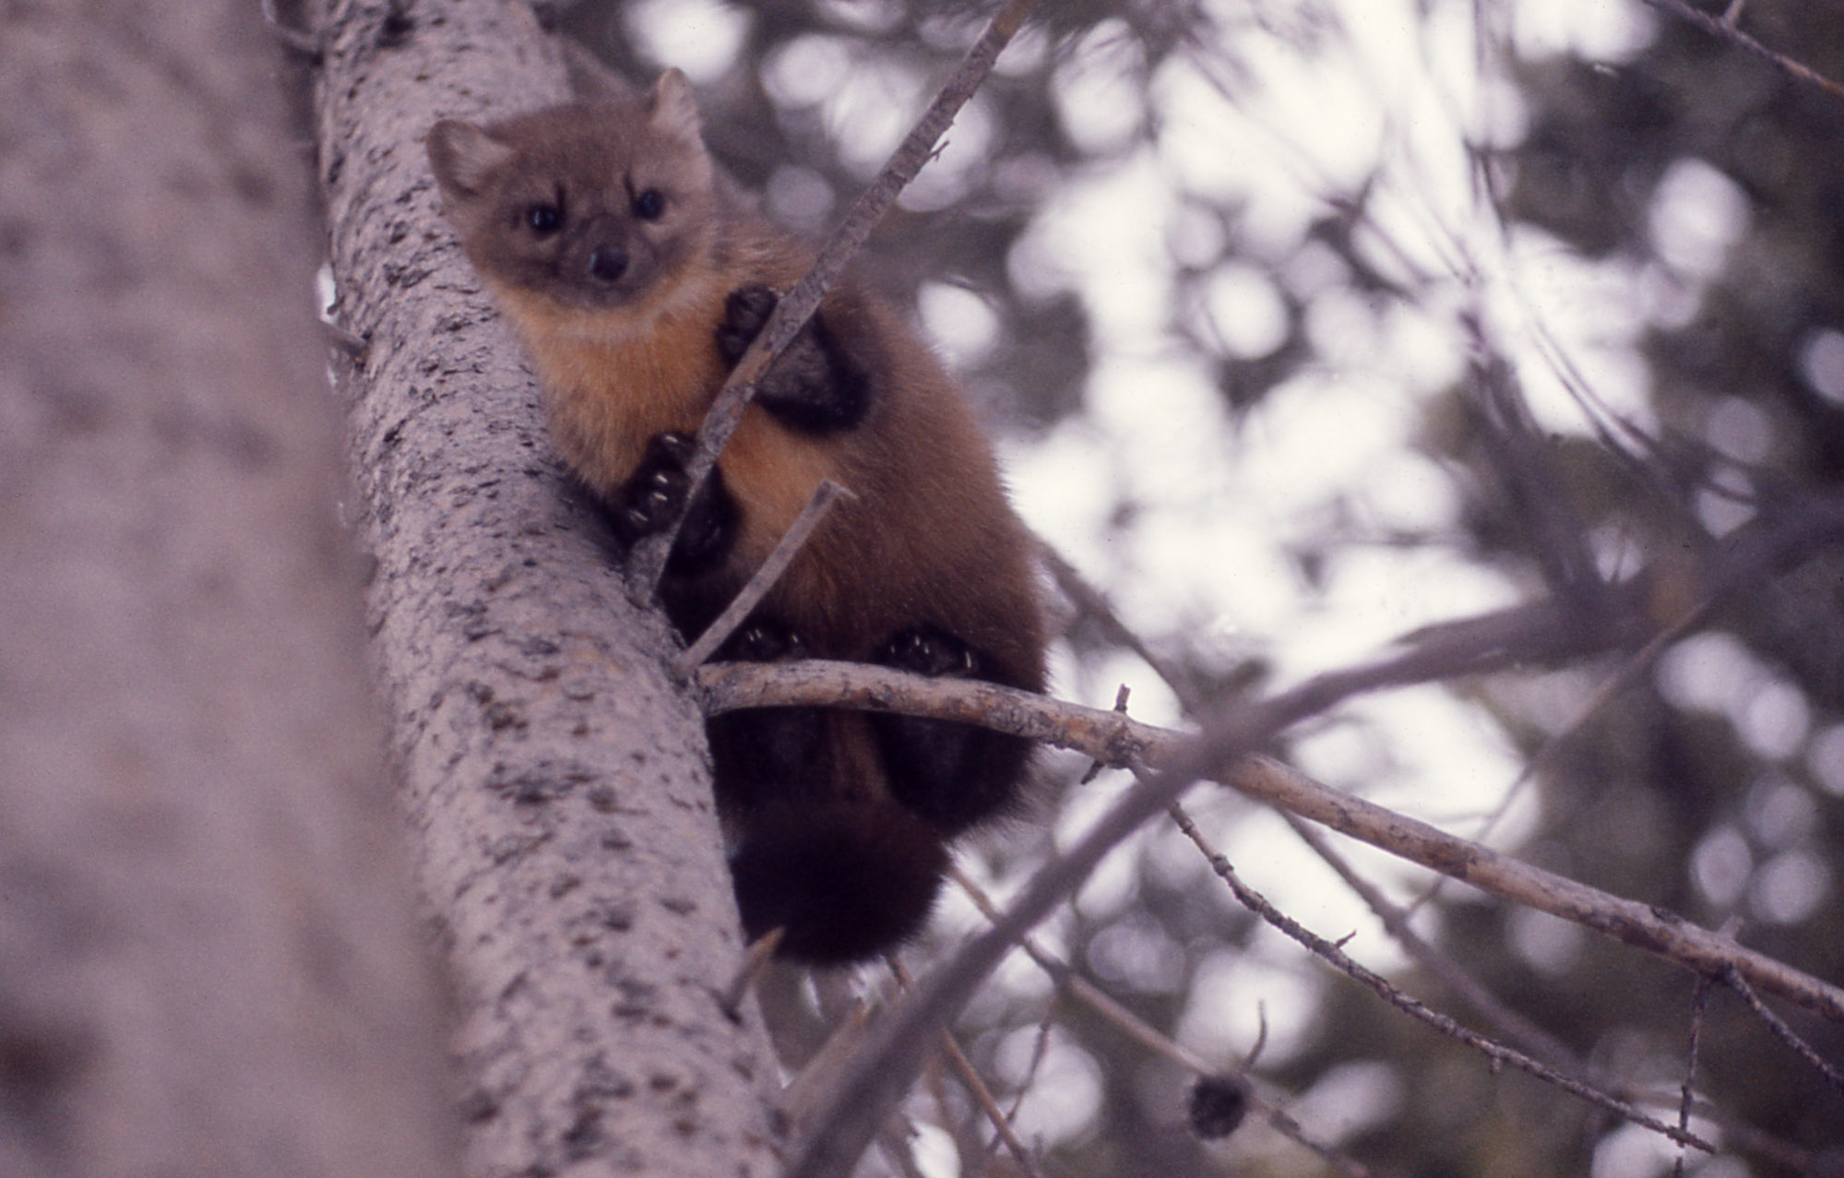

Slide 32
seminal work

Slide 33
co-citation
these two articles are likely related
author
institution
topic
country
language
journal

Slide 34
what is citation analysis?
utilizes quantitative analysis and statistics to describe patterns of publication within a given field or body of literature

Slide 35
what do you do with citation analysis?
researchers may use bibliometric methods of evaluation to determine the influence of a single writer, for example, or to describe the relationship between two or more writers or works
  production and productivity
  Impact
  co-publication patterns
  connections between subject areas

Slide 36
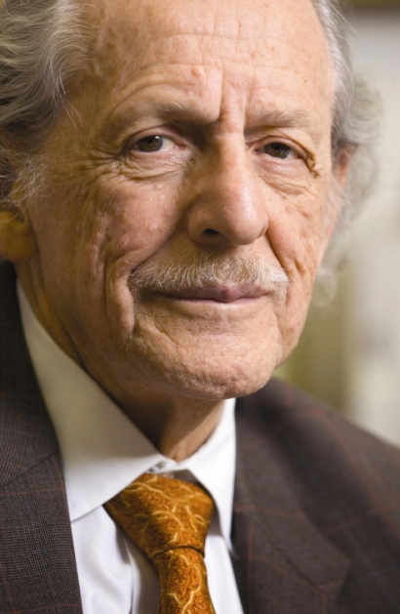
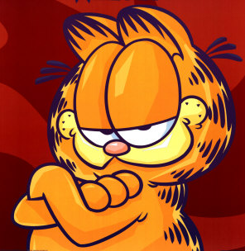
Index of Citations

Slide 37
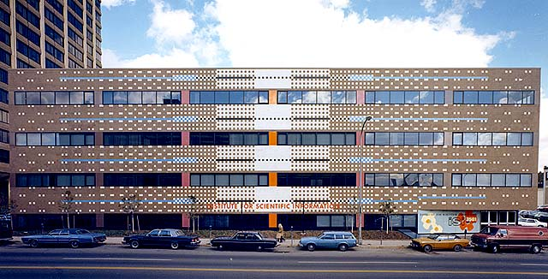
Institute for Scientific Information Building, Philadelphia
Architect: Venturi, Scott Brown and Associates, Completed 1977
http://www.vsba.com/projects/fla_archive/190.html

Slide 38
ISI
SCI
SSCI
A&H
JCR
Histcite

Slide 39
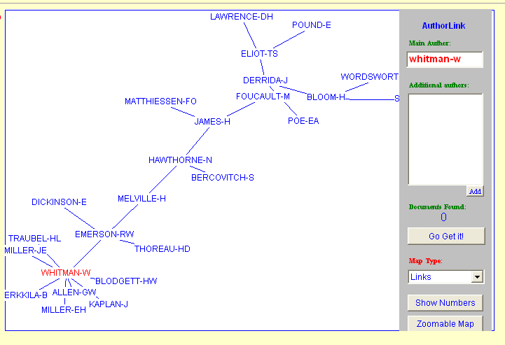
Arts & Humanities Citation Index
authors co-cited most often with…WHITMAN-W
Author Co-Citation

Slide 40
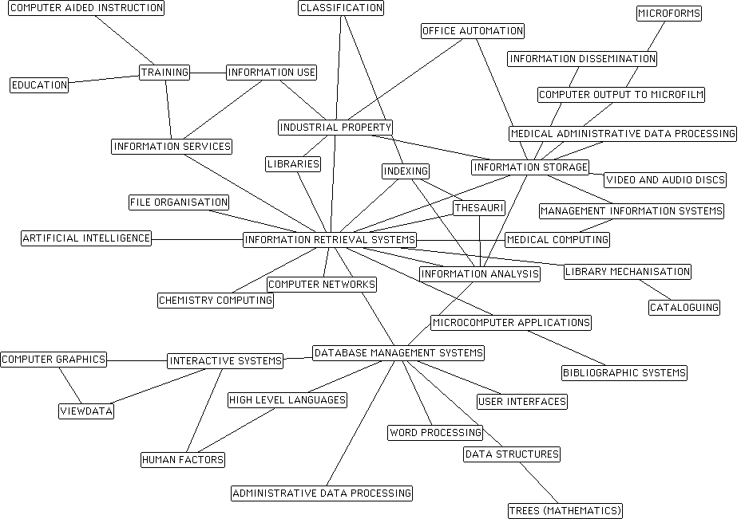
80’s

Slide 41
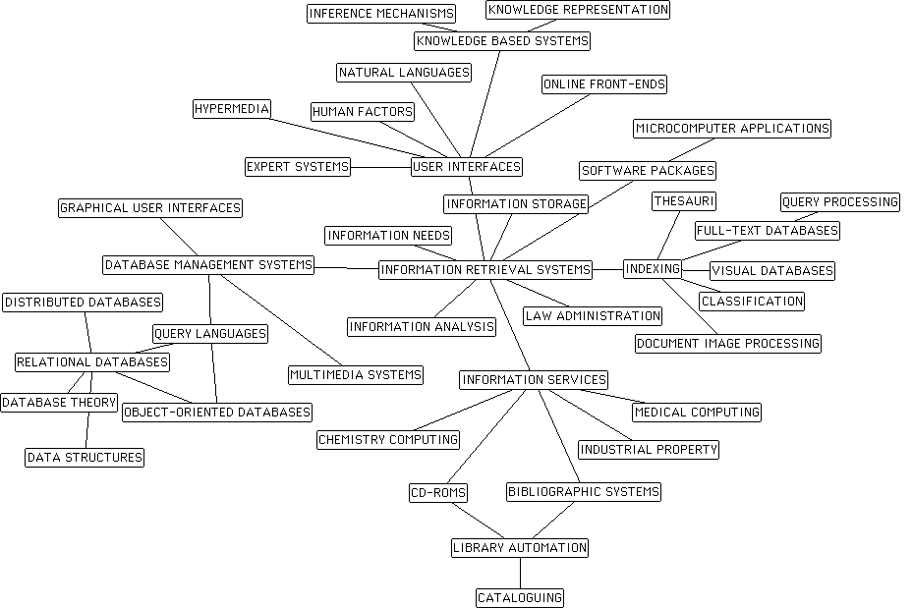
90’s

Slide 42
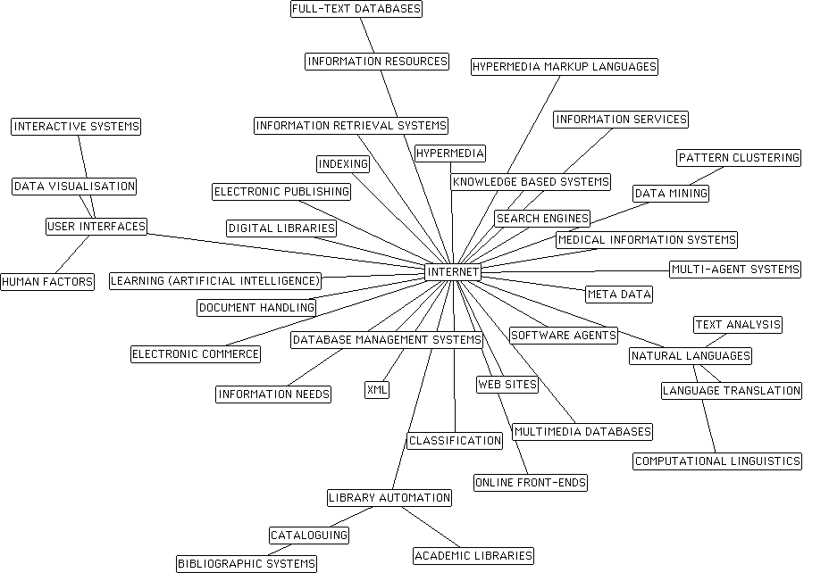
00’s

Slide 43
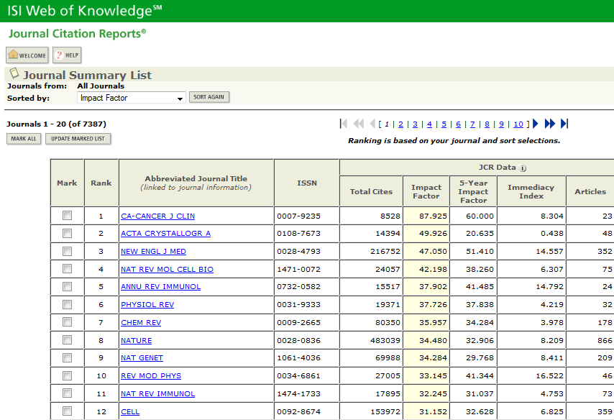
Science Citation Index

Slide 44
Journal Impact Factor for The New England Journal of Medicine
Number of items published in: | 2008 | 356
Number of items published in: | 2007 | 343
Sum of recent items |  | 699
Cites in 2009 to items published in: | 2008 | 16072
Cites in 2009 to items published in: | 2007 | 16816
Sum of recent citations |  | 32888
Journal Impact Factor | 32888 / 699 | 47.050

Slide 45
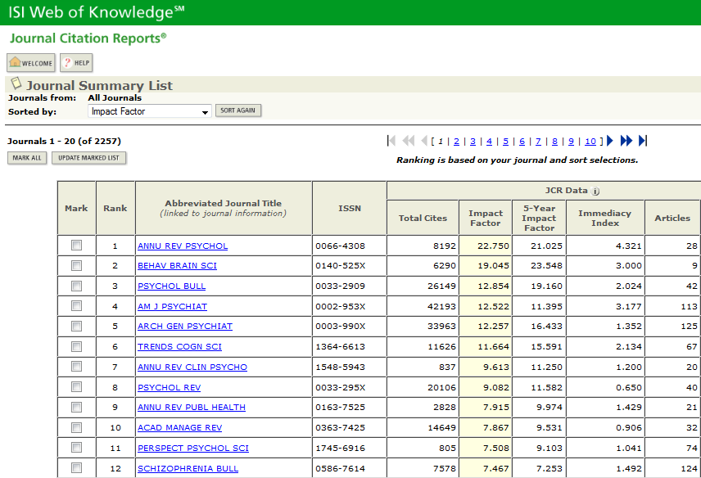
Social Sciences Citation Index

Slide 46
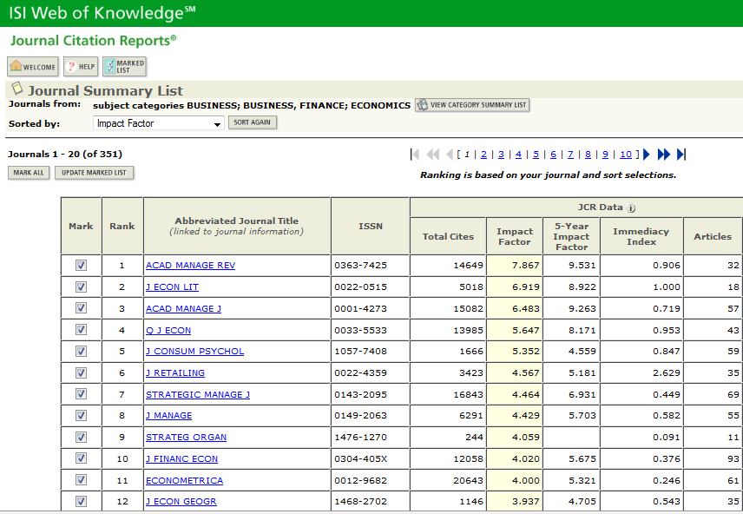
Social Sciences Citation Index

Slide 47
http://www.lib.unc.edu/ e-Research tools web of science (ISI)

Slide 48
Provocative Questions for Discussion
What/why do you cite?
What do you infer from a reference list?
Are all citations equal?

Slide 49
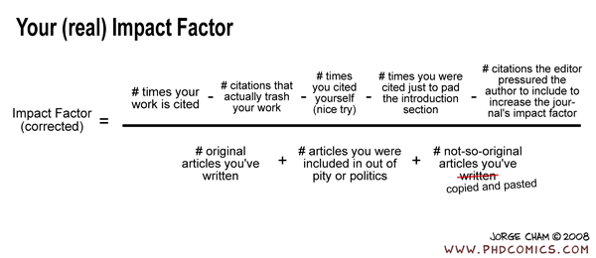
issues & concerns surrounding citation analysis

Slide 50
This traditional method of measuring scholarly impact is being challenged by several forces…discuss alternative metrics of impact (Google scholar, blog citations, open access…)

Slide 51
Information Literacy

Slide 52
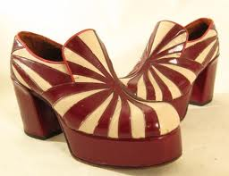
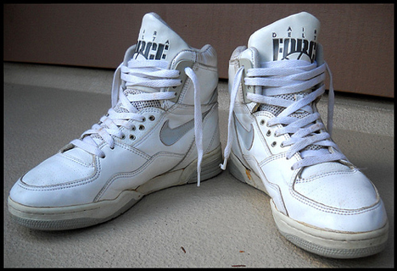
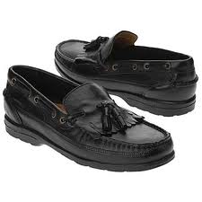
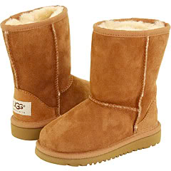
1974 | Paul Zurkowski, then the president of the Information Industry Association, defined information literacy as an individual’s capacity to use information tools and primary sources to address problems
1989 | ALA published an authoritative report outlining the content of the concept. To to be information literate, a person must be able to recognize when information is needed and have the ability to locate and use information effectively
1990 | Michael Eisenberg and Robert Berkowitz proposed the model of “Big Six Skills” that describes the phases or stages of information seeking and use for the purposes of problem solving
2000 | ACRL approves Information Literacy Competency Standards (5). Central thrust of the movement is to integrate library and information skills more fully with the learning process

Slide 53
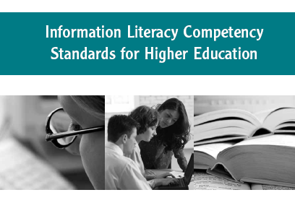
Determine the extent of information needed
Access the needed information effectively and efficiently
Evaluate information and its sources critically
Incorporate selected information into one’s knowledge base; use information effectively to accomplish a specific purpose
Understand the economic, legal, and social issues surrounding the use of information, and access and use information ethically and legally

Slide 54
Criticisms of IL ?
combines two concepts (information and literacy) that in themselves are ambiguous and resist exact definitions
phrase does not clearly communicate its meaning
abstract metaphor rather than a description of tangible practices
shopping-lists of desired behaviors” and trivialize human information practices

Slide 55
Criticisms of IL cont’d
viewing IL as comprising generic skills that are independent from content and context—subject matter, practices, and discourses of different disciplines—is a false starting point
Tuominen, K., Savolainen, R., & Talja, S. (2005). Information literacy as a sociotechnical practice. Library Quarterly, 75(3), 329-245.

Slide 56
in preparation for our next class
TO DO:
ask a librarian where or how they learned to teach…

