Slide 1
“User Education”
rachael clemens
Notes:
I don’t have many occasions to talk about user education and library instruction – and it’s something I really get excited about. For 6 years I was a reference and instruction librarian at Cal State University Fullerton – large public university in Southern California. We had an extensive and successful information literacy program that was embedded across the curriculum of almost all the departments. I was the liaison with the Dept of Nursing so focused most of my teaching and outreach there

Slide 2
discussion leader assignment
 experiment with techniques and strategies to engage our learners  explore the actual content of the readings together
approach the reading as a whole or pick out a small part(s) for discussion
take one of the concepts and get us to think about it in a different way
address some potential implications and/or problems related to the reading
construct some sort of argument or question emerging from the reading
look for problems between research and practical application
find examples from media that illustrate the concept
“so, what did you think about this reading?” [not very effective]

Slide 3
instruction observation assignment
 experience a teaching/learning environment with a critical eye  reflect on your own teaching style and strategies you might explore
UNC Libraries (Davis, UL, Special Collections/Archives, Health Sciences, Art, Music, Carolina Population Center, Law)
UNC Center for Faculty Excellence
Duke Libraries (ask Rachael for contact)
NCSU Libraries (“)
NCCU Libraries (“)
Odum Institute
Other?

Slide 4
imagine…
You are the decision-maker for a national, public funding agency that supports long-range efforts to advance the quality of decision-making and problem-solving skills of the general public.
Three research proposals are competing for a multi-year, multi-million dollar grant. All proposals are from teams of world-renowned researchers.

Slide 5
Proposal 1
We will develop new information systems that provide immediate and comprehensive access to the world’s information resources. New organization schemes, culturally sensitive retrieval algorithms, enhanced privacy mechanisms, and highly customizable user interfaces will promote a knowledge-access level playing field for citizens.
Proposal 2
Proposal 3
Our aim is to remove all barriers to information.

Slide 6
Proposal 1
Proposal 2
Working with librarians around the world, we will develop new communication technology that allows for immediate and real-time access to an “information support service”. Information professionals will respond to all inquiries using a triage approach – matching each expressed information need to a generalist, subject specialist or facilitator who works with each individual throughout the information search process.
Proposal 3
Our aim is to match citizens with the best information through personal consultation.

Slide 7
Proposal 1
Proposal 2
Proposal 3
We will develop extensive training and outreach services to strengthen information literacy skills across all sectors of society. Extensive needs assessment, targeted marketing, and the design of effective learning/training environments will be continuously improved based upon feedback and assessment measurements. Research from human information behavior will be put into practice to address the diverse nature of citizens and their information needs.
Our aim is to teach citizens how to effectively utilize existing information systems.

Slide 8
Proposal 1
Proposal 2
Our aim is to match citizens with the best information through personal consultation with information professionals.
Proposal 3
Our aim is to teach citizens how to effectively utilize existing information systems through extensive training.
Our aim is to remove all barriers to information through an improved systems approach.

Slide 9
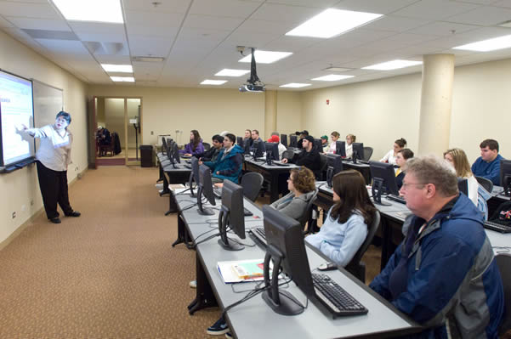
call it what you will…
bibliographic instruction
library instruction
library user education
user education
information literacy
research instruction
information competency
library literacy
network literacy
digital literacy
Notes:
These terms are often used interchangeably – but there are some nuances depending upon the company you keep; for example I’m actually not a fan of the literacy and competency terms – demeaning connotation – but not intended to

Slide 10
Teaching users how to make the most effective use of the library system
Tiefel, V.M. (1995). Library user education:
Examining its past, projecting its future. Library Trends 44(2): 318-338.
Information Literacy is the set of skills needed to find, retrieve, analyze, and use information
ACRL Association of College & Research Libraries http://www.ala.org/ala/mgrps/divs/acrl/issues/infolit/overview/intro
Notes:
Two fairly inclusive definitions

Slide 11
1881…
Students need to “develop the art of discrimination” to able to judge the value of books to develop critical judgment
Students need to become independent learners – to teach themselves
Students need to continue to read and study – to become lifelong learners
Otis Hall Robinson called for clarification of instructional roles at the ALA convention
Notes:
Otis Hall Robinson, a graduate of the University of Rochester and professor of mathematics, was appointed librarian in 1869.
He was interested in developing the more scholarly use of books and libraries. Until his day, Rochester students had merely referred to library books; Robinson believed they should instead become intelligent readers. With this goal in mind, he initiated classroom instruction in the use of books and libraries, and supported that with additional instruction within the library. He made himself available to talk about books with students and to help students make their selections. He showed the students how to carry on an investigation of a topic--"reading a few paragraphs in one place, a few pages in another, and a few volumes in still another, till they made the library yield up all it contained on the subject in hand.”
He helped establish the American Library Association

Slide 12
Notes:
He is also the man who put the hole in library catalog cards.
"The tendency of even careful persons was to pick up from the case a small bunch of cards for a close examination, and when examined to put them back, while the mind was occupied with the contents of the card, into any convenient opening. I am informed that this is still a great annoyance in many libraries where card catalogues are used. To overcome this difficulty the cards were then punched near the lower left-hand corner, as they now appear, and a short wire inserted, running through the entire case. . . ."

Slide 13
handout…

Slide 14
1940
Harvie Branscomb, Duke, proposed reference librarians go outside the library to build communication with faculty
17th Century
Library instruction at German universities - lectures about reference books, study techniques, how to use library, Ewert 1986
1991
Michael Gorman
calls for
“BI-less” library
Early 20th Century
Instruction wanes
1967
ALA forms Committee on Instruction in Library Use
2000
ACRL Information Literacy Competency Standards
1881 Instructional Goals
Develop the art of discrimination
Become independent learners
-Become lifelong learners
-Robinson at ALA
1920s
Discussions about instruction (place, timing, instructors)
1987
65% of academic libraries offer instruction – up from 24% in
1979
1960s
Grassroots movement to update / improve seemingly routine and remedial instruction programs
Lots of new ideas
End of 19th Century
Dialog started about “the nature and purposes of user instruction” , Hardesty 1986
1858
Need for a “Professor of Books” Ralph Waldo Emerson
Early 21st Century
Instruction expands into emerging media such as audio/video podcast and SecondLife
1972
LOEX formed
History of Library Instruction
1950s
College enrollment increases as does value perception; librarians overwhelmed by numbers and lack of conceptual framework for instruction
1970s
Online catalogs, databases
1990s Web
End of 19th Century
Desire for practical training instead of classical curriculum
Growth of research
1850s
Colleges adding classes in math, science and modern language
1961
Increase in technology and audiovisual materials; Study found no appreciable difference between instruction by TV or by traditional methods, Fagerburg
Following Civil War
Land Grant Universities
Growth in vocational / technical colleges, professional schools, normal schools, women's colleges
1960s
Changes in higher education – more diversity in disciplines, expansion of colleges, movement to liberate students from textbooks and assigned paper topics
Notes:
Bibliographic instruction has quite a history in the U.S. – with the evolution of the academe and shift from the classic curriculum to more “useful knowledge” and growth of research and scientific method – and of course the dissemination of information…in the late 60’s and 70’s we start to see more organized efforts of library instruction. LOEX is formed which is still around today as ‘all things library instruction’.

Slide 15
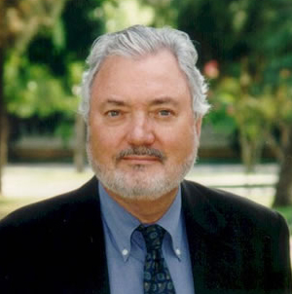

Slide 16
Gorman says his ideal computer system would walk users through search "without pain or human mediation" (360).
Is human mediation ever a barrier in terms of information?

Slide 17
BI-Less Library
Instruction Immersion

Slide 18
Information Environments
USER EDUCATION
Academic library
Public library
K-12 school library media center
Archives and special collections
Museum
Private library
Special library
Community center
Notes:
So let’s talk about how this concept of information literacy, library instruction may become relevant across a variety of information environments…

Slide 19
What do you teach?
Skills & Mechanics
Concepts
Starting points
Using bibliographic databases effectively
Citation formatting
Using a Finding Aid
Obtaining full-text
Interlibrary Loan
Geography of collection and services
Getting more help
Scholarly communication process, peer-review
Primary, secondary, tertiary
Critical evaluation
Organization of archives
Attribution and plagiarism
Literature of other disciplines

Slide 20
Instruction Opportunities
Tours and orientation
Specialized workshops (RefWorks, citation analysis, subject expertise, career-job search)
Online modules / tutorials / podcasts
For-credit courses (Freshman First Year, bibliographic research)
Faculty Development Center (effective library assignments, copyright, specialized research)

Slide 21
Instruction Opportunities
6. Instruction at the reference desk, online reference, email reference, research consultations
Technology workshops (presentation skills, podcasting, PPT)
New faculty orientation
Departmental faculty workshop
Classes in Second Life

