Slide 1
welcome to user education
INLS 502
rachael clemens

Slide 2
what does user education mean to you?
what qualities, knowledge and/or skills characterize an amazing instruction librarian? (be creative)
what sorts of contexts/venues can you envision that would benefit from user education?
[groups of 3 – write on whiteboards]

Slide 3


Slide 4
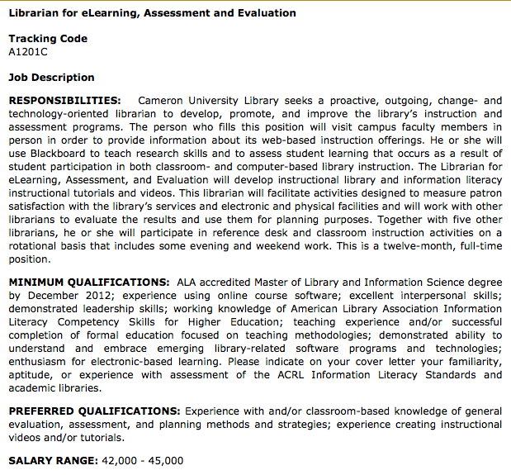
Proactive
Outgoing
Change oriented
Instruction & assessment
Collaborate with faculty
Online course support
Assessment for improvement
Emerging technology

Slide 5


Slide 7
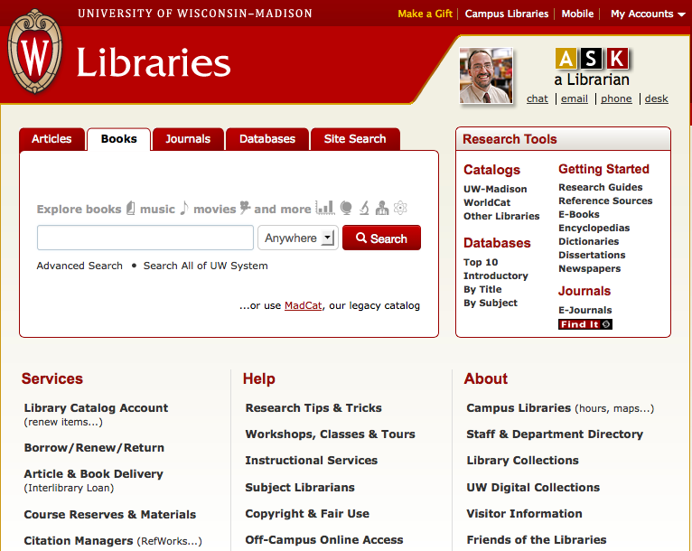

Slide 8
Learner’s library for 20th cent
‘Wartburg Plan of Essential Education’
Info literacy embedded in curriculum
Focus on students
Collaborate with faculty
Collaborate with librarians

Slide 9
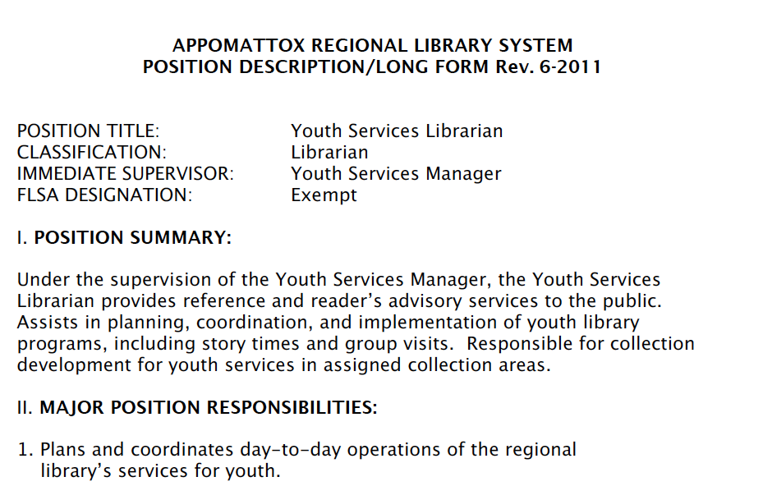

Slide 10
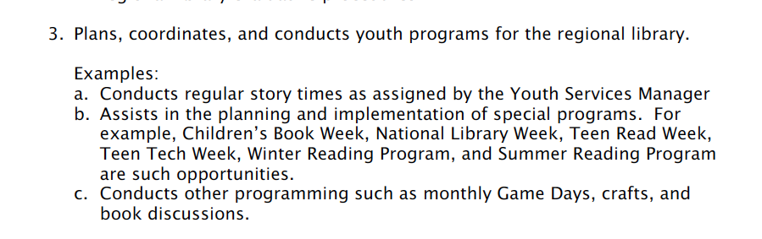
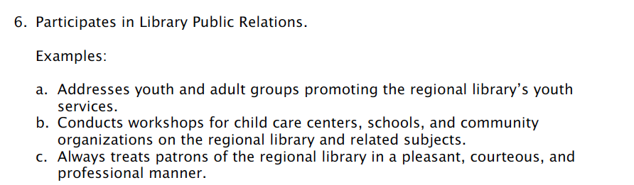
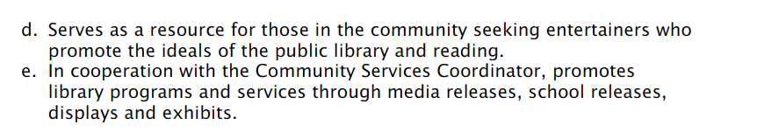
Programming: design + assess
Create opportunities
Outreach and promotion
Collaborate with teachers and community

Slide 11
overview of course [syllabus + schedule]
Sakai
caveat: I’m still tweaking the schedule but will have
print copy on Thursday

Slide 12
core concepts in course:
information literacy ACRL information competencies and other standards
learning theories conceptual frameworks that describe how information is absorbed, processed, and retained during learning Behaviorism, cognitivism, constructivism, humanism
learning styles learning style inventory/schema – how do we incorporate this research into library instruction?
evaluation and assessment what do we mean by assessing learning? methods, techniques, teaching & assessing simultaneously
instructional design / creating a lesson plan learning outcomes, strategies, assessment
evidence based practice

Slide 13
what else would you like to see?

Slide 14
☑ | learning from and with each other – get to know everyone in our class (don’t have to be BFF). Bring recent instruction-related experiences to class to share
☑ | supportive classroom environment – place for us to try new things, take risks and make mistakes, engage in constructive feedback
☑ | projects and assignments are for your benefit – you will find some intentional ambiguity. View this as an opportunity to be creative and make the project work for your development

Slide 15
my intent is to create a classroom community infused with high challenge, low threat, and high support…so let’s start getting to know each other
find a partner wearing very similar shoes to yours (or is also barefoot)
sit in classroom or take a 5-minute walk around the halls, introduce yourself and take turns talking about G-L-P
  “G” stands for something you are grateful for
  “L” stands for something you learned over the summer
  “P” stands for a promise you are going to make to yourself

