Slide 1
Papers Without Borders
or new models of Digital Scholarship
Brad Hemminger, UNC
School of Information and Library Science
Informatics and Visualization Lab (IVLab)
The work described here is primarily by students in my laboratory, including Laura Marcial, Xi Niu, Jason Priem, Sarah Ramdeen, Jeff Calculterra, Danny Nyugen, Julia Termaat, as well as previous students

Slide 2
Why are we looking at changing things?
Serials Crisis
Peer Review issues
Changes with Web 2.0 technologies to dissemination, searching, sharing of scholarly information.
Let’s rethink the whole ecosystem

Slide 3
Overview
Capturing the complete “scholarly communications discussion”
Universal Journals
Universal Annotations
Scholarly Impact (more than citation counts)
Universal (Improved) Search by using all of the above

Slide 4
Capturing the Complete Scholarly Process
What all do we want to capture?

Slide 5
Public Commons of Knowledge
Open Publishing/Open Science/Open Data, etc.
Multiple open digital archives, holding all the world’s knowledge. A single logical universal archive, created by dynamic federation of all public archives.
Contains everything: archive holds grey literature (publicly deposited) and gold literature (refereed articles).
No barriers to access. Knowledge is freely available to anyone, any time, anywhere.
Access to information and knowledge correlates to society’s quality of life.

Slide 6
Archive Model (NeoRef)
All content is contributed to a public OAI archive.
OAI archives have automated or manual moderator to filter out “junk”.
Everything--articles, reviews, comments, indexings, etc., are stored as digital content items on archive using the same mechanism. Reviews contain quantitative score, qualitative grade, qualitative comments.
All materials universally available via search engines that harvest metadata and full text from OAI archives.
Retrieval is through Google like one stop shopping search interface, with dynamic filtering based on metadata and reviews to limit hits to manageable number to review.

Slide 7
Challenges are in Retrieval
All material is archived (good and bad)
Metrics (some new) are used to differentiate type, content, and quality.
Dynamic Searching allows quickly finding material of most interest. Search on
Type article=Review AND date > 1950
Content (schizophrenia AND GeneX)
Quality: Peer reviewed {journals}, #downloads > X; citation rate > Y, recommended by Z % of selected peers

Slide 8
Scholarly Communications Process Today’s Example
Idea
V1
Present to colleagues
V2
Present at conference
V3
Submit to journal V4
Revision to update analysis
V7
Revision to include additional new results V8
Referees Revision for journal V5
Journal Final Revision
V6

Slide 9
Scholarly Communications Process: What’s Captured Today
Journal Final Revision
V6
Only one version is captured, and the same community then pays to buy back access to article

Slide 10
Change the Process!
Think of scholarly communication as continuous process instead of single product (journal publication).
Capture significant changes/versions of a work.
Include all criticisms and comments about work (all stages).
Support normal scholarly discourse, including authors responses as well as others comments.
Add reviewer’s quantitative rating of material to allow better filtering based on absolute quality metric during retrieval.
Add machine (automated) reviews.
Include other forms of information (audio, pictures, video, graphs, datasets, statistics)

Slide 11
Can we save the Gold and Grey?
formulate
discussion
discussion,
revision
Idea
V1
Present to colleagues
V2
Present at conference
V3
Submit to journal V4
comments
comments
comments
Author revision
Revision to correct analysis
V7
Revision to include additional new results V8
Referees Revision for journal V5
Journal Final Revision
V6
Copyproofing
Criticisms, new thoughts,
revision
new results,
revision
Two peer reviews

Slide 12
Universal Journals
Modified vision (2011)--Why not have single cloud based storage of all knowledge in one place (with backups, LOCKSS).
This would greatly facilitate all the uses we want to have (i.e. saving, editing, publishing, copy proofing, commenting/reviewing, attaching other materials).
Most important: can we change the ecosystem to be a marketplace that will facilitate the goals we have? More efficient, cost effective dissemination and retrieval of the information?

Slide 13
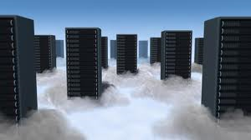
Recommendations
Free
Comments & Annotations
Free
Reviews
Free to
Paid
search
Marketing
?
Certification/Stamp
?
Copy editing
$50
Preservation
Permanent archive
$0.07
Universal Journals
Universal Journals
Registration
And all other content types
Notes:
Just talk about serparting them out, and economics benefit. Leave for Jason to talk about how new metrics.

Slide 14
Scholarly Impact
Describe altmetrics (separate slidedeck)
Summarize twitter study.

Slide 15
Twitter Study
In our sample of tweets containing hyperlinks, 6% were Twitter citations. Of these, 52% were first-order links and 48% were second-order. Among second-order intermediary pages, 69% contained a hyperlink to the cited resource; the remainder included descriptions and metadata.

Slide 16
Twitter Study (cont’d)
Groth (2010) observes that citations on blogs are faster than citations in traditional media. Given the relative ease of composing tweets, we hypothesized that Twitter citations would have even greater immediacy.
Our quantitative sample bore this out. As shown in Figure 2, the number of Twitter citations decays rapidly; 39% of citations refer to articles less than one week old, and 15% of citing tweets refer to articles published that same day.

Slide 17
Twitter Study (cont’d)
Tameka saw using Twitter as “crowdsourcing reading the professional literature and telling about what is interesting.” Much of the value was associated with trusting what Greg called the “curatorial skill” of the people citing resources
In addition to acting as a filter, Twitter can also be a net for catching useful citations that scholars might not otherwise be exposed to; as Derrick said, “it’s kind of like I have a stream of lit review going.” Zhao and Rosson (2009) describe this function of Twitter as a “people-based RSS feed”

Slide 18
Annotations

Slide 19
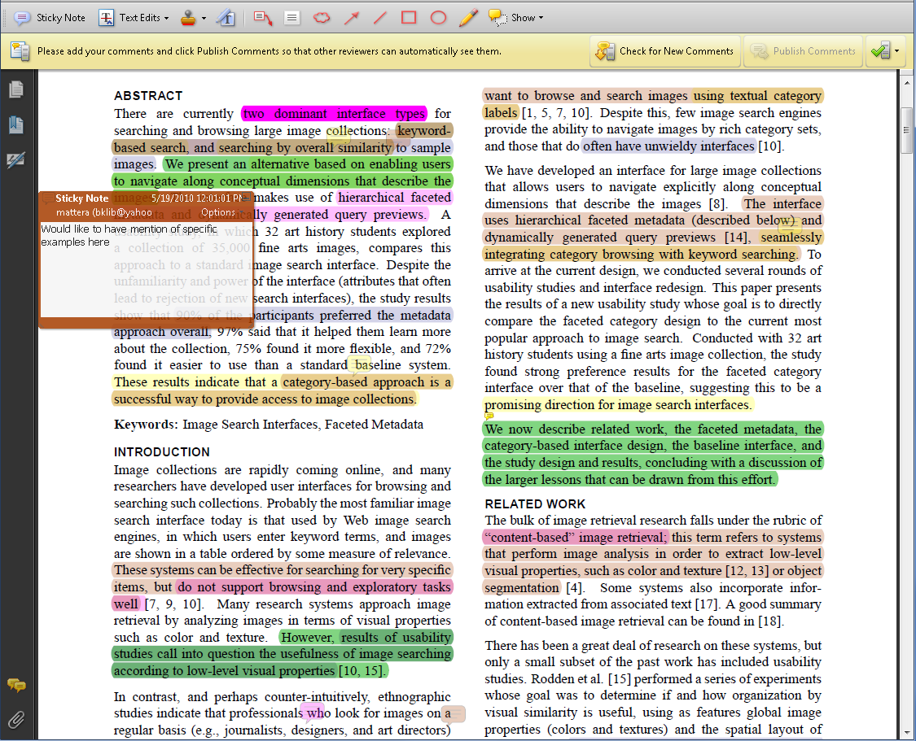
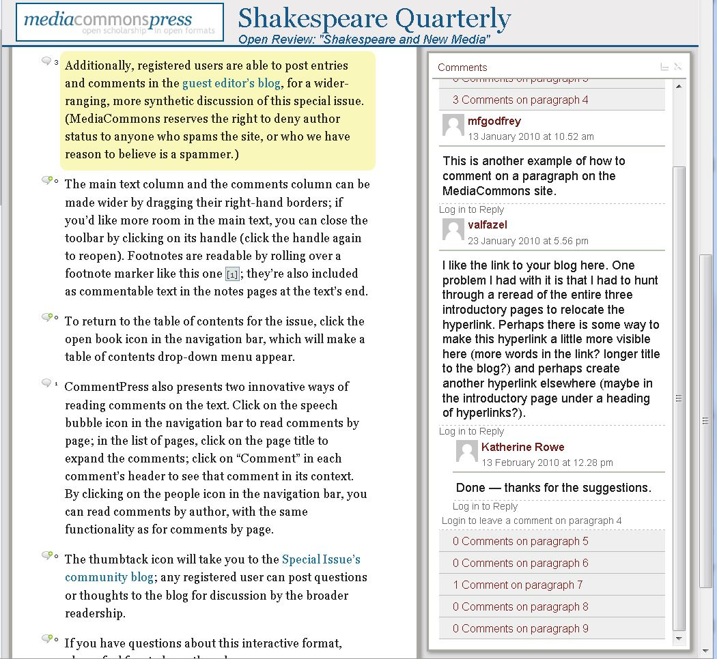
Universal Annotations
Universal Annotations
What if all the annotations ever made on a content item were permanently associated with it, and available for you to view, or to mine, to help you understand the article and it’s importance?
Could we better, or more easily recognize important articles or parts of articles? By numbers of comments, types of comments, location of comments, content of comments….

Slide 20
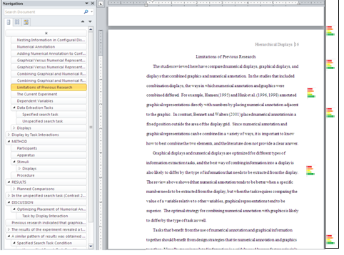

Slide 21
Annotations Findings (2010)
Academics (doctoral students) indicated
They would make (identified) annotations, less clear on doing for global use
They would use other’s annotations (qualified)
They expect others would use theirs (qualified)
Their reading would be affected by how an article was annotated (quantity and quality)

Slide 22
Search

Slide 23
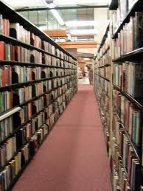
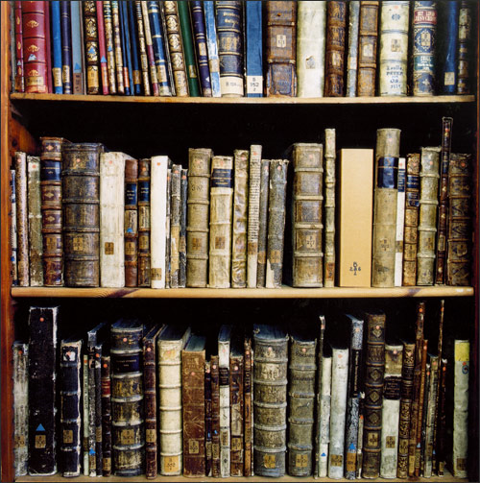
Universal Search
Universal Search
What if …..
We found everything we searched for in a few seconds?
By using information about what we’ve
viewed, searched, saved, shared, …
and by utilizing social recommendation systems based on people “like” us (in behavior, actions, collections), or like groups we participate in (research group, department), or just the most popular.

Slide 24
NeoNote Vision
Watch video
(http://www.youtube.com/watch?v=hm4UNtR0WfI)

Slide 25
Scholarly Reading and Searching
Reading on mobile (iPod), tablet (iPad), and desktop
Searching for information on same devices.

Slide 26
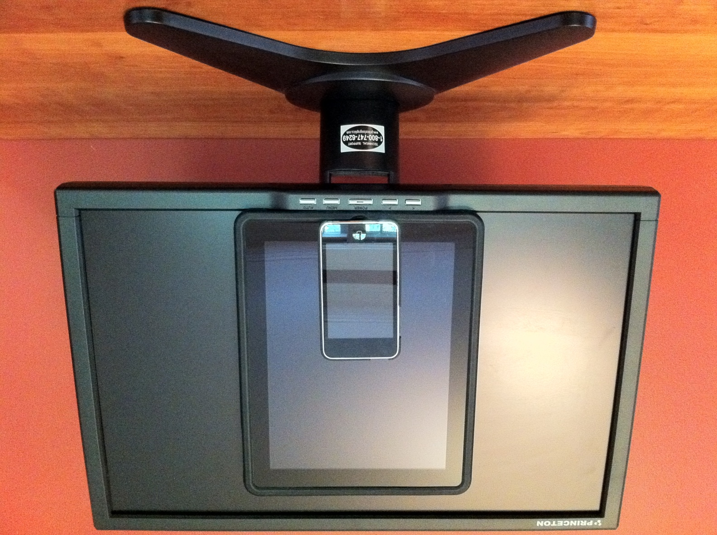
Information Searching
RQ1: How does display size affect task execution time and task load?
Conclusion: Task execution time increases with smaller display size

Slide 27
Information Searching Experiment
RQ2: How does interaction device affect task execution time and task load for similar display size (iPad vs desktop)?
Conclusion: Task execution time does not significantly change
RQ3: How does navigation method affect task execution time and task load?
Conclusion: Task execution time does not significantly change for paging versus scrolling navigation

Slide 28
Scholarly Reading
Is reading on an iPad as easy as a desktop or laptop? Is reading an article on your smartphone also equivalent? ☺
What do you think?
Want to try?

Slide 29
Questions and Discussion
Brad Hemminger
bmh@ils.unc.edu
http://ils.unc.edu/bmh

